Slide 1
Gazdasági alapok a hálózattervezésben
Takács György
2. Előadás

Slide 2
Mai elektronikus kommunikáció folyamata
Pénzbefektetés
Forgalom
igény
Műszaki
tervek
Projekt
döntés
Megvaló-
sulás és
üzemelés
Elektronikus
kommunikációs
szolgáltatás
Koncepció
váltás
Új
igény
Nyereség

Slide 3
Hálózatba fektessük a pénzünket vagy berendezésgyártásba?

Slide 5
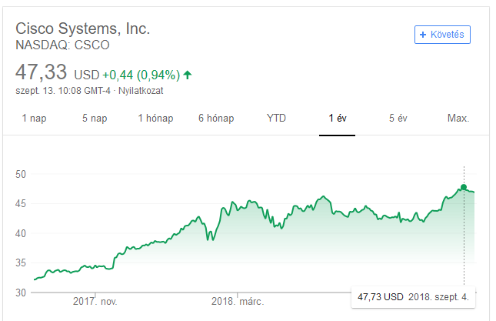
CISCO share prices

Slide 6
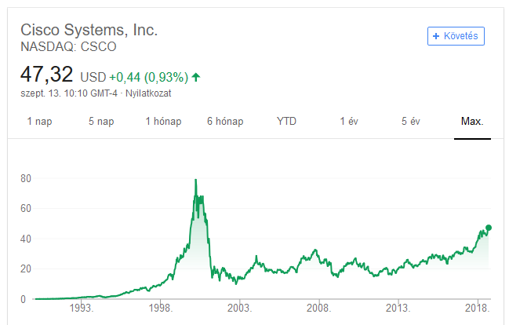
CISCO share prices

Slide 7
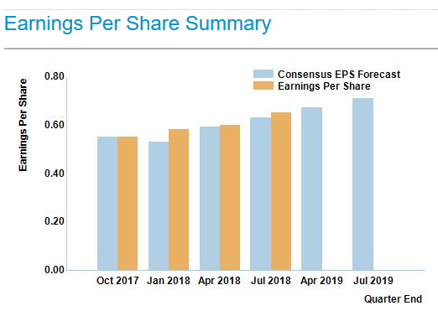

Slide 8
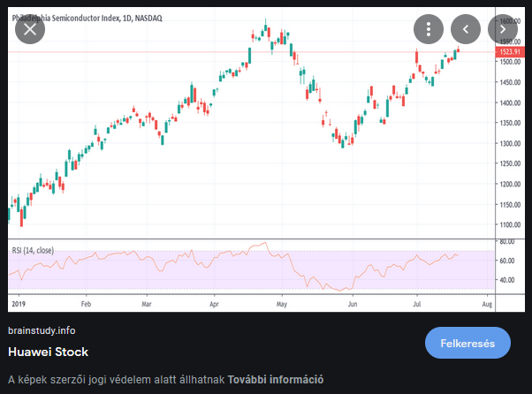
Huawei részvényárfolyamok

Slide 9
Huawei Culture Co Ltd részvényárfolyamok

Slide 10
Huawei profit
Chinese tech powerhouse Huawei reported a 33 percent rise in net profit for 2015 from the previous year, on the back of its growing consumer device business and rising demand for information and communications technologies (ICT) globally.
Net profit rose to 36.9 billion yuan ($5.7 billion), it said in a statement. Huawei, which saw growth in all three of its business units, saw a 37 percent year-on-year increase in global revenues to 395 billion yuan despite economic headwinds.

Slide 11
Router piac
The worldwide enterprise and service provider Router market lost some of its momentum after growing 7.8% year over year in 3Q13 and grew a more modest but still solid 2.2% year over year in 4Q13. Regionally, the growth was quite uneven and ranged from 7.9% increase in Asia/Pacific to a decline of -17.6% year over year in Latin America (due to a tough comparison against a very strong 4Q12). North America increased 3.8% year over year and EMEA also recorded a minor positive growth of 0.3% year over year in 4Q13.
From a vendor perspective, Cisco's Ethernet switch (Layer 2/3) market share in 4Q13 held steady from last year at 61.3%. Cisco's market share in the fast-growing 10GbE market segment was 64.0% in 4Q13. For the full year 2013, Cisco’s Ethernet switch revenue increased 2.1% year over year.
HP's Ethernet Switch revenue increased 3.8% quarter over quarter and 3.6% year over year in 4Q13, just slightly below the overall market levels. HP's market share now stands at 9.3% in 4Q13. HP's full year 2013 growth reached 4.4% year over year.
Juniper had an impressive quarter having outperformed in both Ethernet switching and routing in 4Q13. Its router revenue was up 15.1% year over year and 3.7% quarter over quarter in 4Q13. Juniper's Ethernet switch revenues increased by 39.7% year over year and 33.7% sequentially this quarter.

Slide 12
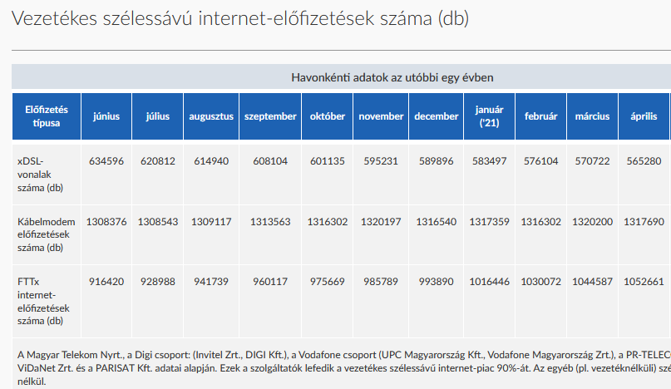

Slide 13
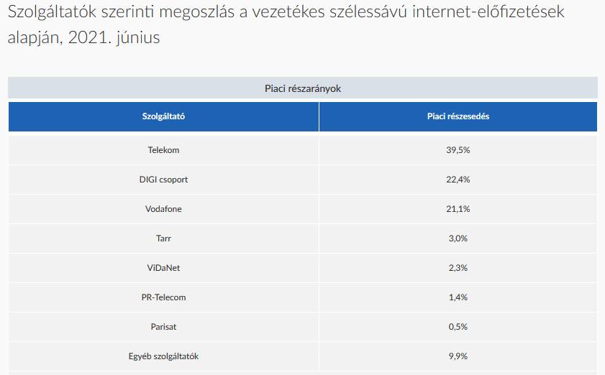

Slide 14
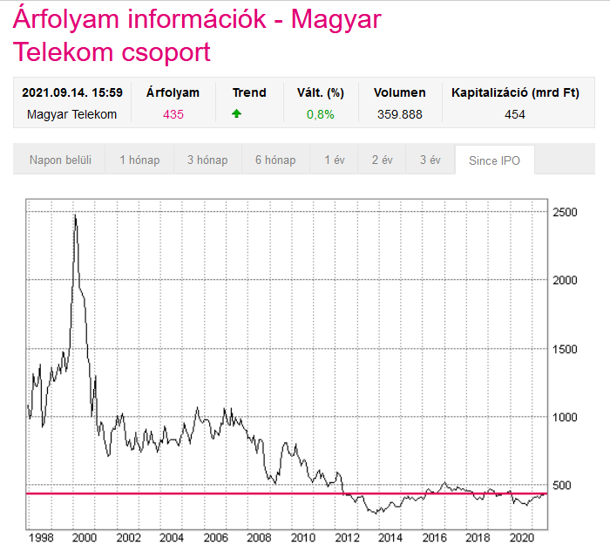

Slide 15
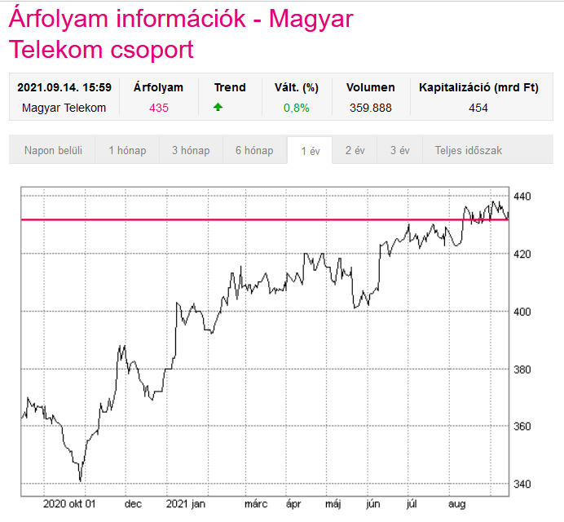
Magyar Telekom részvényárfolyamok

Slide 16
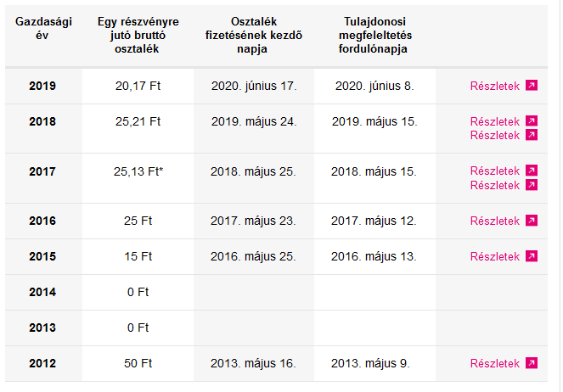

Slide 17
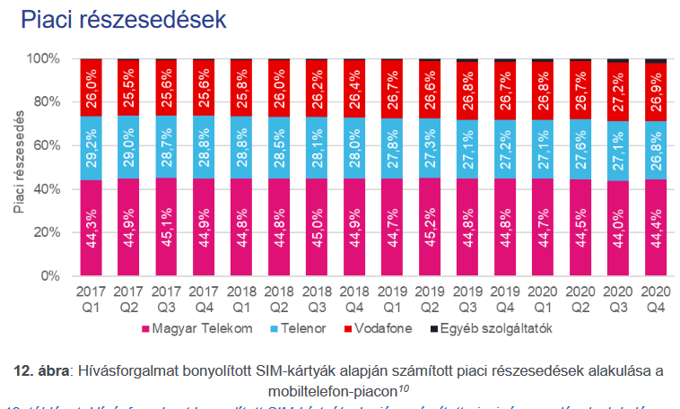

Slide 18
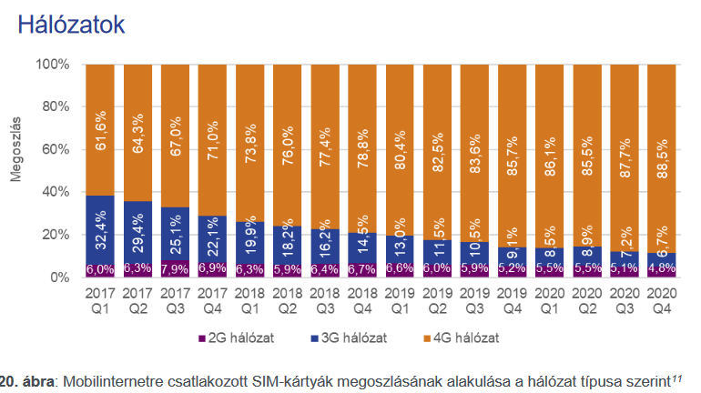

Slide 19
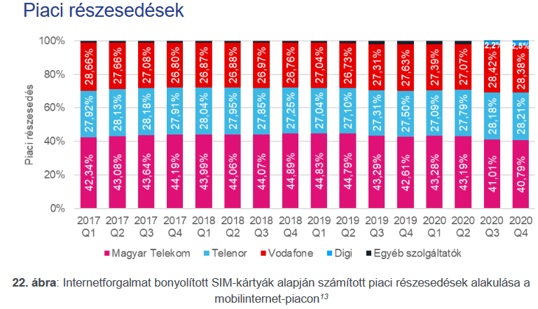
Látszik, hogy az elvándorlás a Digi belépésével nem a Vodafon és nem a Telenor előfizetőinek számát csökkenti!

Slide 20
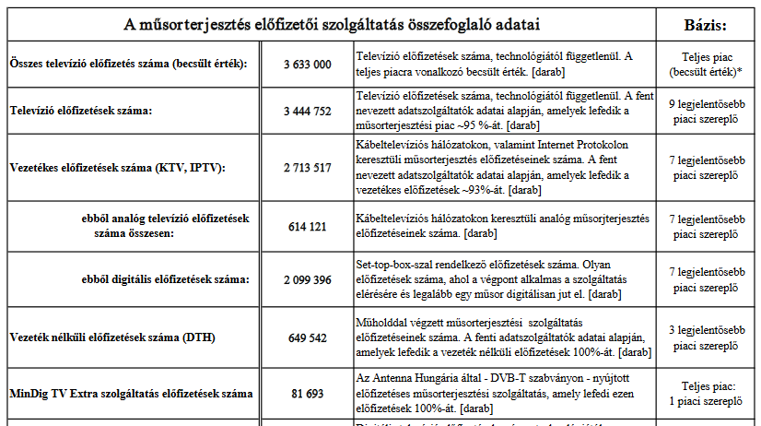
Televízió gyorsjelentés, 2021. június

Slide 21
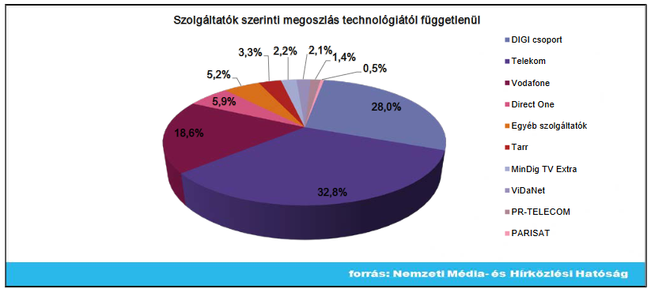
TV előfizetők piaca

Slide 22
Forrás
http://users.itk.ppke.hu/~takacsgy/Manual_Draft_Version02l.pdf

Slide 23
Business planning
A Business Plan presents the calculation of the financial indicators that enable the managers to evaluate the financial performances of an enterprise in order to take best decisions for the overall operation. Due to the high number of alternatives today and the need to find economical feasibility in competition, the business evaluations are being used not only for the business plan itself but as an iterative evaluation of those techno-economical alternatives to select the ones that perform better in the competitive market.

Slide 24
A Business Plan summarises the results of the planning process:
- the objectives to reach ( subscribers demand, sales)
- the future revenues expected from the plan and per service class;
- the planned expenses (investment and operations) as overall and per service class;
- the accounting statements and the financial indicators characterising the profitability of the project.

Slide 25
Business model structure for planning

Slide 26
Economic modelling for planning
Economical modelling to evaluate network solutions (modelling tariffs, equipment costs per type, economy of scale, lifecycle, equipment deployment, elasticity, trends with time, etc. )

Slide 27
Economical concepts and terms
The following terms and associated concepts are the most frequently used to analyze the Telecom business and decide on best project alternatives with its specific properties due to the multiplicity of diverse equipments, life cycles and operational practices. For a more detailed economical terms definition refer to classical books of Economy.

Slide 28
Assets (vagyon)
Resources owned by an enterprise.
In the balance sheet (mérleg) assets are listed in rising order of liquidity (eladhatóság).
They include
fixed assets (állóeszközök) --land and buildings, plant and machinery, etc),
current assets (forgótőke) -- inventories (raktárkészlet), account payable (fizetési kötelezettség), etc…
liquid assets (pénzeszközök) --cash in hand, cash in banks,, cheques, etc).

Slide 29
Capacity
Capability of an equipment, network or sub network to handle the traffic flows with an associated grade of service.
Maximum capacity
is the limit that may be reached over a short period of time without overload protection
Nominal capacity
is the value of the proper engineering to account for the natural statistical variations over sustained periods and the overload protection to guarantee the traffic handling in a sustained manner

Slide 30
Operating Expenditures, commonly referred to as OPEX, are the on-going costs for running a product, business, or system. Its counterpart, Capital Expenditures (CAPEX), refers to the cost of developing or providing non-consumable parts for the product or system. For example, the purchase of a photo copier is the CAPEX, and the annual paper and toner cost is the OPEX. For larger systems like businesses, OPEX may also include the cost of workers and facility expenses such as rent and utilities.
Capital expenditures ("CAPEX") are expenditures used by a company to acquire or upgrade physical assets such as equipment, property, industrial buildings. In accounting, a capital expenditure is added to an asset account (i.e. capitalized), thus increasing the asset's basis (i.e. the cost or value of an asset as adjusted for tax purposes).

Slide 31
Cash flow (pénzáram????)
Cash receipts and cash disbursements over a given period.
Also funds generated internally by the activity of an enterprise or a project equivalent to the balance between the inflow of funds arising from revenues and the outflow of
funds arising from expenditure.
Net cash flow or self-financing capacity generally = net distributed profits + depreciation charges.

Slide 33
Churn
Annual rate at which the own customers or subscribers leave the service either to move to a competitor, to migrate to other service or leave the market.

Slide 34
Depreciation (értékcsökkenés)
Loss of value of an asset over time, as a result of wear , aging or obsolescence. With the method of linear (or straight-line) depreciation, the loss of value of an asset is
spread uniformly over the number of years of its useful life. Depreciation charges do not give rise to an actual outflow of funds and the sums remain available to the enterprise.

Slide 35
Discounted Cash Flows
An investment appraisal technique which takes into account both the time value of money (i.e. the conversion of cash flows that occur over time to an equivalent amount at a particular point in time) and the total profitability over a project' life.

Slide 36
Discount factor (leszámítolási tényező)
The discount rate used to calculate the net present value of a company or project. This rate has to consider the cost factors for the capital of the company such as interest rate, and expected inflation in a strict sense. In a more wider sense has to consider also the risk rate for long term evaluation in large projects and new scenarios with uncertainty.
(interest rate – kamatláb)

Slide 37
EBITDA
Annual Earnings Before Interest, Tax, Depreciation and Amortization. This means all the revenues minus operating costs that is the basic information for the evaluation of a business from its own specific factors and the first indicator to be calculated and analysed.

Slide 38
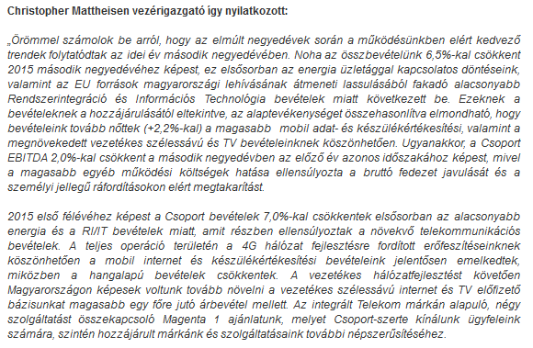

Slide 39
EVA
Economical Value Added or net operating profit (after tax) minus the cost of the capital used to generate that profit either in debt or in equity. It is a good indicator for the point of view of the investors

Slide 40
Future Value (FV)
The value of a present amount at a future date. It is found by applying compound interest over a specified period of time.
FV = PV * (1 + k)^{n}

Slide 43
Present Value (PV) (jelenérték)
The current monetary value of a future amount. The amount of money that would have to be invested today at a given interest rate over a specified period to equal the future amount.
PV = FV / (1 + k)^{n}
PV is the currency value today of some future inflow, outflow, or balance of funds. In essence, it is the discounting of future funds to their present value by taking into account the time value of money. It is useful in providing a common basis for comparing investment alternatives. See also discounted cash flow, future value, and net present value.

Slide 45
MNB jegybanki alapkamat alakulása 1990-2016
Simor András (2007- 2013) csús 11,5%
Matolcsy György (2013-) 2016 júliustól 0,9%

Slide 46
10 év múlva befolyó 1 millió Ft bevétel jelenértéke
11,5% kamatnál:
PV= 10⁶/1,115¹⁰=336 706 Ft
0,9% kamatnál:
PV=10⁶/1,009¹⁰=914 299 Ft
Tehát a 10 év múlva esedékes bevétel jelenértéke több, mint két és félszeres (2,72-szeres)Matolcsy (2016) kamattal, mint Simor (2008) kamattal !!!
Kit szerethetnek a hálózattervezők???

Slide 47
Internal rate of return (IRR)
This is the discount rate that equates the present value of investment outflows with the present value of inflows produced by the investment. The internal rate of return may be considered as the highest rate of interest admissible for a project wholly financed by borrowing.
IRR is the discount rate that equates the present value of cash inflows with the initial investment associated with a project, thereby causing NPV = 0.
IRR = 0 = [CF/(1 + IRR)^{t}] – Initial Investment

Slide 49
Life cycle costing
The full cost of an asset over its life. This includes all costs associated with acquiring, controlling, operating and disposing of the asset.

Slide 50
Net Present Value (NPV) (nettó jelenérték)
A global capital budgeting technique; found by subtracting a project’s initial investment from the present value of its cash inflows discounted at a rate equal to the firm’s cost of capital.
NPV = present value of cash inflows - initial investment
NPV = [CF/(1 + k)^{t}] – Initial Investment

Slide 52
Payback period (megtérülési idő)
The number of years required for a firm to recover the initial investment required by a project from the cash inflows it generates. Short payback periods are preferred.
Like internal rate of return, the payback period metric takes essentially an "Investment" view of the action, plan, or scenario, and its estimated cash flow stream.
Payback period is the length of time required to recover the cost of an investment (e.g. purchase of computer software or hardware), usually measured in years. Other things being equal, the better investment is the one with the shorter payback period.
Also, payback periods are sometimes used as a way of comparing alternative investments with respect to risk: other things being equal, the investment with the shorter payback period is considered less risky.

Slide 54
Revenues (bevételek)
An income statement term, referring to the sum of money owed the company for sales of goods and services. Revenues (or "Sales") is ordinarily the top line in the income statement, against which most other costs and expenses are subtracted to calculate income. In Britain, the term turnover is often used in place of revenues.
The term revenues generally means "gross revenues, " that is, revenues before adjustments for customer discounts and allowances. (see Profit)

Slide 55
Residual value
Value of an investment at the end of its economic or estimated life. At the end of the period, residual value may be treated as a positive cash flow, and discounted as such.
The present value of the business attributable to the period beyond the forecast period.

Slide 56
Profit
Another term for Net Income or Earnings. Surplus of sales revenues over costs or expenditure during an accounting period or operating cycle. Leads to an increase in owners' equity, though not necessarily to an increase in cash. It may be reflected in increased assets or decreased liabilities. Net profit may refer to profits after tax (on profits) or to profits less financial costs, depending on the purpose of the analysis.

Slide 57
ROCE
Return on Capital Employed or net income divided by the sum of fixed assets and working capital. Shows the company profitability from the point of view of the owners

Slide 58
Business model structure for planning

Slide 59
STEM is a Strategic Telecoms Evaluation Model which brings clarity and understanding to the complex world of telecoms business planning. STEM enables you to build robust business and investment plans that embrace alternative market, technical and economic futures.

