Slide 2
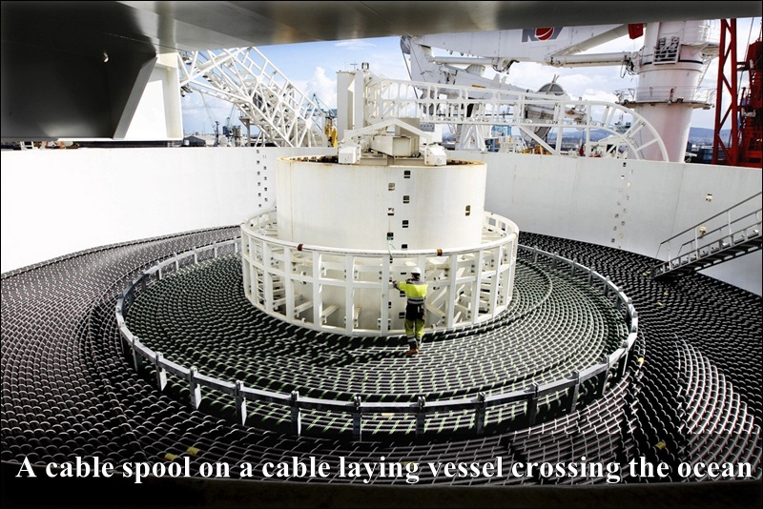

Slide 3
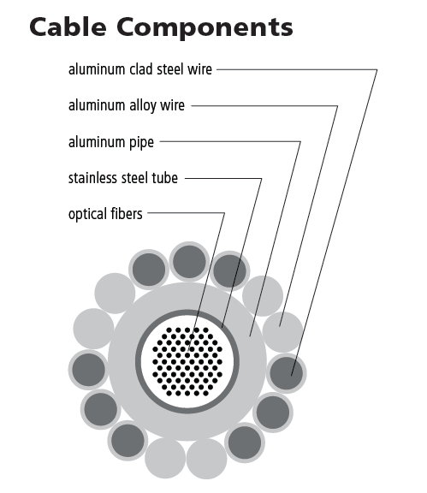
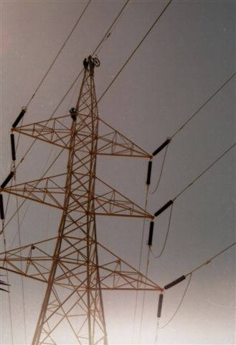
optical ground wire (OPGW)
used in the construction of electric power transmission
combines the functions of grounding and communications.
OPGW

Slide 4
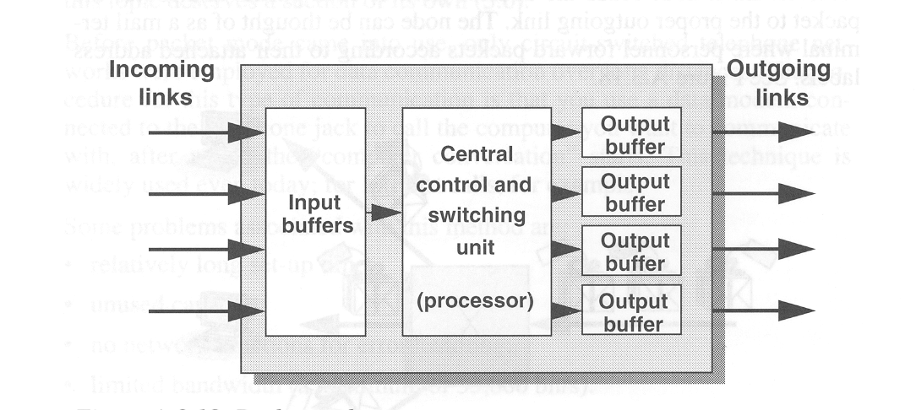
Circuit or packet switching???
A rule of thumb:
Band is cheap: circuit switching
Processing is cheap: packet switching
Distributed vs. centralized intelligence in the network
Packet processing by 10¹⁶ b/s ????

Slide 5
packet switch like node solution

Slide 6
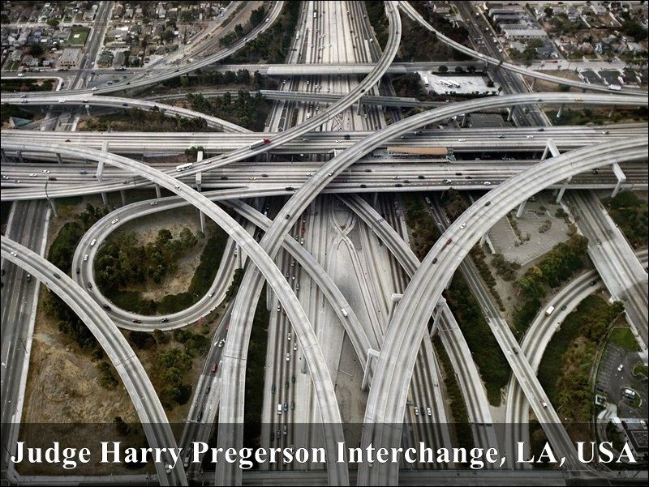
Point-to point like network node solution in a modern highway system

Slide 7
Photonic Fibre Switches
In free-space devices, the light is focused from the input fibre, deflected by a micro-mirror (typically several times) and finally launched into the output fibre. The Micro-Electro-Mechanical Systems (MEMS) technology is mature and can produce switch matrices with up to hundreds of input and output ports (128x128 or 256x256), low insertion loss (IL), very low cross talk, low power consumption, millisecond switching speed, and broadband operation. The mirrors can typically be controlled electro-magnetically, electro-statically or by piezoelectric actuators.

Slide 8
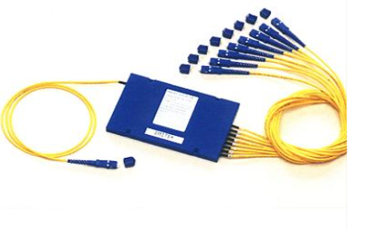
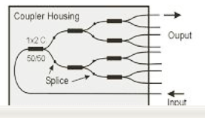
Passive optical splitter

Slide 9
Passive optical splitter

Slide 10
Operational principle and example of 3D MEMS array
collimator

Slide 12
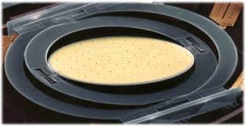

Slide 15
