Slide 1
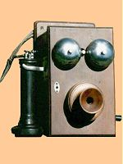
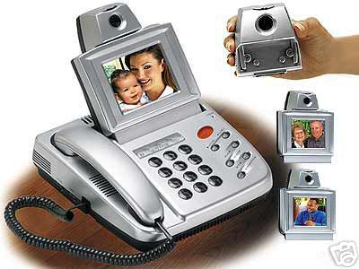
Infokommunikációs rendszerek
Infocom Systems
5.
Nyilvános távbeszélő (PSTN) hálózatok, gerinchálózatok
Telephone networks(PSTN), backbone networks
Takács György

Slide 2
The 3 lessons in network studies
Public Switched Telephone Networks (PSTN),
Mobile Networks -- Public Land Mobile Networks (PLMN) GSM, UMTS, DECT, TETRA, Bluetooth, Globalstar, Iridium
Private networks, Broadcasting networks, Cable TV networks (CaTV)

Slide 3
Miért lehet érdekes a hálózat egy mérnök informatikusnak?
Csak szolgáltatást lehet eladni az infokom piacon!
Ma Magyarországon többet költünk infokom termékekre és szolgáltatásokra, mint élelmiszerre (beleértve a kenyeret, húst, gyümölcsöt, sört…..)
Hálózat nélkül nincs infokom szolgáltatás!
Sokan ebből fognak megélni.

Slide 4
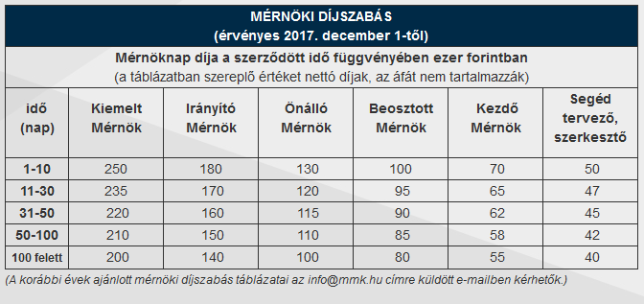
Miért lehet érdekes a hálózattervezés egy mérnök informatikusnak?

Slide 5
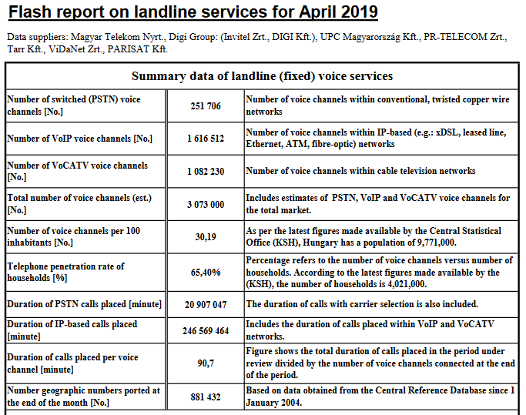

Slide 6
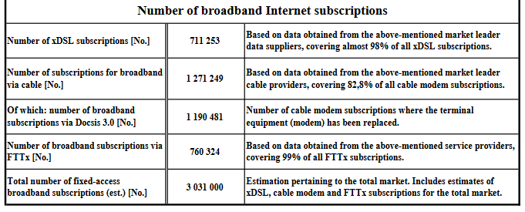
Flash report on landline services for April 2019

Slide 7
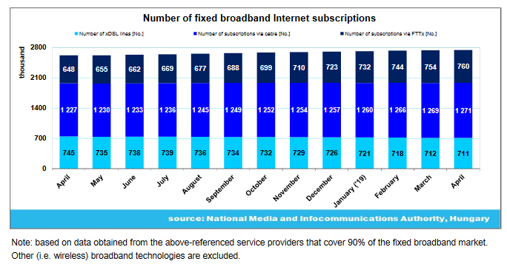

Slide 8
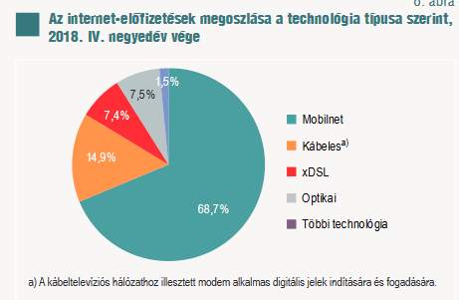
Technologies of Internet Access in Hungary
The total number of subscriptions was about 9,5 million
Source: KSH Statisztikai Tükör 2018. IV. negyedév

Slide 9
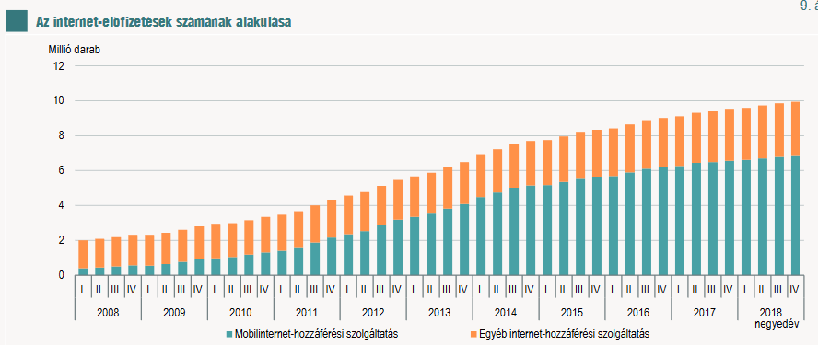
Source: KSH Statisztikai Tükör 2018. IV. negyedév

Slide 10
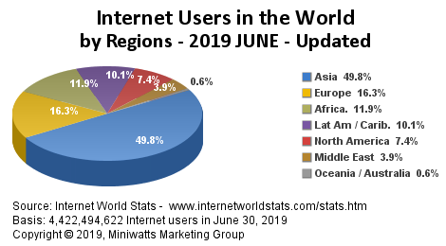
Source: https://www.internetworldstats.com/stats.htm

Slide 11
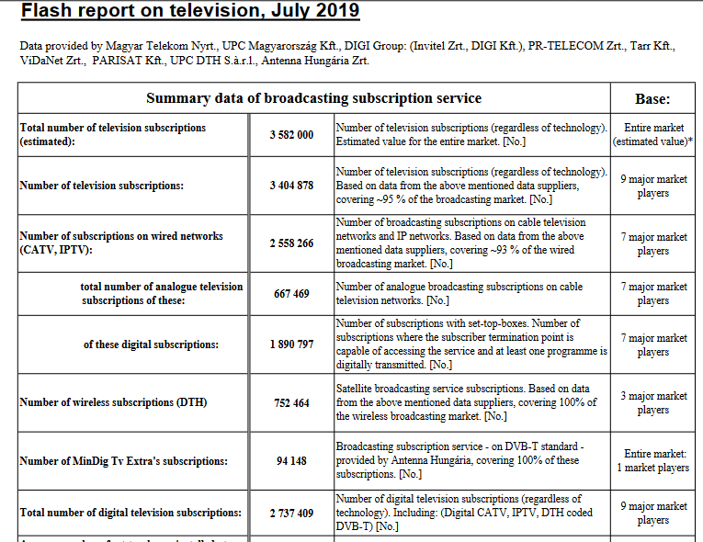

Slide 12
Special features of networks
Only services can be sold on the real market!
There are not infocommunication services without networks.
You could not buy networks. You have to plan, to construct, to operate, to develope according to the actual demands and to eliminate at the and of service provision.

Slide 13
Service, application and content providers….
Like: Vodafone, CIB Bank, CNN, Servers
Network operators
Transmission lines,
Multiplexers,
Routers,
Switches
v
End users
Like: subscribers,
Companies
Mobile sets, TV sets,
computers

Slide 14
Basics of network components
Backbone networks: long distances, high traffic, interconnection of nodes, transport bits of any services, high reliability, high availability.
Access networks: local distances, interconnection of terminals and local nodes
Network planning: selecting topology, optimal selection of positions of nodes, dimensioning of node traffic handling capacities, dimensioning of link capacities, selecting technologies.

Slide 15
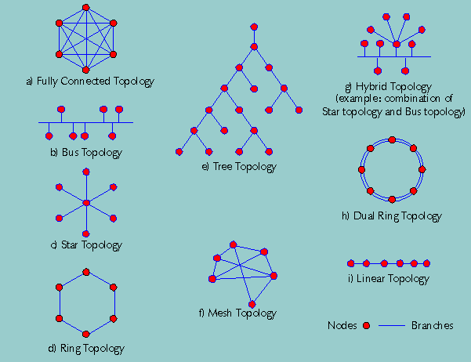

Slide 16
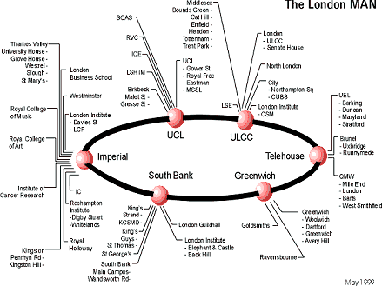

Slide 17
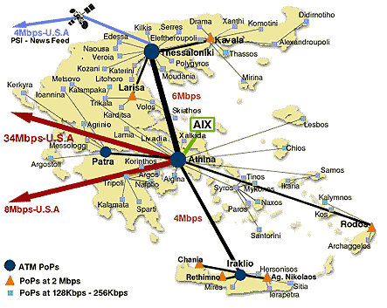

Slide 18
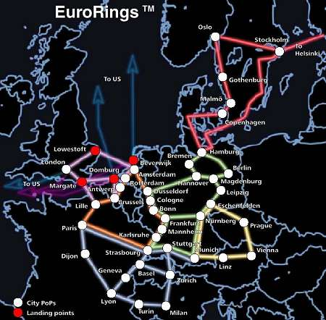
The pan European KPNQwest network, when complete, will connect major cities together by six high-capacity backbone rings.

Slide 19
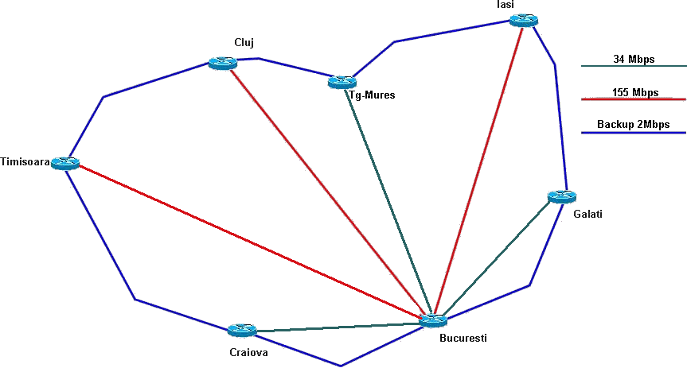

Slide 20
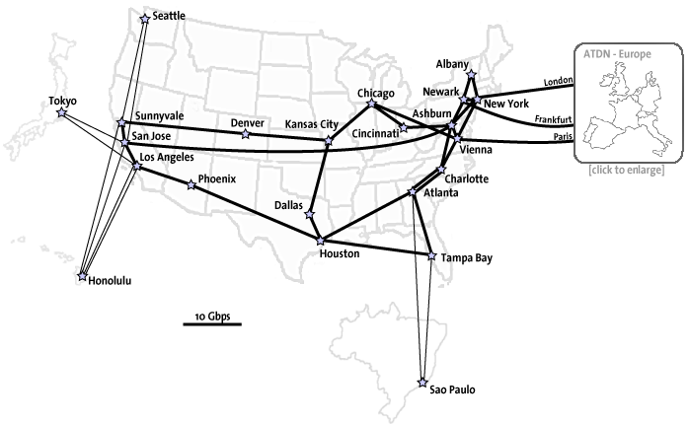
AOL USA BACKBONE

Slide 21

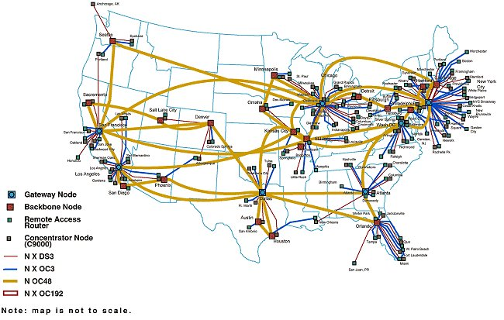

Slide 22
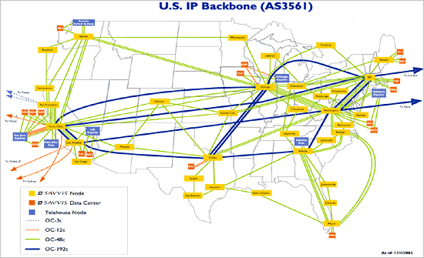

Slide 23
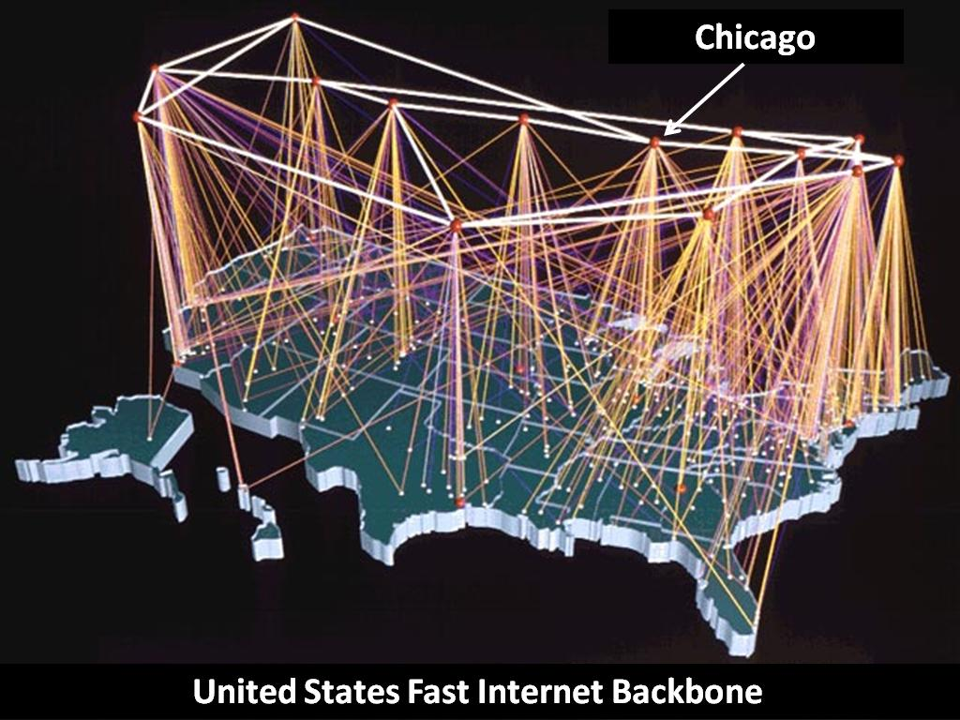

Slide 24
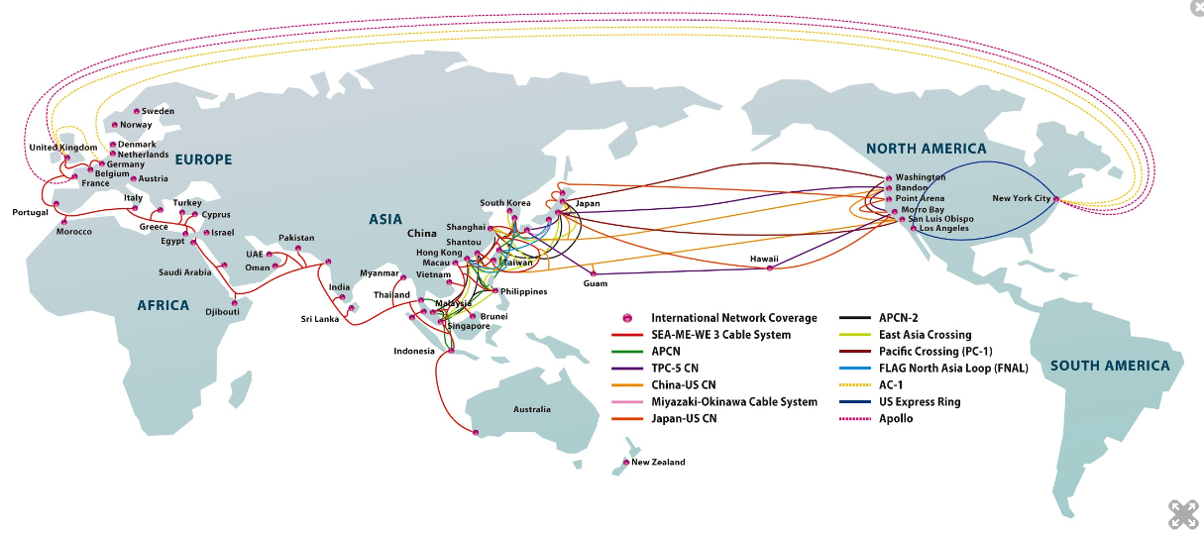

Slide 25
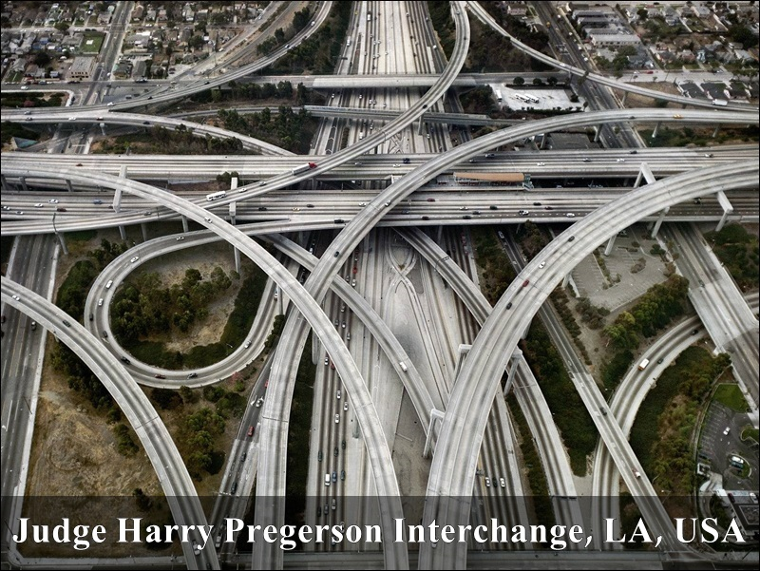

Slide 26
Public Switched Telephone Networks (PSTN)
Brief history
Basics
Network structures
Network implementation
Network development trends
Missing topics

Slide 27
Brief history I.
1876 A. G. Bell Patent of telephone (50.000 phone within 3 years)
1877 T. A. Edison patent of carbon microphone (covering long distances)
1878 Puskás Tivadar the first telephone exchange in Connecticut
1881 Puskás Ferenc the first telephone exchange in Budapest
1890 The first Wien-Budapest international telephone connection
1892 The first automatic telephone exchange in Indiana (Strowger switch)
1928 The first automatic telephone exchange in Budapest
1997 The last manual exchange moved to museum in Hungary

Slide 28
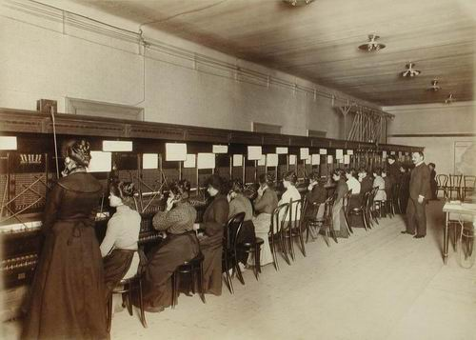

Slide 29
Brief history II.
The technical level of Hungarian PSTN networks are very high due to the fast development from 1992-2002
From 1 million subscriber to 10 million one
From 1000 manual exchange to almost fully digital network
COCOM list restriction not from our side!!!

Slide 30
Basics of telephony
2/4 wire for voice
Feeding of circuit
Access solutions
Backbone
Signalling basics for a telephone call
Source of revenues
ADSL principles

Slide 31
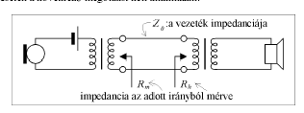
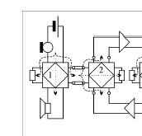
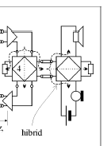
2/4 wire for voice
2 wire simplex
4 wire simplex
2 wire duplex

Slide 32
Electronic hybrid circuit (the uplink/downlink signal flow on a simple twisted pair cable)
Z_{g}
r
r
Twisted pair cable
Z_{T}
Z₀ characteristic impedance
Z_{T} ~Z₀

Slide 33
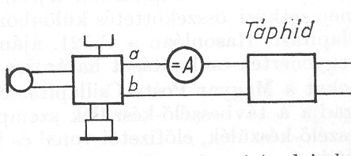
Powering of telephone sets
Feeding bridge
Traditional feeding bridge circuit
DC line current: 20….60 mA
Subscriber line
Local exchange

Slide 34
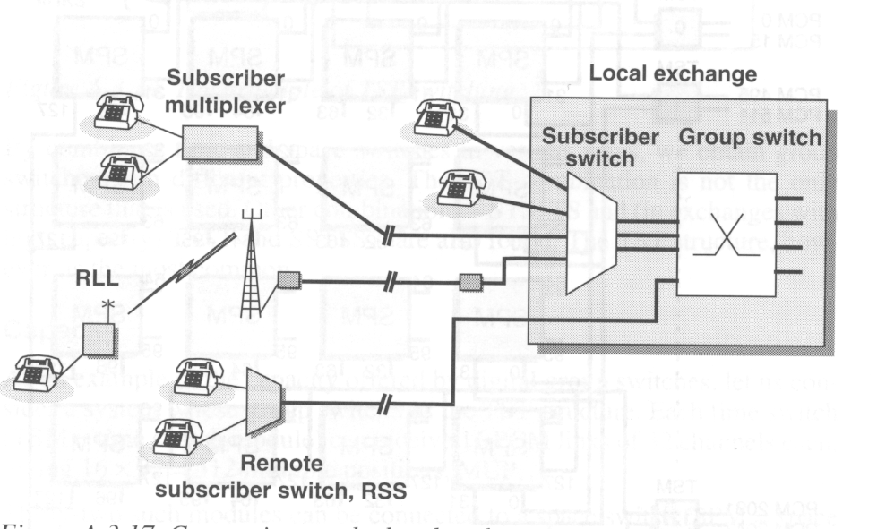
Access solutions

Slide 35
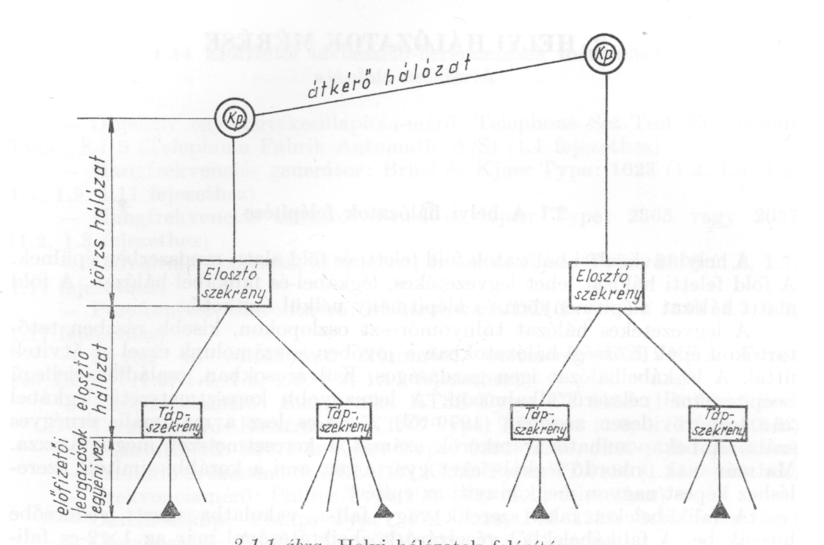
Connections to the local exchange
Main cables
Distribution cabinets
Distribution cables
Distribution boxes
Drop cables,
Indoor cables

Slide 36
Access network implementation

Slide 37
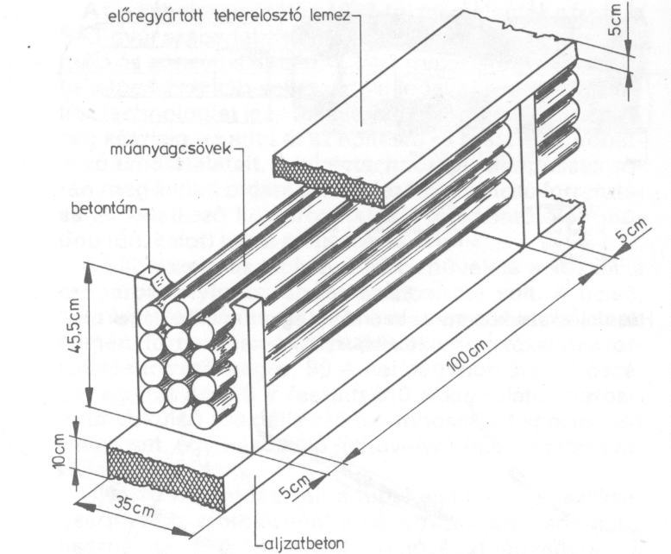
Cable duct system implementation

Slide 38
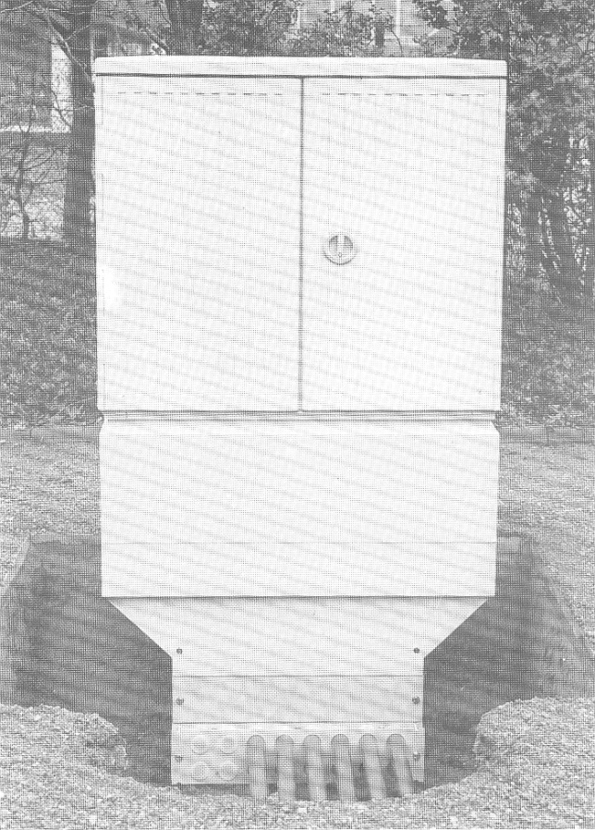
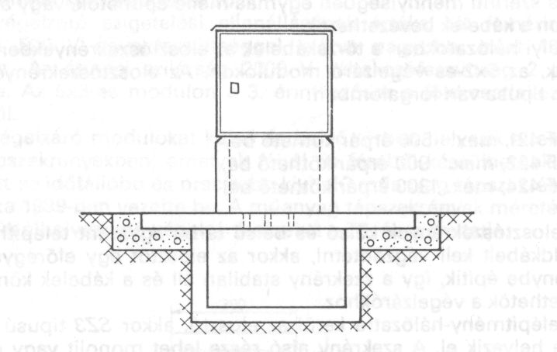
Cable distribution cabinet (street version) implementation

Slide 39
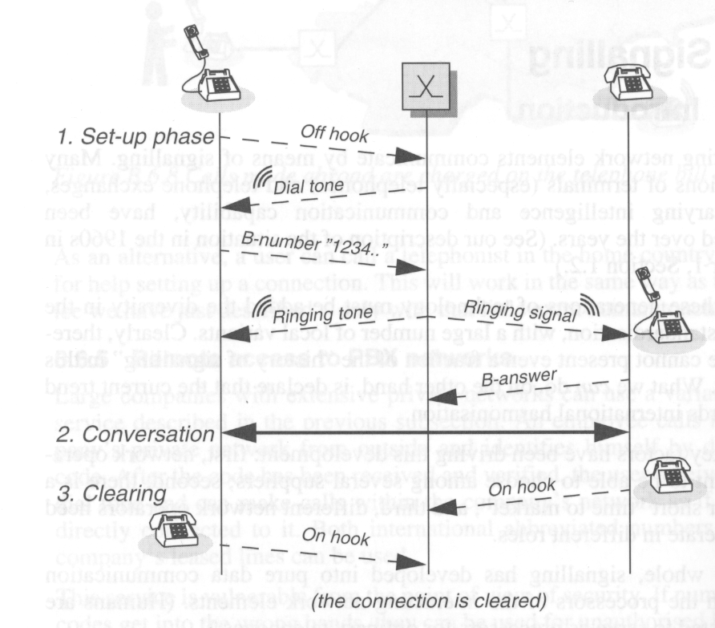
Signalling basics for a telephone call

Slide 40
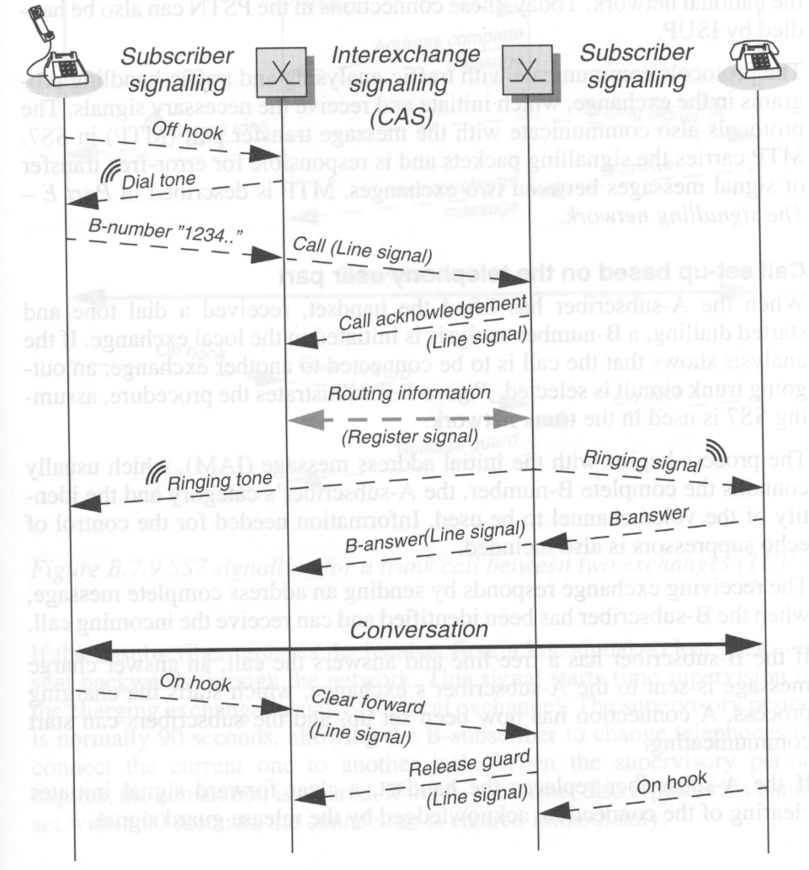
Channel-associated signalling for a trunk call

Slide 41
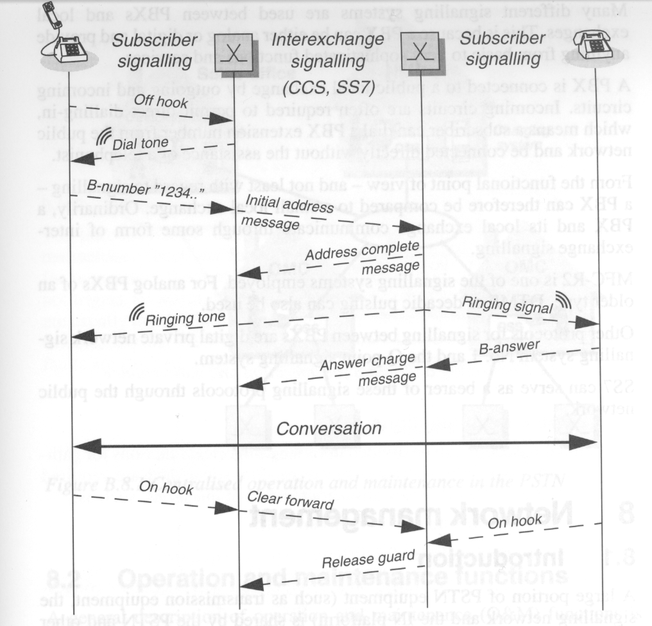
Common-channel signalling for a trunk call

Slide 42
Backbone issues in a small country with dense population
Fully optical – only spare radio connections
Covered distance between nodes max 100 km
In Hungary the source of telecom traffic (including telephone, TV programs, Internet) concentrated in Budapest (like the road traffic)
Concentration of switching capacities in higher level nodes
Fault tolerant topology is required for reliable services

Slide 43
Network structures
Basics
Telecom Hungary network structures
PANTEL network structures
Interconnection issues
Structure and numbering
Intelligent Network Concept

Slide 44
Basic structures in PSTN/ISDN networks
Star topology
Multipolar topology
Meshed topology
Ring topology
Bus topology

Slide 45
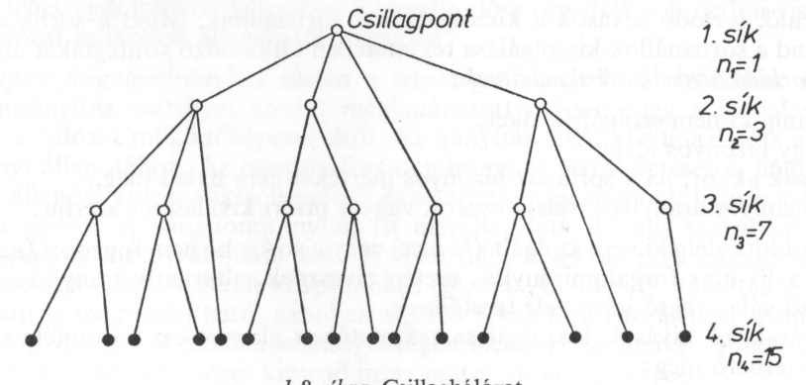
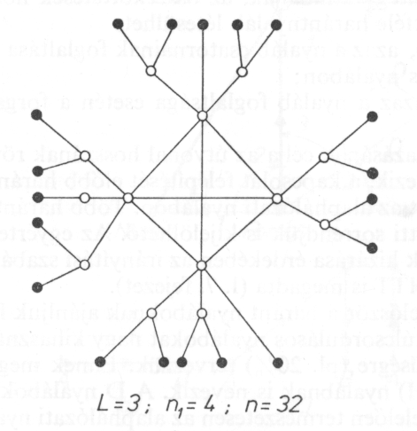
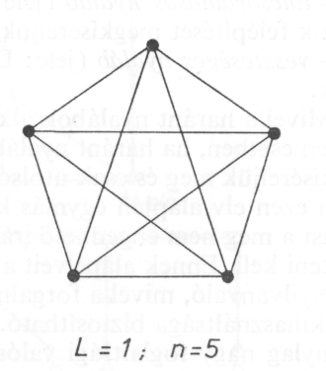
STAR
BUS
RING
MESHED
MULTIPOLAR

Slide 46
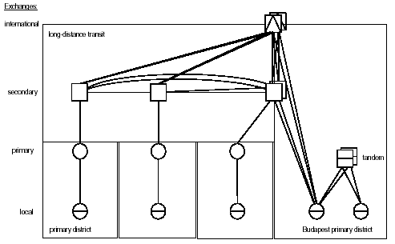
MATÁV NETWORK STRUCTURE

Slide 47
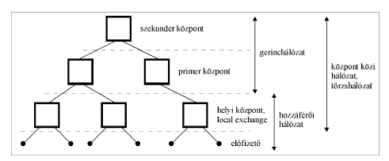
Telephone network structure of T-COM
Secondary exchange
Backbone
network
Primary exchange
Inter
exchange
network
Local
exchange
Access
network
Subscriber

Slide 49
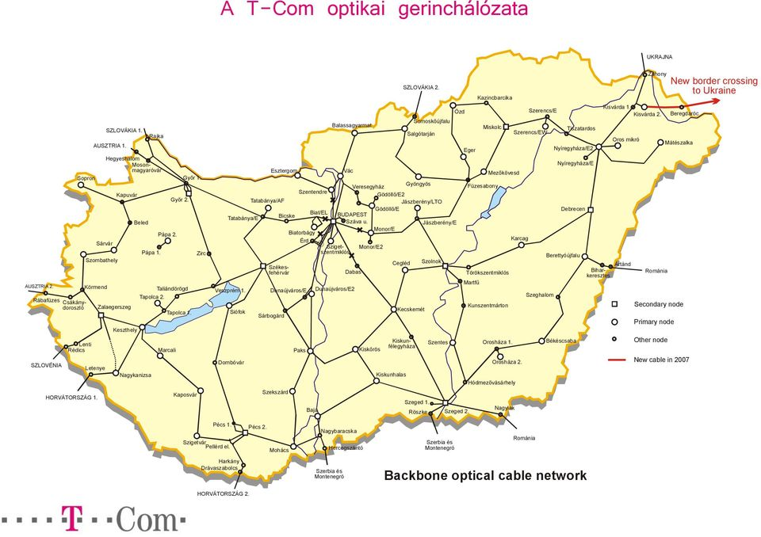

Slide 50
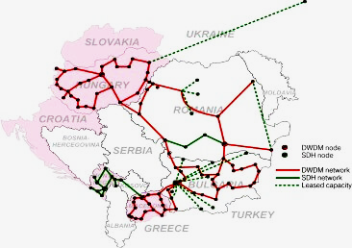
A Magyar Telekom terjeszkedési tervei:
A magyarországi hálózati kapacitás továbbfejlesztése, bővítése,
valamint további határátlépő pontok létesítése Románia, Bulgária Törökország és Ukrajna felé.

Slide 53
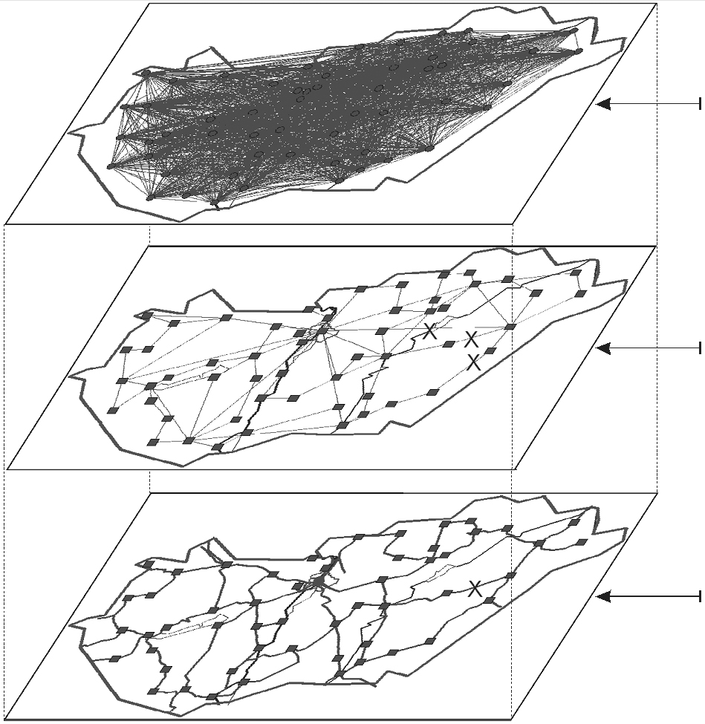
3. Layer
Network layer
2. Layer
Data link layer
IP link
Layer
Physical layer
Optical cable

Slide 54
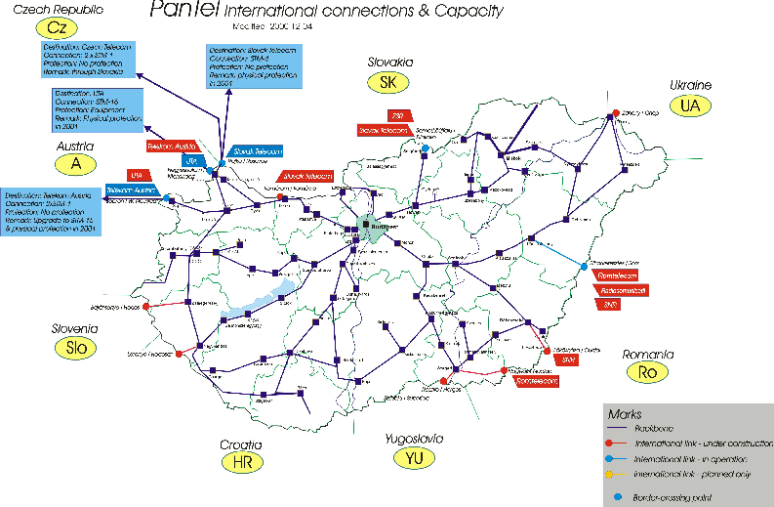
PANTEL optical backbone structures

Slide 55
PANTEL logical SDH rings

Slide 56
Interconnection principles

Slide 57
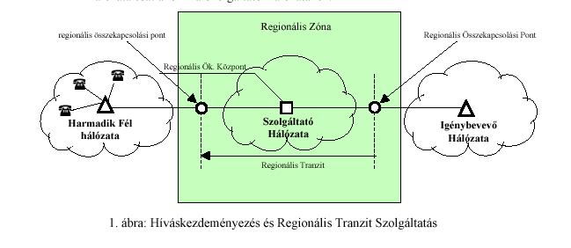
Interconnection principles

Slide 58

280x0,009=2,5Ft/perc !!!!

Slide 59
Interconnection implementation

Slide 60
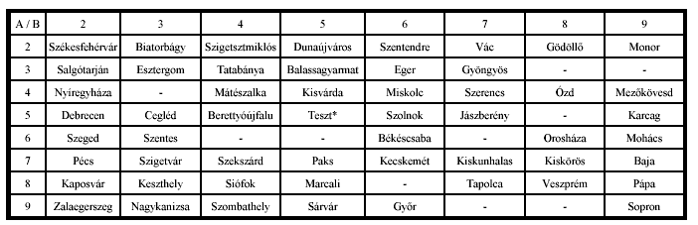
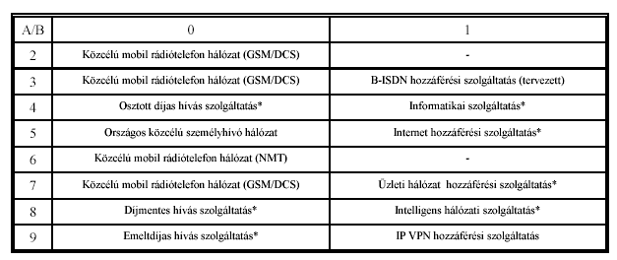
Network structure and numbering

Slide 61
Network implementation
Access issues: Rural, City, Down-town, areas, In-door cabling, Underground copper cables, Overhead cables, ADSL, Fibre To the Curb (FTC), distribution frames
Core issues: Underground fibres, overhead fibres,
Switching and multiplexing position of nodes
Traffic issues: dimensioning of switches and links

Slide 62
Access network implementation

Slide 63
Costs and revenues –> market failure
The revenues are monthly fees and traffic based fees
Network costs are implementation and operation
Network costs
Wireline networks
Cellular networks
Traffic density (Erlang/km2

Slide 64
Telephone bill balance
balance
balance
time
Pre-paid
time
balance
time
Post-paid

Slide 65
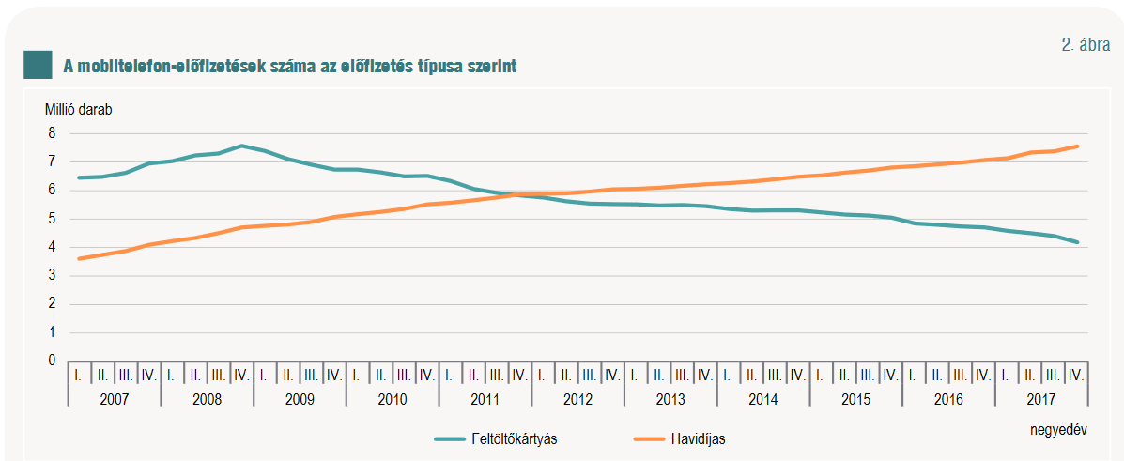
Prepaid and billed mobile subscriptions in Hungary
Prepaid
subscription
Monthly billed
subscription

Slide 66
Missing topics
Telephone sets, terminal equipment (Lecture in Nov )
Services (Lecture in Nov )
Regulation issues (Lecture in November )
Details of ADSL
NGN (Next Generation Networks in December)
Network planning (optional subject in semester 7.)

Slide 67




Network development trends
Traditional Solutions in
Services
Future Solutions
Services/Applications
PSTN/ISDN
Data/IP Networks
CATV
Data/IP
Networks
PLMN
PSTN/ISDN
CATV
PLMN
Connectivity
Access Transport & Switching Networks

