Slide 1
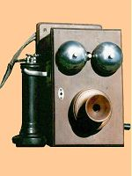
Infokommunikációs rendszerek Infocom Systems 5. Nyilvános távbeszélő (PSTN) hálózatok, gerinchálózatok Telephone networks(PSTN), backbone networks
Takács György

Slide 2
The 3 lessons in network studies
Public Switched Telephone Networks (PSTN), Integrated Service Digital Networks (ISDN), backbone networks
Mobile Networks -- Public Land Mobile Networks (PLMN) GSM, UMTS, DECT, TETRA, Bluetooth, Globalstar, Iridium
Private networks, Broadcasting networks, Cable TV networks (CaTV)

Slide 3
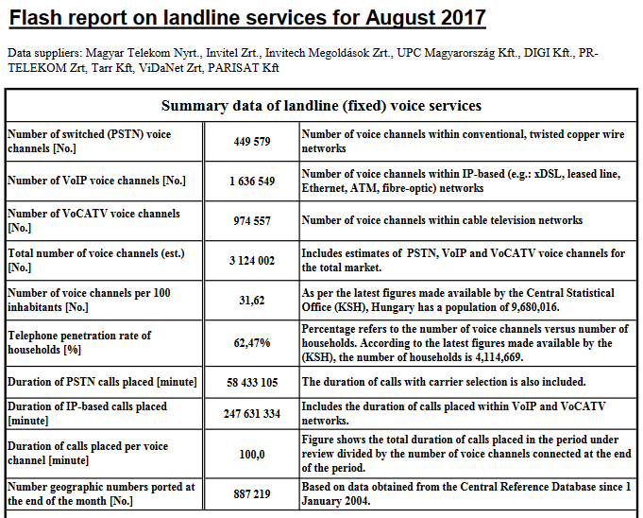

Slide 4
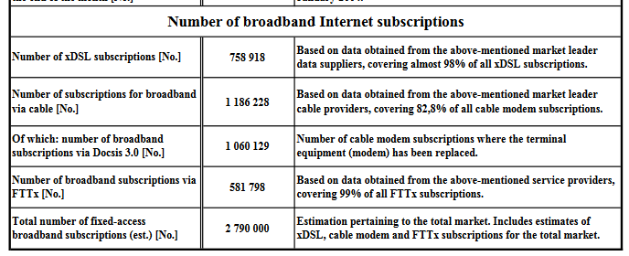
Flash report on landline services for August 2017

Slide 5
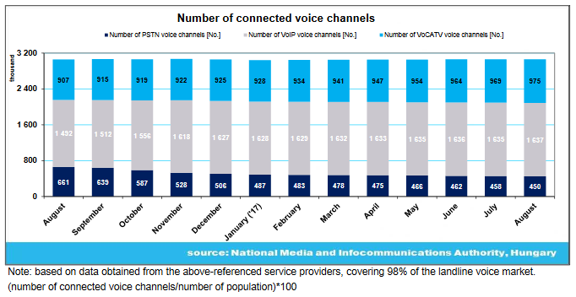
Flash report on landline services for August 2017

Slide 6
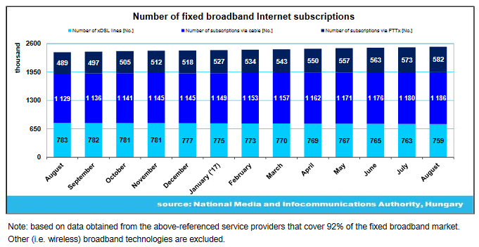

Slide 7
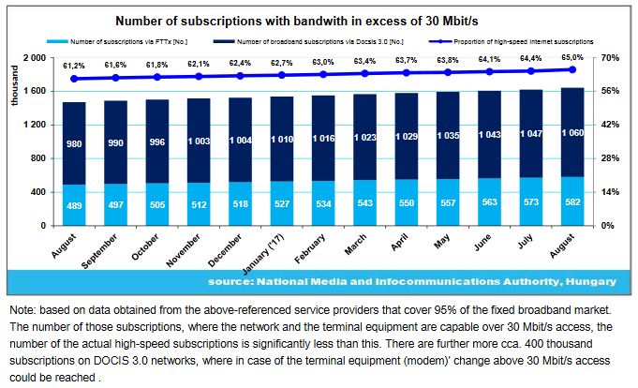

Slide 8
Number of mobile Internet subscriptions (pc)

Slide 9
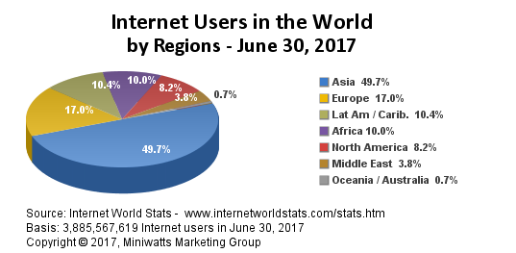

Slide 10
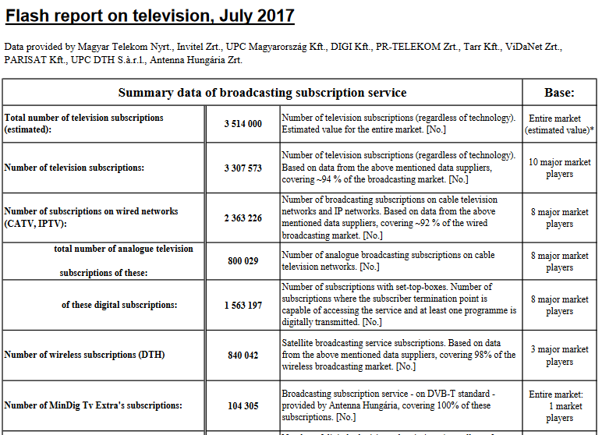

Slide 11
Special features of networks
Only services can be sold on the real market!
There are not infocommunication services without networks.
You could not buy networks. You have to plan, to construct, to operate, to develope according to the actual demands and to eliminate at the and of service provision.

Slide 12
Service, application and content providers….
Like: Vodafone, CIB Bank, CNN
Servers
Network operators
Transmission lines,
Multiplexers,
Routers,
Switches
v
End users
Like: subscribers,
Companies
Mobile sets, TV sets,
computers

Slide 13
Basics of network components
Backbone networks: long distances, high traffic, interconnection of nodes, transport bits of any services, high relability, high availability.
Access networks: local distances, interconnection of terminals and local nodes
Network planning: selecting topology, optimal selection of positions of nodes, dimensioning of node traffic handling capacities, dimensioning of link capacities, selecting technologies.

Slide 14
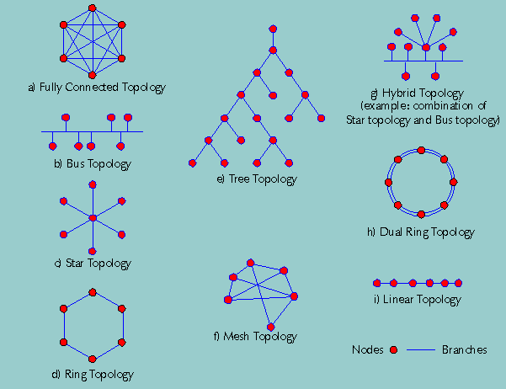

Slide 15
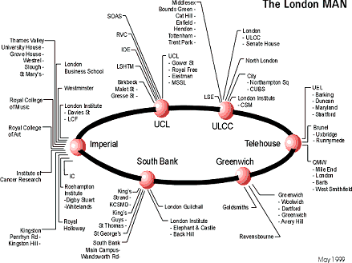

Slide 16
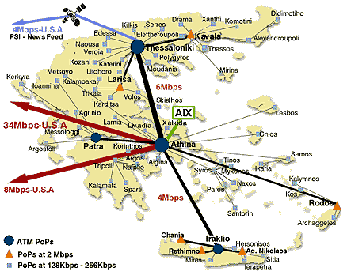

Slide 17
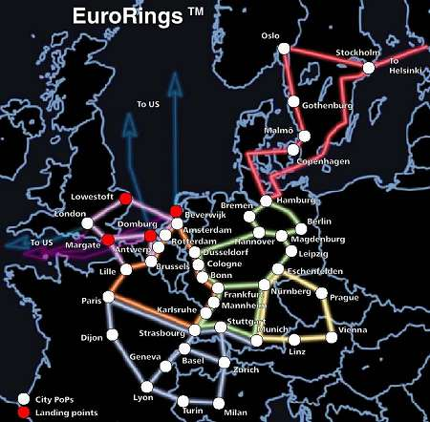
The pan European KPNQwest network, when complete, will connect major cities together by six high-capacity backbone rings.

Slide 18
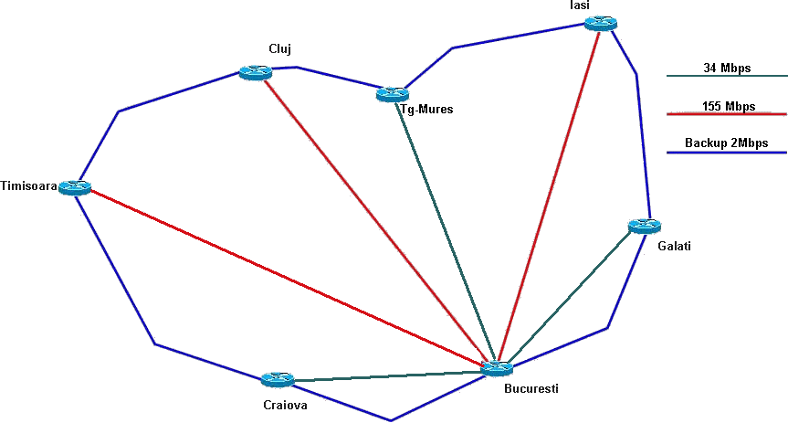

Slide 19
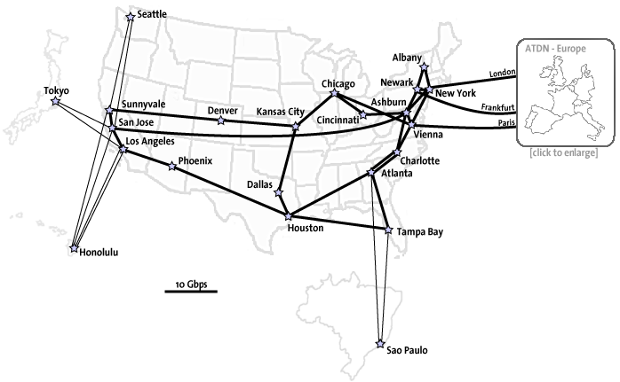
AOL USA BACKBONE

Slide 20
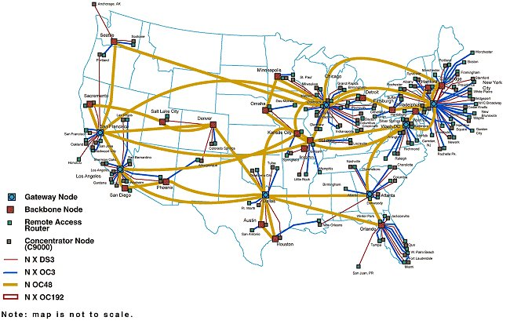

Slide 21
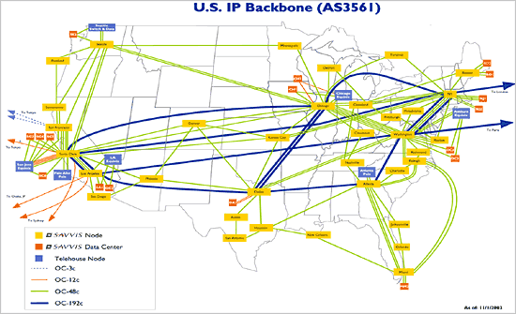

Slide 22
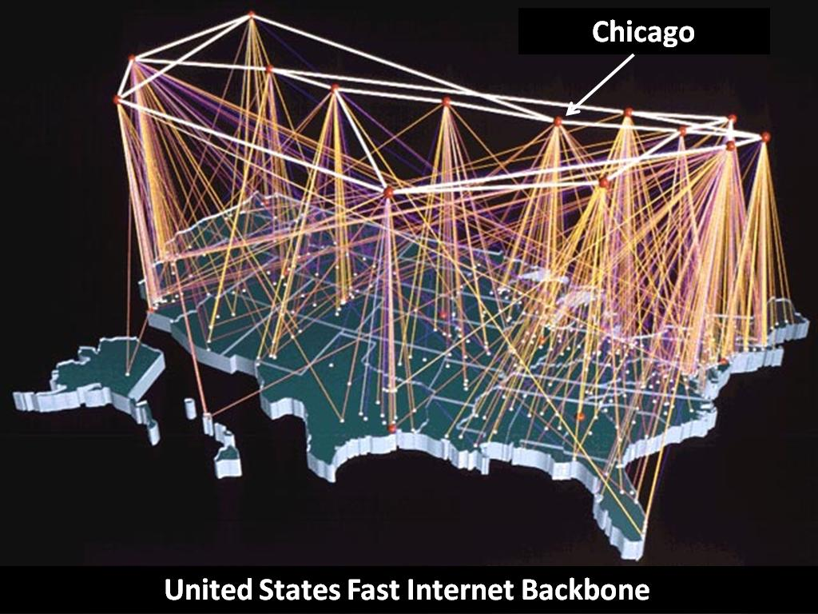

Slide 23
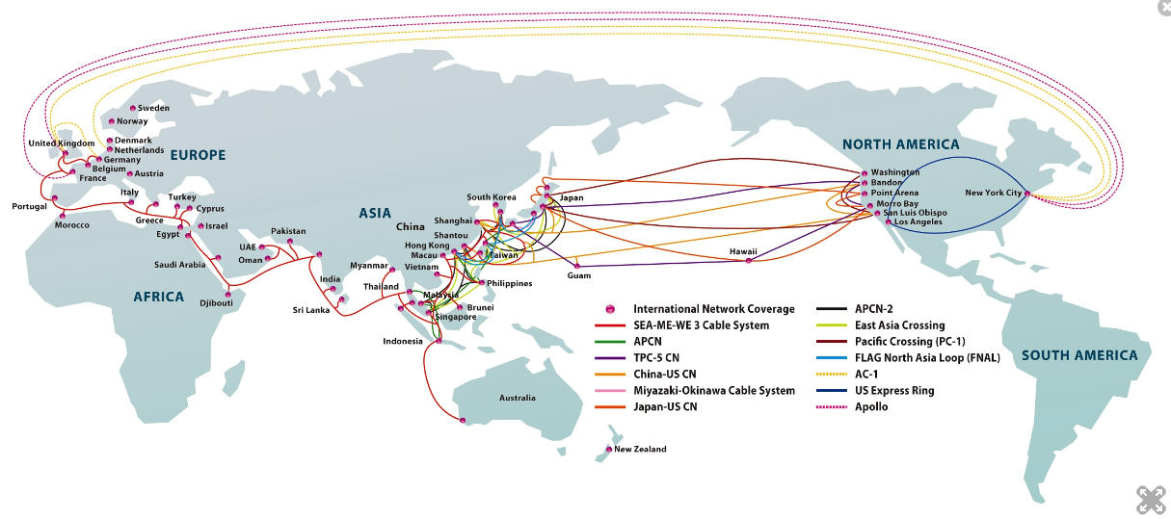

Slide 24
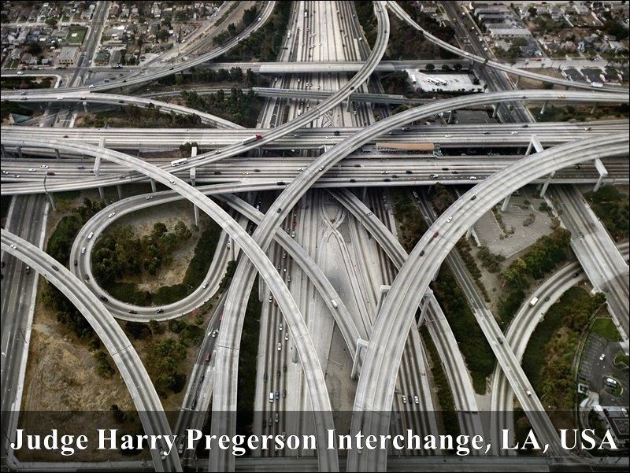

Slide 25
Public Switched Telephone Networks (PSTN)
Brief history
Basics
Network structures
Network implementation
Network development trends
Missing topics

Slide 26
Brief history I.
1876 A. G. Bell Patent of telephone (50.000 phone within 3 years)
1877 T. A. Edison patent of carbon microphone (covering long distances)
1878 Puskás Tivadar the first telephone exchange in Connecticut
1881 Puskás Ferenc the first telephone exchange in Budapest
1890 The first Wien-Budapest international telephone connection
1892 The first automatic telephone exchange in Indiana
1928 The first automatic telephone exchange in Budapest
1997 The last manual exchange moved to museum in Hungary

Slide 27
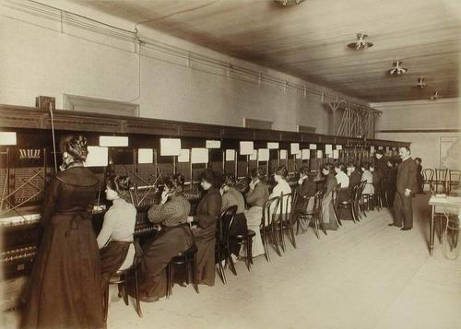

Slide 28
Brief history II.
The technical level of Hungarian PSTN networks are very high due to the fast development from 1992-2002
From 1 million subscriber to 10 million one
From 1000 manual exchange to almost fully digital network
COCOM list restriction not from our side!!!

Slide 29
Basics of telephony
2/4 wire for voice
Feeding of circuit
Access solutions
Backbone
Signalling basics for a telephone call
Source of revenues
ADSL principles

Slide 30
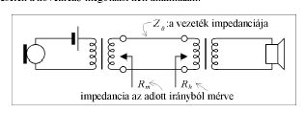
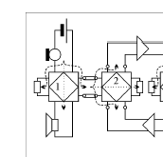
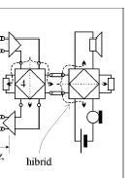
2/4 wire for voice
2 wire simplex
4 wire simplex
2 wire duplex

Slide 31
Electronic hybrid circuit
Z_{g}
r
r
Twisted pair cable
Z_{T}
Z₀ characteristic impedance
Z_{T} ~Z₀

Slide 32
Powering of telephone sets
Feeding bridge
Traditional feeding bridge circuit
DC line current: 20….60 mA
Subscriber line
Local exchange

Slide 33
Access solutions

Slide 34
Connections to the local exchange
Main cables
Distribution cabinets
Distribution cables
Distribution boxes
Drop cables,
Indoor cables

Slide 35
Access network implementation

Slide 36
Cable duct system implementation

Slide 37
Cable distribution cabinet (street version) implementation

Slide 38
Signalling basics for a telephone call

Slide 39
Channel-associated signalling for a trunk call

Slide 40
Common-channel signalling for a trunk call

Slide 41
Backbone issues in a small country with dense population
Fully optical – only spare radio connections
Covered distance between nodes max 100 km
In Hungary the source of telecom traffic (including telephone, TV programs, Internet) concentrated in Budapest (like the road traffic)
Concentration of switching capacities in higher level nodes
Fault tolerant topology is required for reliable services

Slide 42
Network structures
Basics
MATÁV structures
PANTEL structures
Interconnection issues
Structure and numbering
Intelligent Network Concept

Slide 43
Basic structures in PSTN/ISDN networks
Star topology
Multipolar topology
Meshed topology
Ring topology
Bus topology

Slide 44
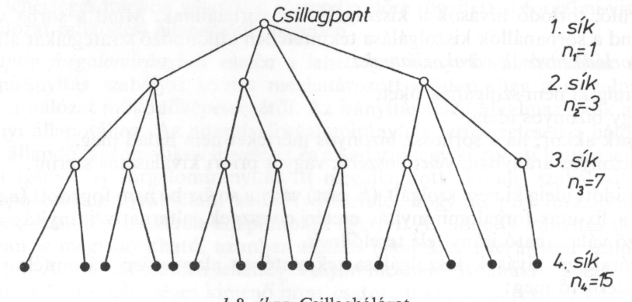
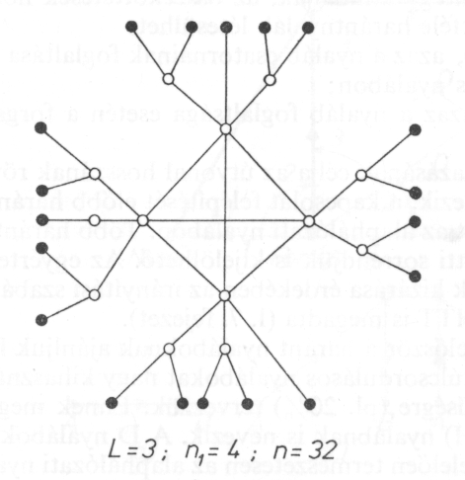
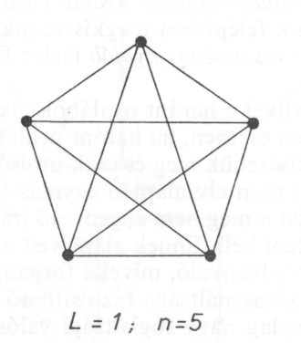
STAR
BUS
RING
MESHED
MULTIPOLAR

Slide 45
MATÁV NETWORK STRUCTURE

Slide 46
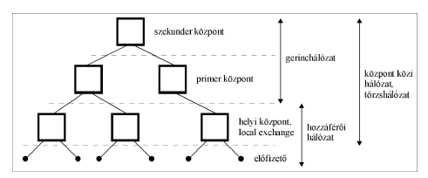
Telephone network structure of MATAV
Secondary exchange
Backbone
network
Primary exchange
Inter
exchange
network
Local
exchange
Access
network
Subscriber

Slide 50
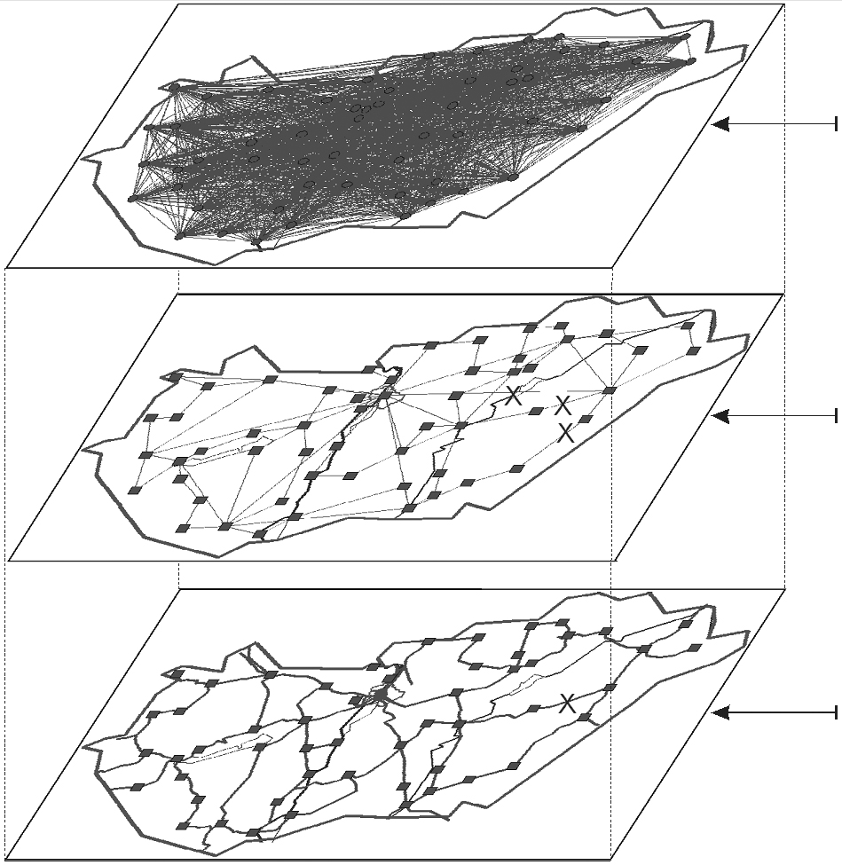
3. Layer
Network layer
2. Layer
Data link layer
IP link
Layer
Physical layer
Optical cable

Slide 51
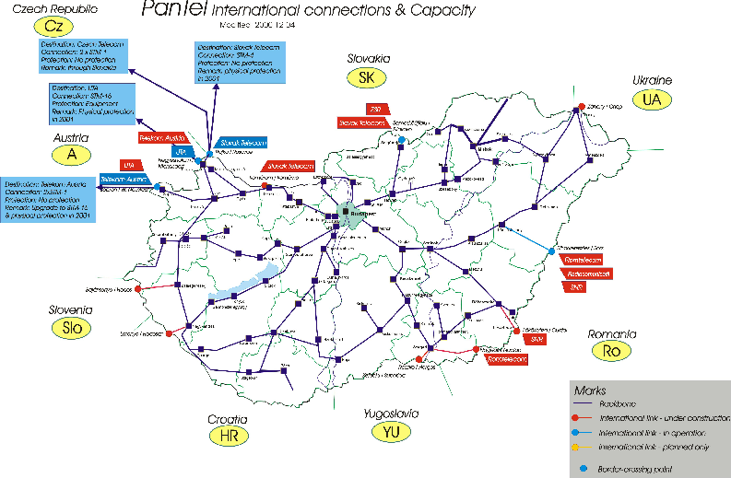
PANTEL optical backbone structures

Slide 52
PANTEL logical SDH rings

Slide 53
Interconnection principles

Slide 54
Interconnection principles

Slide 55
Interconnection implementation

Slide 56
Network structure and numbering

Slide 57
Network implementation
Access issues: Rural, City, Down-town, areas, In-door cabling, Underground copper cables, Overhead cables, ADSL, Fibre To the Curb (FTC), distribution frames
Core issues: Underground fibres, overhead fibres,
Switching and multiplexing position of nodes
Traffic issues: dimensioning of switches and links

Slide 58
Access network implementation

Slide 59
Costs and revenues –> market failure The revenues are monthly fees and traffic based fees Networ costs are implementation and operation
Network costs
Wireline networks
Cellular networks
Traffic density (Erlang/km2

Slide 60
Telephone bill balance
balance
balance
time
Pre-paid
time
balance
time
Post-paid

Slide 61
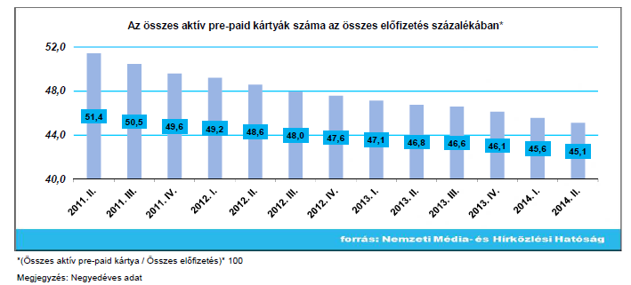

Slide 62
Missing topics
Telephone sets, terminal equipment (Lecture in Nov )
Services (Lecture in Nov )
Regulation issues (Lecture in November )
Details of ADSL
NGN (Next Generation Networks in December)
Network planning (optional subject in semester 7.)

Slide 63
Network development trends
Traditional Solutions in
Services
Future Solutions
Services/Applications
PSTN/ISDN
Data/IP Networks
CATV
Data/IP
Networks
PLMN
PSTN/ISDN
CATV
PLMN
Connectivity
Access Transport & Switching Networks

