Slide 1
5G hálózatok tervezése
Források:
https://ibwave.com/5g-networks/
https://www.ericsson.com/en/network-slicing
https://www.ibwave.com/Marketing/Download/ebook-5G-in-building-wireless-convergence.pdf
https://ebin.pub/5g-an-introduction-to-the-5th-generation-mobile-networks-3110724375-9783110724370.html

Slide 2
Network development trends
Traditional Solutions in
Services
Future Solutions
Services/Applications
PSTN/ISDN
Data/IP Networks
CATV
Data/IP
Networks
PLMN
PSTN/ISDN
CATV
PLMN
Connectivity
Access Transport & Switching Networks

Slide 3
Traditional cellular network itt: propriatery – a berendezésgyártó saját belső specifikációja szerint működő, azaz nem szabványos

Slide 7
„orchestrating” és „slicing” értelmezése
Az architektúra feltételezi, hogy tartományonként egy „orchestrator” felelôs a szolgáltatás- és erőforrás-menedzsmentért. Jelenleg még nem alakult ki a megfelelô magyar terminológia az „orchestrator” elnevezés kiváltására, a felhő rendszer virtuális erőforrásainak koordinálását, a virtuális gépek menedzsment és vezérlési feladatait ellátó funkcionális elemet nevezik így. A cikkben az „orchestrator” által megvalósított funkciót („orchestration”) harmonizálásnak fogjuk nevezni. Az architektúra megvalósításának alapfeltétele, hogy olyan „orchestrator” típust vezet be, mely képes több tartomány együttes kezelésére. Az „orchestrator” által a végfelhasználó számára úgy tudja gyorsan, hatékonyan és dinamikusan létrehozni az igényelt szolgáltatást, ha a tartományok „orchestratoroktól” igényelt erôforrásokat úgynevezett szeletekbe (slice) szervezve tudják elkérni.

Slide 9
What is network slicing?
Network slicing is the operators’ best answer on how to build and manage a network, that meets and exceeds the emerging requirements from a wide range of users. The way to achieve a sliced network is to transform it into a set of logical networks on top of a shared infrastructure. Each logical network is designed to serve a defined business purpose and comprises of all the required network resources, configured and connected end-to-end.
https://www.ericsson.com/en/network-slicing
See video!

Slide 11
5G network slicing enables service providers to build virtual end-to-end networks tailored to application requirements

Slide 13
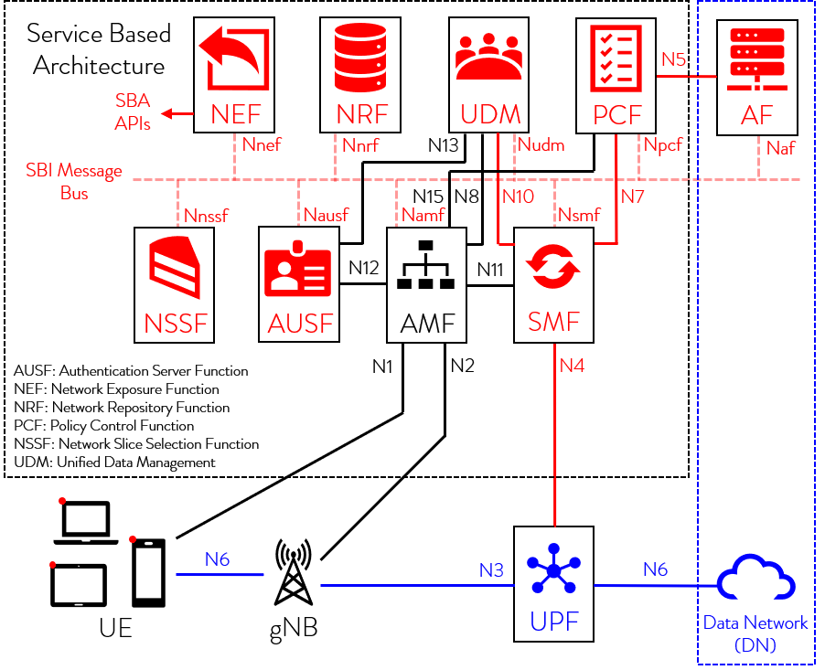
The Session Management Function within a 5G Service-Based Architecture
AMF – Access and Mobility Management
SMF – Session Management Function
UPF – User Plain Function

Slide 14
What are 5G networks?
Simply put: 5G networks are the next step in wireless evolution. 5G New Radio (NR) enables:
Enhanced Mobile Broadband (eMBB) The first stage of 5G adoption will bring high-speed data transfer to portable devices. Smartphones will be able to stream or download HD in seconds, browse the web with lightning-fast speeds, and instantly upload content to their favorite social media network.
Ultra-Reliable Low-Latency Communications (URLLC) Robust data exchange with little to no delay for mission critical applications such as Public Safety Networks. Other anticipated use-cases of URLLC include smart factories, autonomous driving, remote surgery or medical diagnostics, and smart energy grids.
Millimeter-band radios (mmWave) 5G takes advantage of spectrum (between 24 GHz and 100 GHz) which benefits from extremely short wavelengths. That means mmWave’s ability to transmit data quickly and accurately will be a huge benefit in densely populated areas.

Slide 15
Massive Internet of Things (IoT) - mMTC While MTC (Machine Type Communication) has been around for a couple of years, 5G technology aims to provide Massive Machine Type Communication, meaning millions of devices will be able to communicate with each other. In order to provide connectivity without implementation, maintenance and energy costs going through the roof, 5G will seamlessly connect networks of embedded sensors in smart devices with low latency, along with the ability to scale down data rates, power and mobility to provide low-cost solutions.
Massive Multiple-Input Multiple-Output (MIMO) Massive MIMO enables dense network architecture which will allow many users to connect within the same area without experiencing slowdowns. Picture a busy street: if 4G is a two-lane highway, massive MIMO with 5G is a four-lane highway with carpooling - a significant increase in capacity and data throughput.

Slide 16
What’s the difference between 4G and 5G networks?
G promises mobile data speeds that vastly exceed the fastest home broadband network currently available to consumers.
Faster Data Transfer With speeds of up to 100 gigabits per second, 5G is set to be up to 10 times faster than 4G. Not only will this change the way consumers use their smartphones -- it will introduce a whole new set of devices that take advantage of the new spectrum.
Less Latency Communication between cellular towers and connected devices is about to get a whole lot smoother. Delays will be cut down to 1/10th that of traditional 4G networks - paving the way for autonomous devices like self-driving cars.
Increased Coverage and Connection Density 5G small cells are more compact, easier to install, and require less power than 4G macrocells. They will be able to connect up to 100 times more devices per square kilometer than 4G.

Slide 18
What will 5G networks allow?
Faster downloads - in the gigabit-per-second range and beyond In a recent survey, 48% said the top 5G benefit would be never having to use public Wi-Fi services again, and the same number pointed to lightning-fast browsing.
More devices & device types for both personal and enterprise use It’s not just faster smartphones or speedier downloads. 5G will overhaul several industries and create whole new lines of innovative technology. Self-driving vehicles have been in development for years - now, with the widespread adoption of 5G, consumer owned smart cars are on the horizon.
Lower end-to-end network latency 5G will virtually eliminate the lag time it takes for a device to communicate with a network. Play your favorite online games with precision and avoid disadvantages due to connection issues. In the medical industry, where stakes are high, mission-critical tools such as automated surgery equipment that require extremely low latency are moving from concept to application.
For automated driving, split-second decision making can be the difference between safe travel or a devastating accident. 5G’s low latency will be essential to ensure vehicles can remain reactive and protect passengers.

Slide 19
Flexibility with network slicing and Bandwidth Parts (BWP) Whether you plan to use 5G to connect gadgets through the internet of things or just want it for high-speed video streaming, network slicing allows you to designate specific streams depending on the purpose of your wireless infrastructure. Unlike designing for 4G, you can assign up to four channels with different use-cases for 5G networks.
See Ericsson video to understanding network slicing!
https://www.ericsson.com/en/network-slicing
Massive IoT with high density of smart devices. Not only will 5G enable these fantastic features, it will also eliminate some of the common complaints of using legacy networks (4G and earlier). 5G will solve issues that have plagued existing technologies for years, such as pixelated video calls, long buffer times for streamed movies, and delays between uploading and sharing content.

Slide 21
What are the 5G challenges?
There are many challenges to designing for 5G networks. Like any new wireless technology, it will take time before the market fully understands the obstacles and opportunities that 5G will bring. We’ve identified four key challenges that
Infrastructure Overhauls mmWave is far more complex to design for than low frequency spectrum, and may require advanced levels of training for RF engineers. These aren’t your average waves!
Challenges of designing for mmWave include poor signal range and increased reflection from building materials. There are also cost considerations as in-building mmWaves require an infrastructure overhaul, with new antennae, fiber cabling, and small cells needing to be installed throughout a locale to connect properly.

Slide 22
The time investment of Beamforming A key feature of 5G NR - Beamforming - enables ultra-precise data transfer but requires high-level processing and input during the planning and design stage. It’s a powerful tool that demands significant design time investments.
The complexity of reliable, consistent low latency With 5G set to enable smart technology like self-driving cars and automated medical equipment, latency can be catastrophic. Accurate, well designed 5G networks are essential to minimizing latency in these industries.
The cost of evolution The enhancements that 5G brings don’t come without investment. Most 5G equipment is non-compatible with existing infrastructures, so upgrading a network will mean upgrading its antennae. It’s no small feat: rolling out 5G across the US could cost an estimated $300 billion.

Slide 23
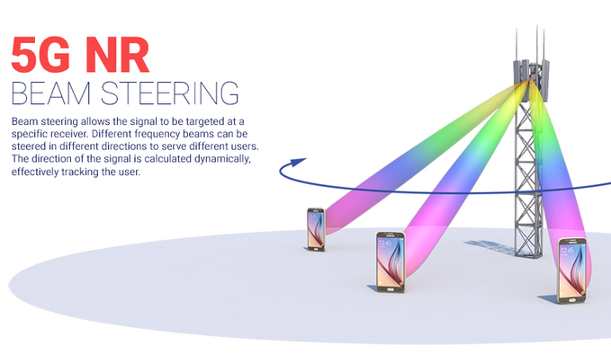

Slide 24
How to correctly plan 5G networks?
5G network design requires in-depth training. The iBwave Certification Program (iCP) provides award winning training to teach you how to design the most accurate, efficient networks possible. It’s accessible online or in a classroom.
Operators, engineers, and system integrators are currently publishing research on the optimal strategy for planning 5G networks, but one thing is for sure:
5G network design requires powerful software. With its optimization and propagation modules, iBwave Design has built in 5G NR functionality, including high-end customization of individual beams through beamforming, bandwidth partitioning, and 3D network visualization tools. Report generation tools and heatmaps provide visual data for stakeholders so project owners can feel engaged through every step of the design process.
5G network design requires in-depth training. The iBwave Certification Program (iCP) provides award winning training to teach you how to design the most accurate, efficient networks possible. It’s accessible online or in a classroom.

Slide 25
Csak az 5G mobil földfelszíni hálózat a megoldás?
Vezetékes hálózatok?
Műholdas hálózatok?

Slide 26
SpaceX submits paperwork for 30,000 more Starlink satellites October 15, 2019
SpaceX, which is already planning the world’s largest low-Earth-orbit broadband constellation by far, filed paperwork in recent weeks for up to 30,000 additional Starlink satellites on top of the 12,000 already approved by the U.S. Federal Communications Commission.
The FCC, on SpaceX’s behalf, submitted 20 filings to the ITU for 1,500 satellites apiece in various low Earth orbits, an ITU official confirmed Oct. 15 to SpaceNews.
SpaceX deployed its first 60 Starlink satellites in May and plans to launch hundreds — potentially over a thousand — more in the year ahead.

Slide 27
Project Kuiper
Amazon is joining the race to provide broadband internet access around the globe via thousands of satellites in low Earth orbit, newly uncovered filings show.
The filings lay out a plan to put 3,236 satellites in low Earth orbit — including 784 satellites at an altitude of 367 miles (590 kilometers); 1,296 satellites at a height of 379 miles (610 kilometers); and 1,156 satellites in 391-mile (630-kilometer) orbits.
The United Nations estimates that almost 4 billion people around the globe are underserved when it comes to internet access, which is becoming increasingly important as the world grows more connected.

Slide 28
Hová juthat még az INFOCOM fejlődése?

Slide 29
További források:
5GPPPArchitecture Working Group 5G Architecture White Paper Version 2.0, December 2017
New Services and Capabilities for Network 2030: Description, Technical Gap and Performance Target Analysis ITU-T / 10/2019
Network 2030 A Blueprint of Technology, Applications and Market Drivers Towards the Year 2030 and Beyond Written by FG-NET-2030
5G hálózatok – helyzetkép és perspektívák -- Zagyva Béla / 2019.05.22
A jövő infokommunikációs technológiái és a szabályozás – Dr. Bartolits István / 2019.11.27
https://docplayer.hu/3668717-Magyar-mernoki-kamara-budapest-2015-junius-24.html
https://www.hte.hu/documents/10180/1727937/HT_2016-1_MJIK2015_6_Cinkler_Simon_Szabo_Szekely_Jakab.pdf

