Slide 1
Theory of nonlinear dynamic systems Practice 5
Juhász János
juhasz.janos@.itk.ppke.hu
Szélig Ádám
szelig.adam.gyorgy@itk.ppke.hu
Goda Márton
goda.marton.aron@itk.ppke.hu

Slide 2
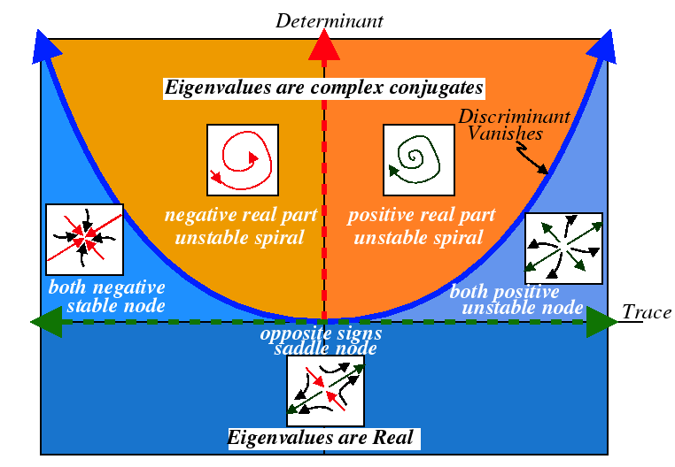
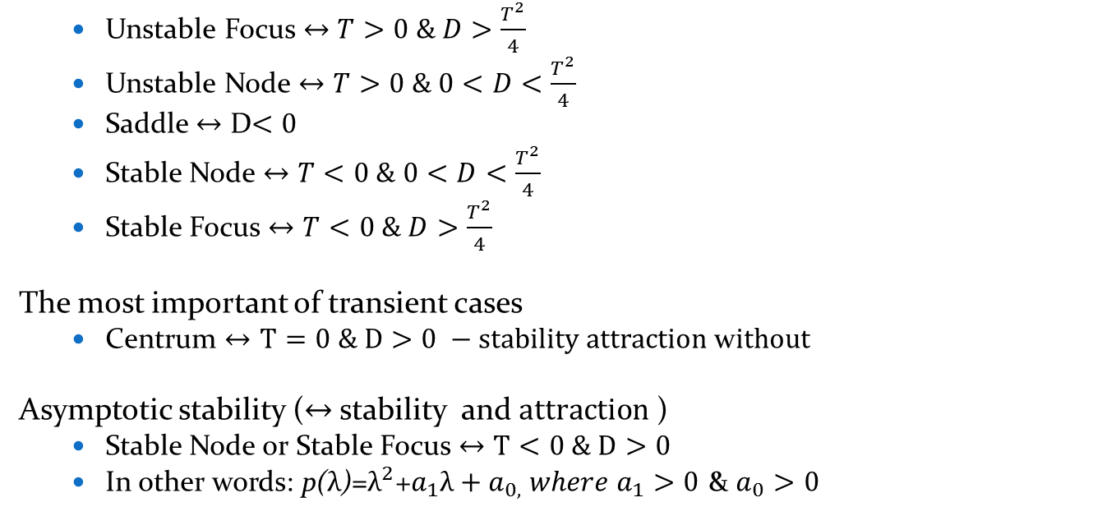
Trace-Determinant Diagram
Unstable Focus $↔$ $T>0 \& D>\frac{T^{2}}{4}$
Unstable Node $↔$ $T>0 \& 0<D<\frac{T^{2}}{4}$
Saddle $↔$ D$<0$
Stable Node $↔$ $T<0 \& 0<D<\frac{T^{2}}{4}$
Stable Focus $↔$ $T<0 \& D>\frac{T^{2}}{4}$
The most important of transient cases
Centrum $↔T=0 \& D>0 −stability attraction$ w$ithout$
Asymptotic stability ($↔$ stability and $attraction$ )
Stable Node or Stable Focus $↔$ $T<0 \& D>0$
In other words: p($λ$)=$λ^{2}$+$a_{1}λ+a_{0,} where{ a}_{1}>0$ & $a_{0}>0$

Slide 3
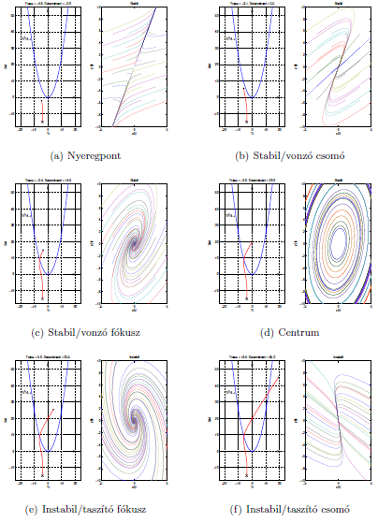

Slide 4
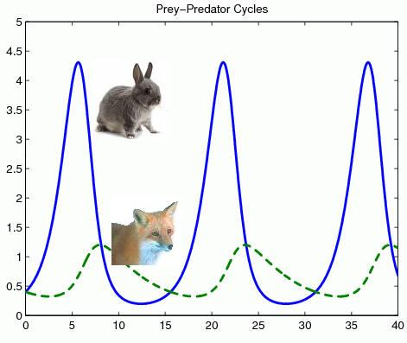
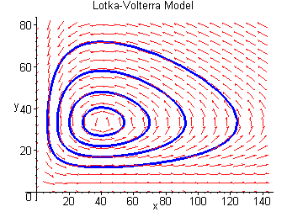
Competitive Lotka–Volterra equations
Models of oscillating chemical reactions, or
Coexistence of Predator (y) and Prey (x) in an ecosystem
dx=x*(α-β*y)
dy=y*(-γ+δ*x)
Initial value dependent stable oscillation emerges in the quantity of the two species.
Rate of natural increase
Natural death
Interactions between the species (here: predation)

Slide 5
Population dynamics 1.
The species of x and y form the system
Equations of their changes:
dx=x*(1-2x-y);
dy=y*(3-2y-x);
The equations show us how do the sizes of populations change from initial x and y.
Tasks:
Show the equilibrium points
What kind of fix points are they
Rate of natural increase
Natural death
Interactions between the species (here: competition)
Notes:
Solution:
Fix points: (dx=0 and dy=0)
O=[0,0] origo, not interesting
R=[-1/3, 5/3] not in the 1. (+,+) quadrant, not relevant now
P=[0.5,0]
E1=2.5
Ev1=[1,-7] (only the direction is important)
E2=-1
Ev2=[1,0]
type: saddle node
Q=[0,1.5]
E1=-0.5
Ev1=[3,-5]
E2=-3
Ev2=[0,1]
type: stable node

Slide 6
Population dynamics 2.
The species of x and y form the system
Equations of their changes:
dx=x*(8-x-2y);
dy=y*(5-y-x);
The equations show us how do the sizes of populations change from initial x and y.
Tasks:
Show the equilibrium points
Draw the saddle point
Show the separating curve of "life and death" (a curve that determines which species will remain
Rate of natural increase
Natural death
Interactions between the species (here: competition)

Slide 7
Thank you for your attention!

Slide 8
Matlab® supplement
[X,Y] = meshgrid(x,y) replicates the grid vectors x and y to produce a full grid.
equation= @(t,y) [y(2); y(1)]; [1. equ of the system; 2. equ of the system]
[t,y]=ode45(equation, [t₀,t_{max}][X_{init},Y_{init}]); there are other solvers as well, first we try this
figure creates figure graphics objects. Figure objects are the individual windows on the screen in which the MATLAB software displays graphical output.
plot(x,y,how…) drawing, has many options
subplot(m,n,p) (divide the figure m*n parts, draws in the p th region)
contour(X,Y,Z), contour(X,Y,Z,n), and contour(X,Y,Z,v) draw contour plots of Z using X and Y to determine the x- and y-axis limits.

