Slide 1
Theory of nonlinear dynamic systems Practice 4
Juhász János
juhasz.janos@.itk.ppke.hu
Szélig Ádám
szelig.adam.gyorgy@itk.ppke.hu
Goda Márton
goda.marton.aron@itk.ppke.hu

Slide 2
Explicit Euler
Def.:
General task:
$$\dot{x}=f\left(x\right), x\left(0\right)=x_{0}∈ℝ^{d}$$
$φ:[0,h_{0}]×$ $ℝ^{d}→ℝ^{d}$
General method:
$x_{k+1}=φ\left(h,x_{k}\right), k=0,1,2,… ↔$ X =$φ\left(h,x\right)$
$φ_{E}$ explicit Euler method
X =$φ_{E}\left(h,x\right)$, where X=x+hf(x)

Slide 3
Implicit Euler
Def.:
General task:
$$\dot{x}=f\left(x\right), x\left(0\right)=x_{0}∈ℝ^{d}$$
$φ:[0,h_{0}]×$ $ℝ^{d}→ℝ^{d}$
General method:
$x_{k+1}=φ\left(h,x_{k}\right), k=0,1,2,… ↔$ X =$φ\left(h,x\right)$
$φ_{I}$ implicit Euler method
X =$φ_{I}\left(h,x\right)$, where X=x+hf(X)

Slide 4
Semi-implicit Euler
Notes:
Force field: a space and time dependent force is applied to the points
Stationary force field: the force is only space dependent (constant in time)
Potential force field: a stationary force field, where the work on a point only depends on the initial and the final state (,but independents from the trajectory between them)
Central force field: the impact lines of all forces cross each other in one point

Slide 5
Semi-implicit Euler
Suppl.:
The exact solutions of Φ: $ℝ×ℝ^{d}→ℝ^{d}, \left(t,\left({x \atop y}\right)\right)→\text{Φ}$ $\left(t,\left({x \atop y}\right)\right)$ conserv:
$\text{energ}\text{y} of \frac{y^{2}}{2}+V\left(x\right)=$ $\frac{{y_{0}}_{}^{2}}{2}+V\left(x_{0}\right)$
area of dx dy at $ℝ^{2}$phase portrait
This special method conservs the dx dy area, according to the det (J)$≡1$, where J=$\frac{∂(X,Y)}{∂(x,y)}.$

Slide 6
Comparation of numerical methods:
Always take care of the physics of the problem
Energy
=> choose problem specific numerical methods

Slide 7
Trace-Determinant Diagram
Unstable Focus $↔$ $T>0 \& D>\frac{T^{2}}{4}$
Unstable Node $↔$ $T>0 \& 0<D<\frac{T^{2}}{4}$
Saddle $↔$ D$<0$
Stable Node $↔$ $T<0 \& 0<D<\frac{T^{2}}{4}$
Stable Focus $↔$ $T<0 \& D>\frac{T^{2}}{4}$
The most important of transient cases
Centrum $↔T=0 \& D>0 −stability attraction$ w$ithout$
Asymptotic stability ($↔$ stability and $attraction$ )
Stable Node or Stable Focus $↔$ $T<0 \& D>0$
In other words: p($λ$)=$λ^{2}$+$a_{1}λ+a_{0,} where{ a}_{1}>0$ & $a_{0}>0$

Slide 8
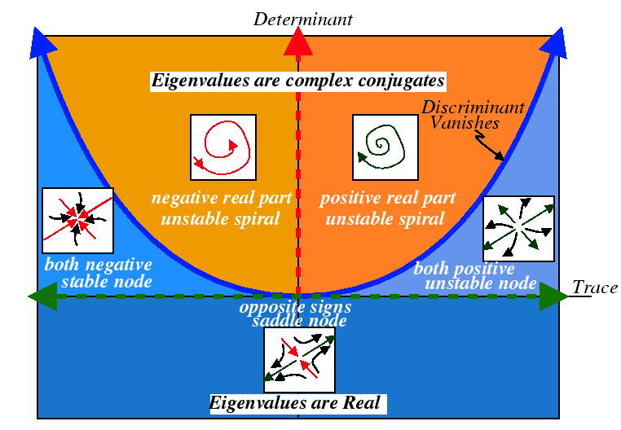
Trace-Determinant Diagram

Slide 9
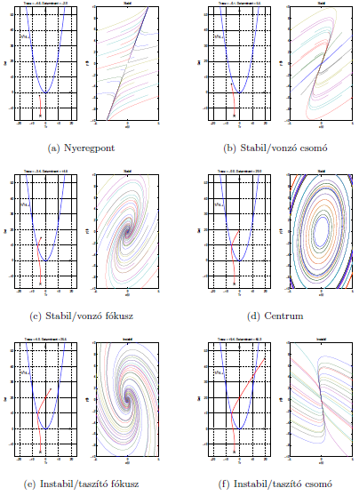

Slide 10
Trace-Determinant Diagram
How the trajectories behave, if the linear system looks like this near the fix point?
1.:
2.:
3.:
Notes:
Solutions:
1: Stable node: eigen_value1= -0.5; eigen_value2= -3
eigen_vektor1=[3 -5]; eigen_vector2=[0 1]
2. Saddle node: eigen_value1= 2.5; eigen_value2= -1
eigen_vektor1=[1 -7]; eigen_vector2=[1 0]

Slide 11
Thank you for your attention!

Slide 12
Matlab® supplement
[X,Y] = meshgrid(x,y) replicates the grid vectors x and y to produce a full grid.
equation= @(t,y) [y(2); y(1)]; [1. equ of the system; 2. equ of the system]
[t,y]=ode45(equation, [t₀,t_{max}][X_{init},Y_{init}]); there are other solvers as well, first we try this
figure creates figure graphics objects. Figure objects are the individual windows on the screen in which the MATLAB software displays graphical output.
plot(x,y,how…) drawing, has many options
subplot(m,n,p) (divide the figure m*n parts, draws in the p th region)
contour(X,Y,Z), contour(X,Y,Z,n), and contour(X,Y,Z,v) draw contour plots of Z using X and Y to determine the x- and y-axis limits.

