Slide 1
Theory of nonlinear dynamic systems Practice 3
Juhász János
juhasz.janos@.itk.ppke.hu
Szélig Ádám
szelig.adam.gyorgy@itk.ppke.hu
Goda Márton
goda.marton.aron@itk.ppke.hu

Slide 2
Van der Pol oscillator I.
An electronic oscillator is an electronic circuit that produces a periodic, oscillating electronic signal, often a sine wave or a square wave
Solution of DE: constant amplitude of sinusoidal signal, where U₀ is the amplitude , ω₀ is the frequency and ς₀ is the phase.
Task: Circuit Implementation

Slide 3
Van der Pol oscillator II.
Problems:
- It depends on the initial conditions (after turning of circuit the amplitude might be change)
- In reality it is necessarily a perfect structure to sinusoidal solution and constant amplitude
- Constant amplitude oscillator could not be constructed with linear elements only
Conclusion: We must ensure constant and stable frequency /amplitude vibration. Furthermore, the system have to reach the constant frequency /amplitude in case of any initial conditions.

Slide 4
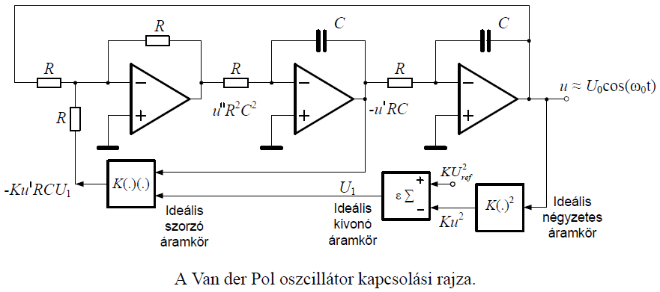
Van der Pol oscillator III.
Solution:

Slide 5
Explicit Euler I.
Example:
Write the explicit Euler method in the case of h=0.5:
$$\left\{\begin{aligned}\text{y}\text{’(}\text{x}\text{)=2}\text{xy}\text{(}\text{x}\text{), }\text{x}\text{ ∈[0;1] } \\ \text{y}\text{(0)}\text{=1 }\end{aligned}\right.$$
Initial value problem! Write the approximation of y(1)!

Slide 6
Explicit Euler II.
Create the interval division of [0;1]. h = 0.5:
$x_{0}=0,$
$x_{1}=0.5,$
$x_{2}=1$
Formula of explicit Euler-method:
$y_{n+1}=y_{n}+h∙$f ($x_{n},y_{n}$), (n=0,…,N-1),
$y_{0}=y(0)$,
Where N=2, because the interval was divided into two parts and f(x,y)=2xy. Concrete examples of applied recursion:
$y_{n+1}=y_{n}+h∙2x_{n}y_{n}=(1+2hx_{n})∙y_{n}$, (n=0,1)
$y_{0}$ = 1.
Since
$$y_{1}= (1+2hx_{0})∙y_{0}$$
$$y_{2}= \left(1+2hx_{1}\right)∙y_{1}=\left(1+0.5\right)∙1=\frac{3}{2} ,$$
therefore $y_{2}$ = $\frac{3}{2}$ at the approximation of y(1). The exact solution of the initial value problem:
y(x)=$e^{x^{2}}$ $→ y\left(1\right)=e$
Notes:
e = 2,718 281
y2 = 1,5
Thanks to the big stepsize
Try h = 1/10 ☺

Slide 7
Explicit Euler III.
Def.:
General task:
$$\dot{x}=f\left(x\right), x\left(0\right)=x_{0}∈ℝ^{d}$$
$φ:[0,h_{0}]×$ $ℝ^{d}→ℝ^{d}$
General method:
$x_{k+1}=φ\left(h,x_{k}\right), k=0,1,2,… ↔$ X =$φ\left(h,x\right)$
$φ_{E}$ explicit Euler method
X =$φ_{E}\left(h,x\right)$, where X=x+hf(x)

Slide 8
Implicit Euler
Def.:
General task:
$$\dot{x}=f\left(x\right), x\left(0\right)=x_{0}∈ℝ^{d}$$
$φ:[0,h_{0}]×$ $ℝ^{d}→ℝ^{d}$
General method:
$x_{k+1}=φ\left(h,x_{k}\right), k=0,1,2,… ↔$ X =$φ\left(h,x\right)$
$φ_{I}$ implicit Euler method
X =$φ_{I}\left(h,x\right)$, where X=x+hf(X)

Slide 9
Semi-implicit Euler
Notes:
Force field: a space and time dependent force is applied to the points
Stationary force field: the force is only space dependent (constant in time)
Potential force field: a stationary force field, where the work on a point only depends on the initial and the final state (,but independents from the trajectory between them)
Central force field: the impact lines of all forces cross each other in one point

Slide 10
Semi-implicit Euler
Suppl.:
The exact solutions of Φ: $ℝ×ℝ^{d}→ℝ^{d}, \left(t,\left({x \atop y}\right)\right)→\text{Φ}$ $\left(t,\left({x \atop y}\right)\right)$ conserv:
$\text{energ}\text{y} of \frac{y^{2}}{2}+V\left(x\right)=$ $\frac{{y_{0}}_{}^{2}}{2}+V\left(x_{0}\right)$
area of dx dy at $ℝ^{2}$phase portrait
This special method conservs the dx dy area, according to the det (J)$≡1$, where J=$\frac{∂(X,Y)}{∂(x,y)}.$

Slide 11
Comparation of numerical methods:
Always take care of the physics of the problem
Energy
=> choose problem specific numerical methods

Slide 12
* Optional homework ☺: Bolzano shooting
Damped pendulum:
task: x_init=-5; b=0.1; y_init=?;
Give the initial value of y, which trajectory approximates the [$π,0$] unstabil point with 6 decimal places.

Slide 13
Thank you for your attention!

Slide 14
Matlab® supplement
[X,Y] = meshgrid(x,y) replicates the grid vectors x and y to produce a full grid.
equation= @(t,y) [y(2); y(1)]; [1. equ of the system; 2. equ of the system]
[t,y]=ode45(equation, [t₀,t_{max}][X_{init},Y_{init}]); there are other solvers as well, first we try this
figure creates figure graphics objects. Figure objects are the individual windows on the screen in which the MATLAB software displays graphical output.
plot(x,y,how…) drawing, has many options
subplot(m,n,p) (divide the figure m*n parts, draws in the p th region)
contour(X,Y,Z), contour(X,Y,Z,n), and contour(X,Y,Z,v) draw contour plots of Z using X and Y to determine the x- and y-axis limits.

