Slide 1
Theory of nonlinear dynamic systems Practice 1
Juhász János
juhasz.janos@.itk.ppke.hu
Szélig Ádám
szelig.adam.gyorgy@itk.ppke.hu
Goda Márton
goda.marton.aron@itk.ppke.hu

Slide 2
Introduction - Requirements
Participation, midterm, homework, PROJECT
Matlab® (why?)
Optional homework
The aim of the practices: deeper understanding of the lecture examples, implementing them in MATLAB (a framework will be given), „playing” with the parameters
Optional MATLAB catch-up
Some students have to work on their own laptop
Notes:
Miért?:
Több egy kép ezer szónál. (és főleg integráljelek, paraméterek és deriváltak sokaságánál)

Slide 3
Theory I.
,,A fizika minden nehézsége, úgy látszik, abban áll, hogy a mozgásjelenségekből a természet erőit kikutassuk, s azután ezeknek az erőknek a segítségével a többi jelenséget megmagyarázzuk.” Newton
Dynamic system: the states of the system are changing with time based on some rules - mathematical description of a physical process

Slide 4
Theory II.
Phase space: the collection of all possible states of the dynamic system Trajectory: the path (trace) of an element from the phase space
Types of the systems: dissipative, conservative, explosive Attractor: stable and attracts its surroundings, can be point, periodic, chaotic

Slide 5
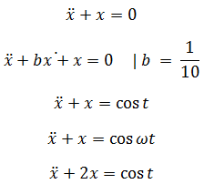
Exercises
Implement the following equations in Matlab, plot trajectories, and investigate the effects of different parameters!
1.
2.
3.
4.
5.

Slide 6
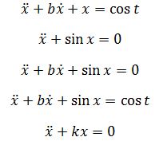
Exercises
Take a look at the following equations as well!

Slide 7
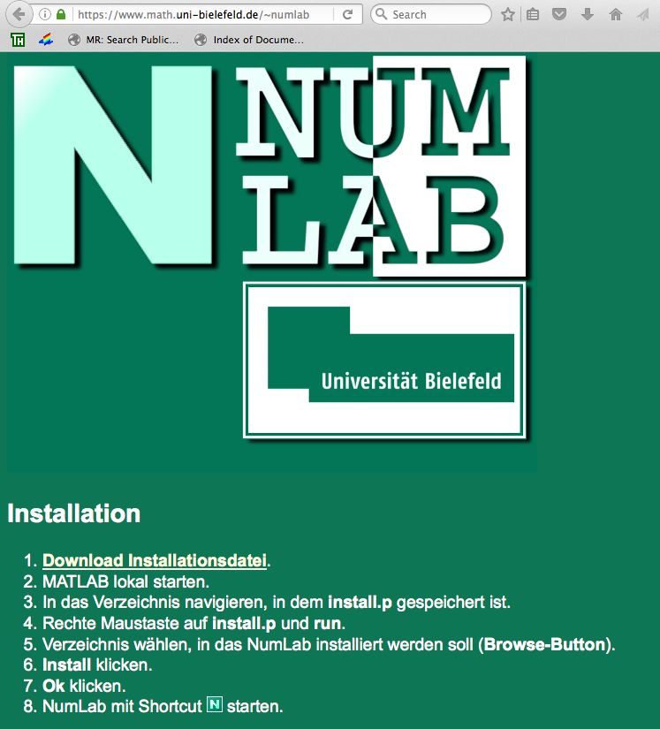
Optional homework
For extra points (and for fun ☺)
Download and install the NumLab Matlab plugin of Bielefeld University: https://www.math.uni-bielefeld.de/~numlab/

Slide 8
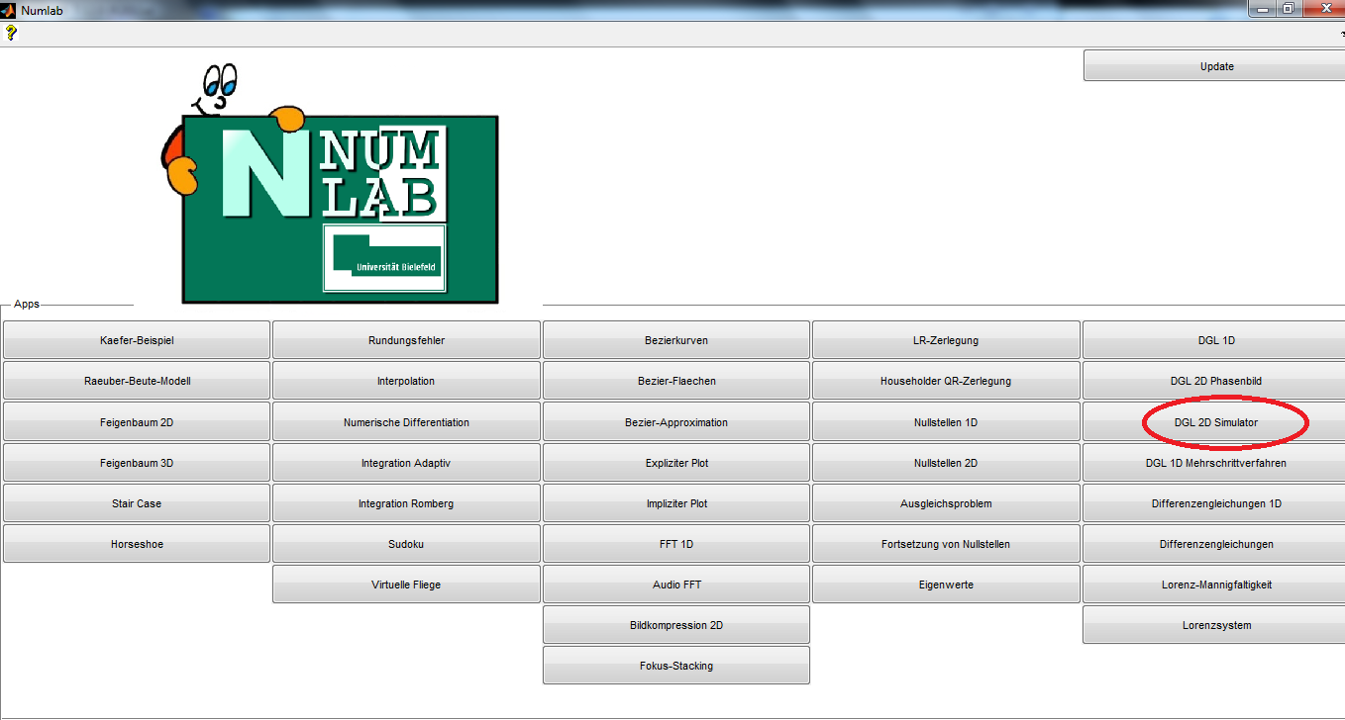
Optional homework
It contains many interesting simulations
Start the GUI called „DGL 2D Simulator”
„play ” with the simulator ☺ : try to catch different behaviors in the function of changing the parameters and initial conditions

Slide 9
Optional homework
What mathematical processes/ behaviors can be recognized during the simulations?
What could be the modeled natural/engineering phenomena?
Send us you findings, ideas (with the suitable snapshots and parameters) in email till the next practice: 09.21. 10:00 am

Slide 10
Matlab® supplement
[X,Y] = meshgrid(x,y) replicates the grid vectors x and y to produce a full grid.
equation= @(t,y) [y(2); y(1)]; [1. equ of the system; 2. equ of the system]
[t,y]=ode45(equation, [t₀,t_{max}][X_{init},Y_{init}]); there are other solvers as well, first we try this
figure creates figure graphics objects. Figure objects are the individual windows on the screen in which the MATLAB software displays graphical output.
plot(x,y,how…) drawing, has many options
subplot(m,n,p) (divide the figure m*n parts, draws in the p th region)
contour(X,Y,Z), contour(X,Y,Z,n), and contour(X,Y,Z,v) draw contour plots of Z using X and Y to determine the x- and y-axis limits.

