Slide 1
Theory of nonlinear dynamic systems Practice 4
Juhász János
juhasz.janos@.itk.ppke.hu

Slide 2
Numeric precision of ode45
Sources of errors (in general):
Matematical error: from the numeric method, higher for big steps
Rounding error: from the computer, higher for a lot of steps
Balancing between the 2
Matlab ode solvers use adaptive stepsize (depending on the „speed of change”)
Absolute tolerance (in Matlab):
Default: 1e-6
~solution is important until then
Relative tolerance (in Matlab):
Default: 1e-3
~number of correct digits

Slide 3
Numeric precision of ode45
Example:
Solve the damped pendulum equation with Max_Time=1500 for
b=1.98
b=2.02
What kind of fixed point you expect (form analytical solution)?
What does the numeric solution show?
How could you agree the two?
Notes:
2.02 -> stable sink
1.98 -> stable spiral
Numeric with default precision cannot show difference
Abstol 1e-24 can show the spiral

Slide 4
Van der Pol oscillator
An electronic oscillator is an electronic circuit that produces a periodic, oscillating electric signal, often a sine wave or a square wave
Solution of DE: constant amplitude sinusoidal signal, where U₀ is the amplitude , ω₀ is the frequency and ς₀ is the phase.
Challenge: circuit implementation

Slide 5
Van der Pol oscillator
Problems:
- Dependence on the initial conditions (after turning of the circuit the amplitude might change)
- In reality a perfect structure is needed to sinusoidal solution and constant amplitude
- Constant amplitude oscillator cannot be constructed with linear elements only
Conclusion:
- We must ensure constant and stable frequency /amplitude vibration.
- The system has to reach the constant frequency /amplitude in case of any initial conditions.

Slide 6
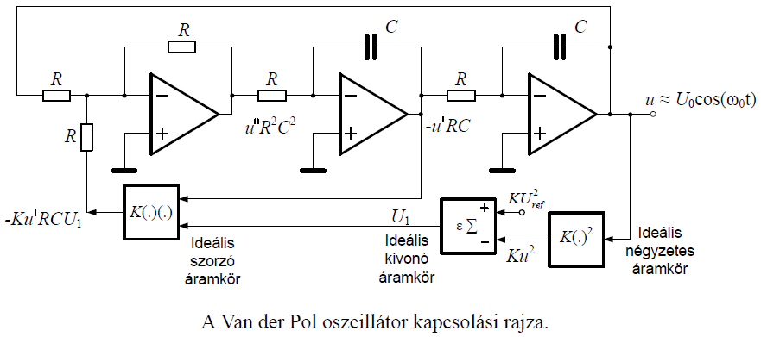
Van der Pol oscillator
Solution:

Slide 7
Van der Pol oscillator
Test the effects of the μ parameter!
μ = 0:0.1:5
μ = 5:10:105
Try to calculate the differential equation for μ = 500.
What do you experience? What could be the solution?
Notes:
ode45 cannot handle so stiff problems, slows down (good for most „average” problems, 1st guess)
ode15s can -> much smaller time steps for much steeper changes, much bigger in „slower changing” regions
Different methods with differnt heuristics (they combine diffent order ode solvers -> see Numeric methods 2)

Slide 8
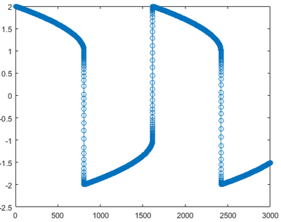
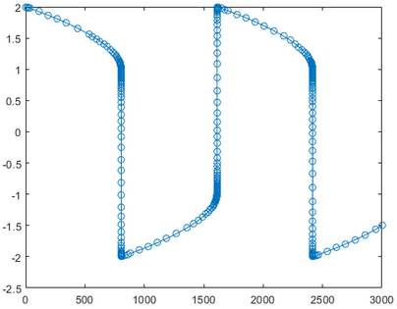
Van der Pol oscillator
ode45
ode15s
cannot handle so stiff problems,
slows down
good for most „average” problems
1st guess
for stiff problems
much smaller time steps for much steeper changes, much bigger in „slower changing” regions
different methods with differnt heuristics
they combine diffent order ode solvers
for more details, see Numeric methods 2 class
Notes:
ode45 cannot handle so stiff problems, slows down (good for most „average” problems, 1st guess)
ode15s can -> much smaller time steps for much steeper changes, much bigger in „slower changing” regions
Different methods with differnt heuristics (they combine diffent order ode solvers -> see Numeric methods 2)

Slide 9

Explicit Euler
Def.:
General task:
$$\dot{x}=f\left(x\right), x\left(0\right)=x_{0}∈ℝ^{d}$$
$φ:[0,h_{0}]×$ $ℝ^{d}→ℝ^{d}$
General method:
$x_{k+1}=φ\left(h,x_{k}\right), k=0,1,2,… ↔$ X =$φ\left(h,x\right)$
$φ_{E}$ explicit Euler method
X =$φ_{E}\left(h,x\right)$, where X=x+hf(x)

Slide 10

Implicit Euler
Def.:
General task:
$$\dot{x}=f\left(x\right), x\left(0\right)=x_{0}∈ℝ^{d}$$
$φ:[0,h_{0}]×$ $ℝ^{d}→ℝ^{d}$
General method:
$x_{k+1}=φ\left(h,x_{k}\right), k=0,1,2,… ↔$ X =$φ\left(h,x\right)$
$φ_{I}$ implicit Euler method
X =$φ_{I}\left(h,x\right)$, where X=x+hf(X)

Slide 11
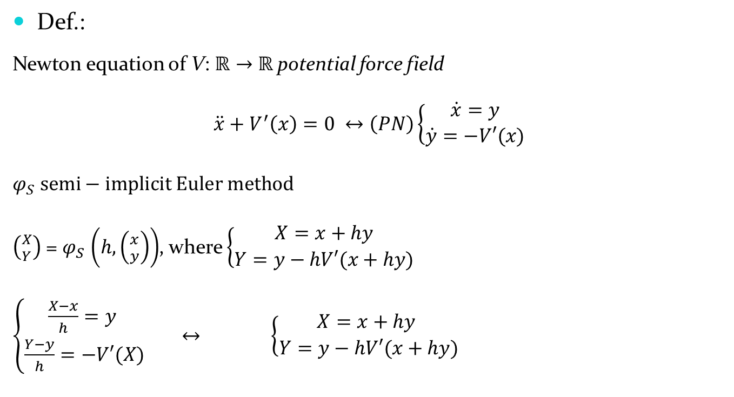
Semi-implicit Euler
Notes:
Force field: a space and time dependent force is applied to the points
Stationary force field: the force is only space dependent (constant in time)
Potential force field: a stationary force field, where the work on a point only depends on the initial and the final state (,but independents from the trajectory between them)
Central force field: the impact lines of all forces cross each other in one point

Slide 12

Semi-implicit Euler
Suppl.:
The exact solutions of Φ: $ℝ×ℝ^{d}→ℝ^{d}, \left(t,\left({x \atop y}\right)\right)→\text{Φ}$ $\left(t,\left({x \atop y}\right)\right)$ conserv:
$\text{energ}\text{y} of \frac{y^{2}}{2}+V\left(x\right)=$ $\frac{{y_{0}}_{}^{2}}{2}+V\left(x_{0}\right)$
area of dx dy at $ℝ^{2}$phase portrait
This special method conservs the dx dy area, according to the det (J)$≡1$, where J=$\frac{∂(X,Y)}{∂(x,y)}.$

Slide 13
Comparation of numerical methods:
Always take care of the physics of the problem
Energy
=> choose problem specific numerical methods

Slide 14
Euler mehods
Try different numeric methods (EE, IE, SE) on the prefect string equation!
Compare the results with ode45 and the analytical solution!

Slide 15
Thank you for your attention!

