Slide 1
Theory of nonlinear dynamic systems Practice 3
Juhász János
juhasz.janos@.itk.ppke.hu

Slide 2
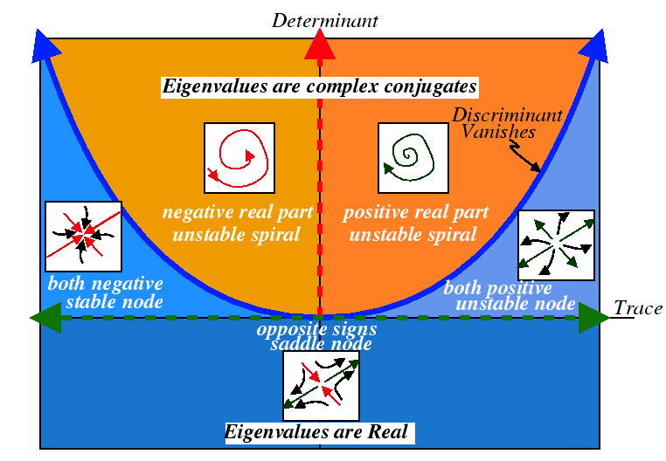
Trace-Determinant Diagram
Unstable Focus, Spiral Source $↔$ $T>0 \& D>\frac{T^{2}}{4}$
Unstable Node, Source $↔$ $T>0 \& 0<D<\frac{T^{2}}{4}$
Saddle Point $↔$ D$<0$
Stable Node, Sink $↔$ $T<0 \& 0<D<\frac{T^{2}}{4}$
Stable Focus, Spiral Sink $↔$ $T<0 \& D>\frac{T^{2}}{4}$
The most important of transient case
Center $↔T=0 \& D>0 −stability without attraction$
Asymptotic stability ($↔$ stability and $attraction$ )
Stable Node or Stable Focus $↔$ $T<0 \& D>0$
In other words: p($λ$)=$λ^{2}$+$a_{1}λ+a_{0,} where{ a}_{1}>0$ & $a_{0}>0$

Slide 3
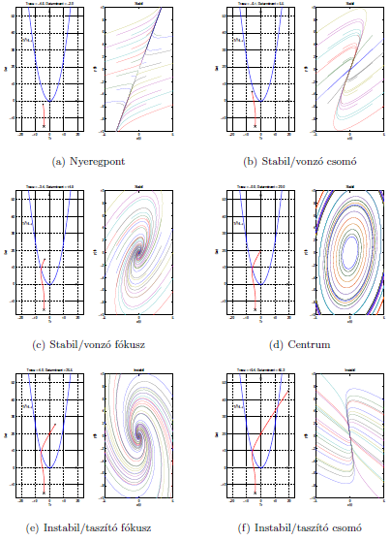
(a) Saddle Point
(b) Stable Node
(c) Stable Spiral
(d) Center
(e) Unstable Spiral
(f) Unstable Node

Slide 4
Trace-Determinant Diagram
How the trajectories behave, if the linear system looks like this near the fixed point?
1.:
2.:
3.:
Notes:
Solutions:
1: Stable node: eigen_value1= -0.5; eigen_value2= -3
eigen_vektor1=[3 -5]; eigen_vector2=[0 1]
2. Saddle node: eigen_value1= 2.5; eigen_value2= -1
eigen_vektor1=[1 -7]; eigen_vector2=[1 0]

Slide 5
Fixed points in inhomogeneous systems
What are the fixed points of the following homogenous system:
xx’’+bx’+x=0 (damped string equ.2 from practice 1)
How does external input (cos(ω*t)) change the system (inhomogenous system) and the stable point(s)?
xx’’+bx’+x= cos(ω*t) (~ equ.6 from practice 1)
Hint: use small b (e.g.: b=0.01) and small resonant frequency (e.g.: ω =0.1)
Notes:
Stable spiral for b<1
Excitation -> periodic behavior (helix in time)
The spiral approaches to the helix -> moving „fixed” points based on the external force

Slide 6
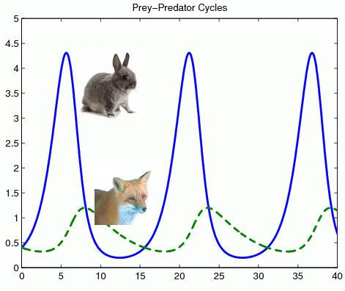
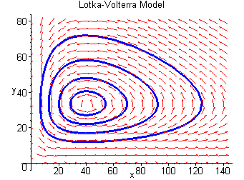
Competitive Lotka–Volterra equations
Models of oscillating chemical reactions, or
coexistence of Predator (y) and Prey (x) in an ecosystem
Only positive x y values are realistic
dx=x*(α-β*y)
dy=y*(-γ+δ*x)
Initial value dependent stable oscillation emerges in the quantity of the two species.
Rate of natural increase
Natural death
Interactions between the species (here: predation)

Slide 7
Population dynamics example
The size of species are x and y form the system
Equations of their changes:
dx=x*(4-x-2y);
dy=y*(6-y-2x);
The equations show us how the sizes of populations change from initial x and y
„+-xy” parts define the type of the interactions
Tasks:
Show the (stable and unstable) equilibrium points
What kinds of fixed point they are?
Show the separating curve of "life and death" (a curve that determines which species will remain
Rate of natural increase
Natural death
Interactions between the species (here: competition)

Slide 8
Thank you for your attention!

