Slide 1
Theory of nonlinear dynamic systems Practice 2
Juhász János
juhasz.janos@.itk.ppke.hu

Slide 2
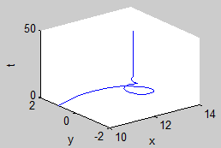
Damped pendulum equation
Examine the following equation:
Energy is decreasing, the system relaxes
b: defines the speed of relaxation (damping factor)

Slide 3
Visualisations
Trajectories:
From 1/ many initial conditions
Energy level curves:
From the energy function (not known for most real life systems)
Vector field:
Gradient vectors in each point
Direction field:
Normalised vector field

Slide 4
Analyse the system: Show the equilibrium points!
What kinds of fixed points they are?
Try to visualise the stable (stable spiral, sink) and the instable (saddle point) fixed points!
Which fixed points are easy to show?
Determine the separation line (separatrix) between two stable fixed points!
What is difference in cases of different damping parameter (see the shapes of the trajectories)?

Slide 5
Analyse the system: Show the equilibrium points!
Energy level curves
Vector field, direction field
Which is the more informative/useful? (vector field or direction field)
Trajectories:
1 trajectory
Many trajectories

Slide 6
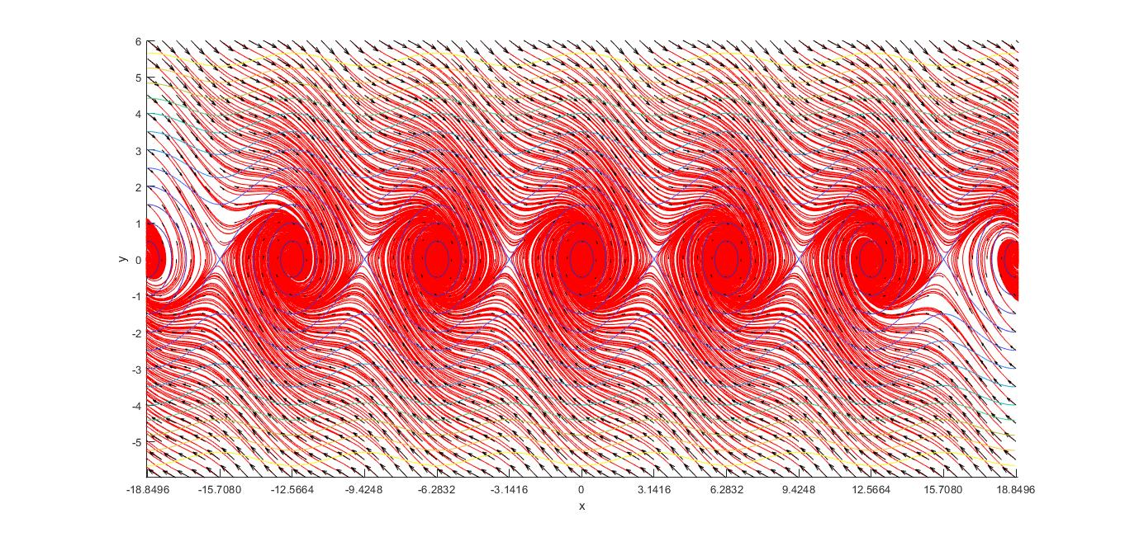
Show the equilibrium points!
Stable fixed points (sink, stable spiral) are easy to see
B=0.5

Slide 7
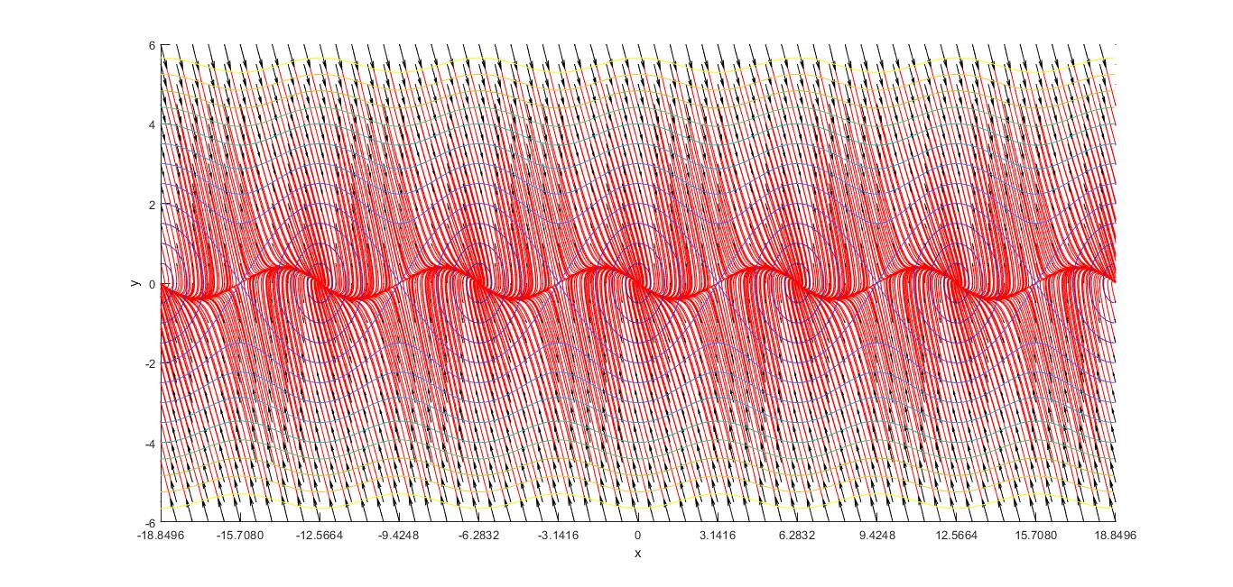
Show the equilibrium points!
Stable fixed points (sink, stable spiral) are easy to see
B=2.5

Slide 8
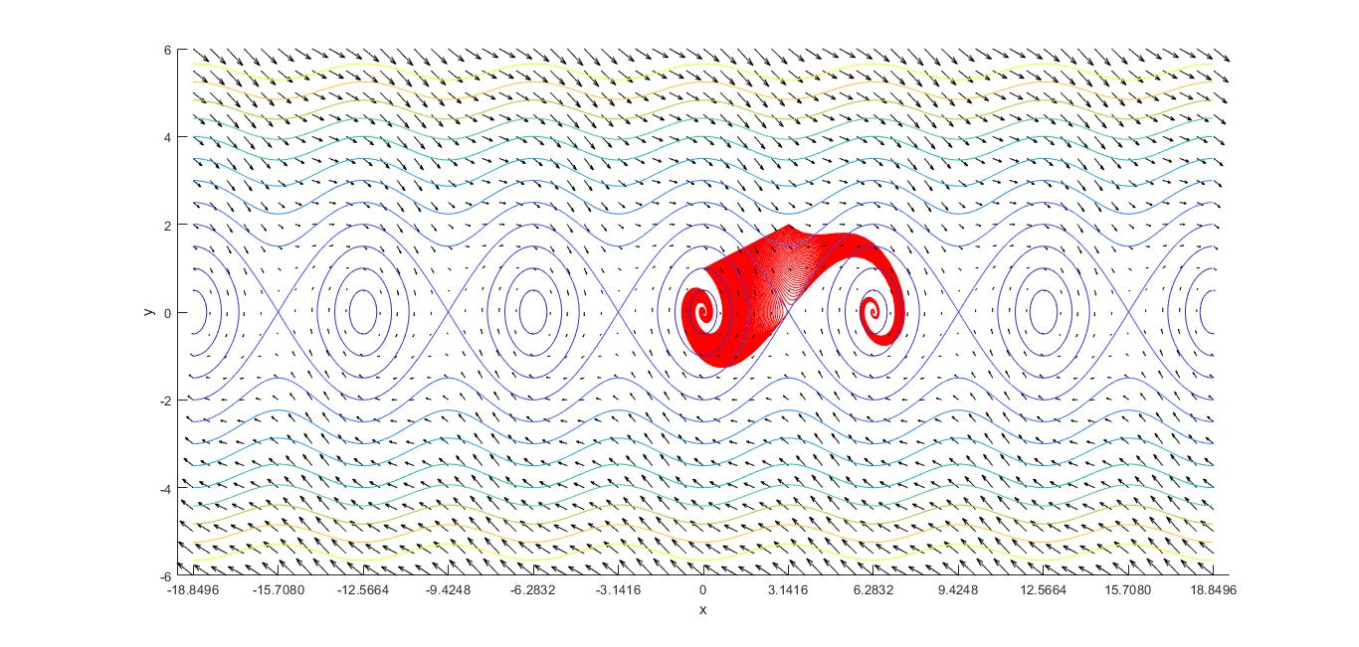
Show the equilibrium points!
Instable fixed points (saddle points are harder to catch)
Trajectories will not stay there, only get close to them
1. start many trajectories from a line (b=0.5)

Slide 9
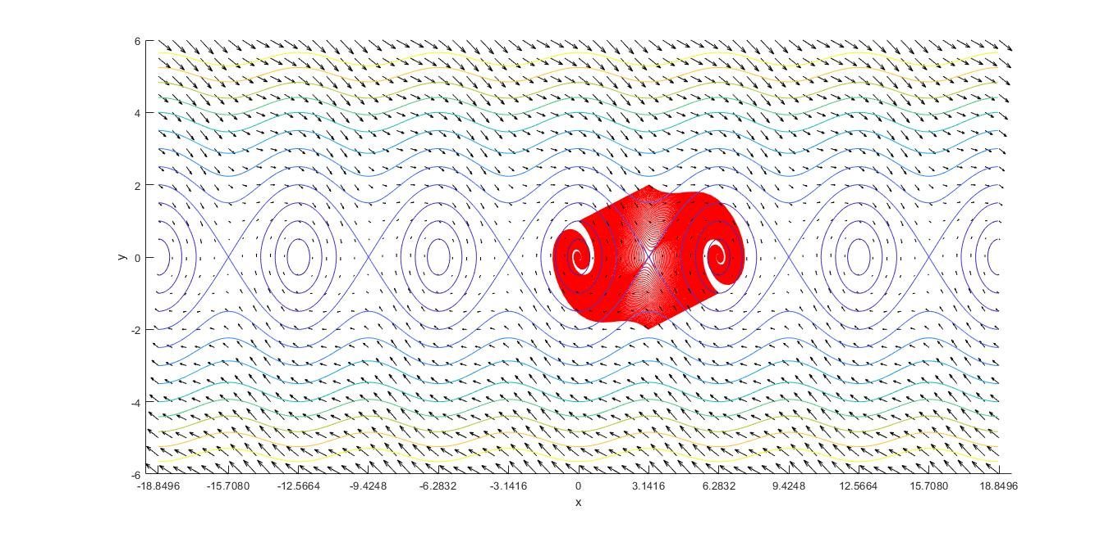
Show the equilibrium points!
Instable fixed points (saddle points are harder to catch)
2. start many trajectories from 2 lines (b=0.5)

Slide 10
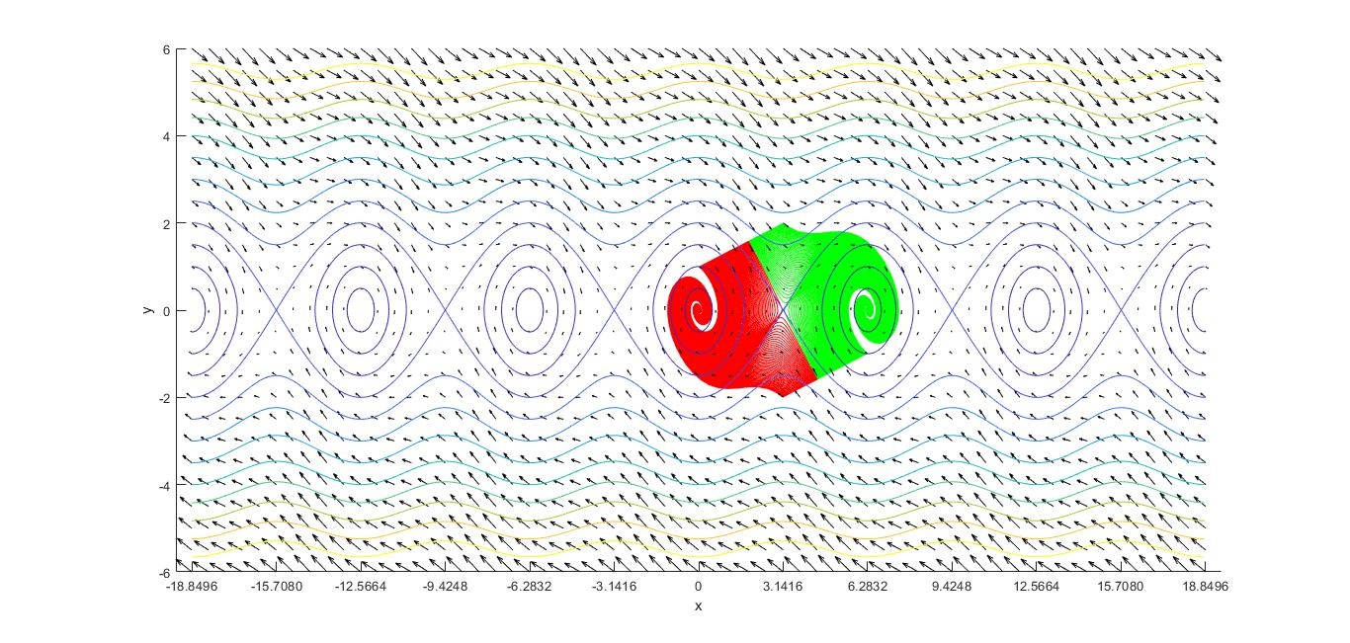
Show the equilibrium points!
Instable fixed points (saddle points are harder to catch)
3. start many trajectories from 2 lines (b=0.5)
Color the trajectories based on there attractor

Slide 11
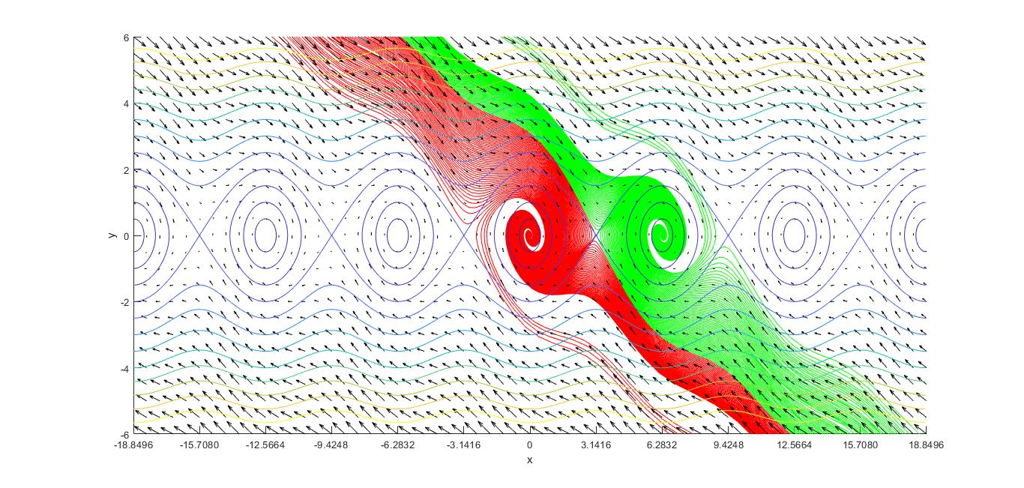
Show the equilibrium points!
Instable fixed points (saddle points are harder to catch)
4. start many trajectories from 2 lines (b=0.5)
Color the trajectories based on there attractor
Turn back time (calculate not only f(x), but also -f(x)) to see the entire separatrix

Slide 12
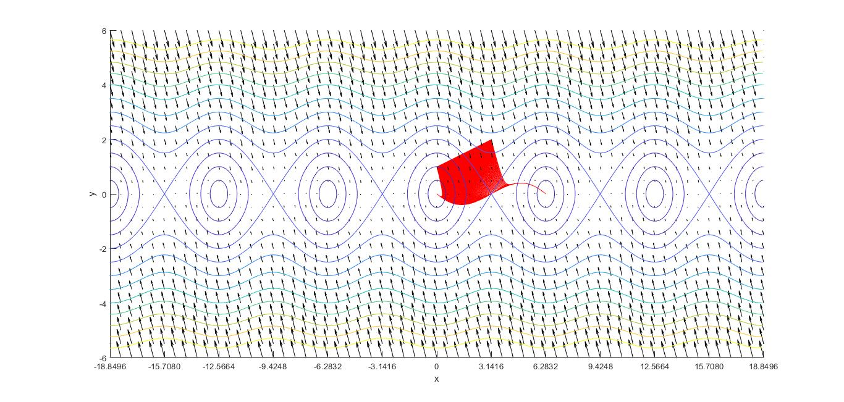
Show the equilibrium points!
Instable fixed points (saddle points are harder to catch)
Trajectories will not stay there, only get close to them
1. start many trajectories from a line (b=2.5)

Slide 13
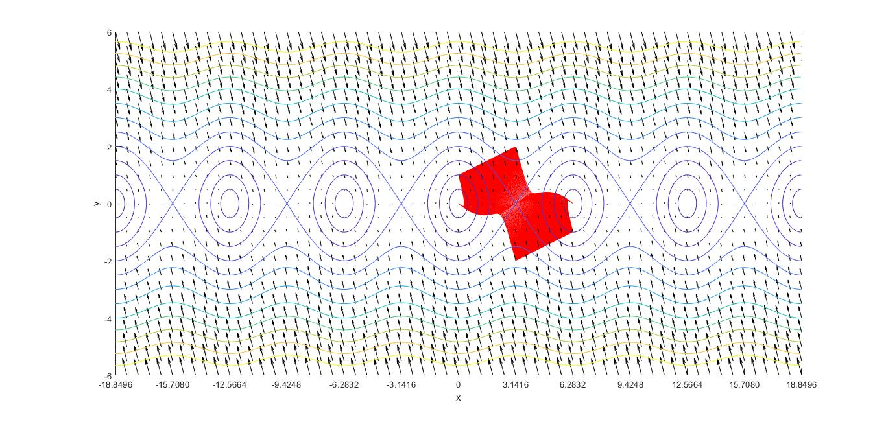
Show the equilibrium points!
Instable fixed points (saddle points are harder to catch)
2. start many trajectories from 2 lines (b=2.5)

Slide 14
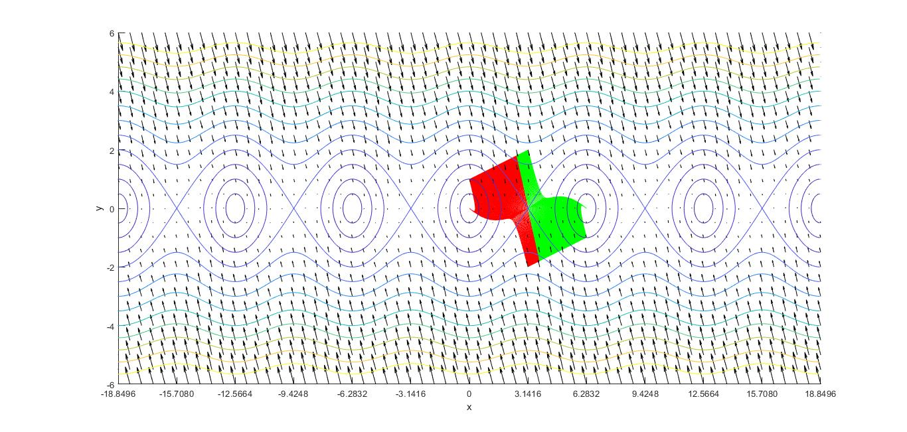
Show the equilibrium points!
Instable fixed points (saddle points are harder to catch)
3. start many trajectories from 2 lines (b=2.5)
Color the trajectories based on there attractor

Slide 15
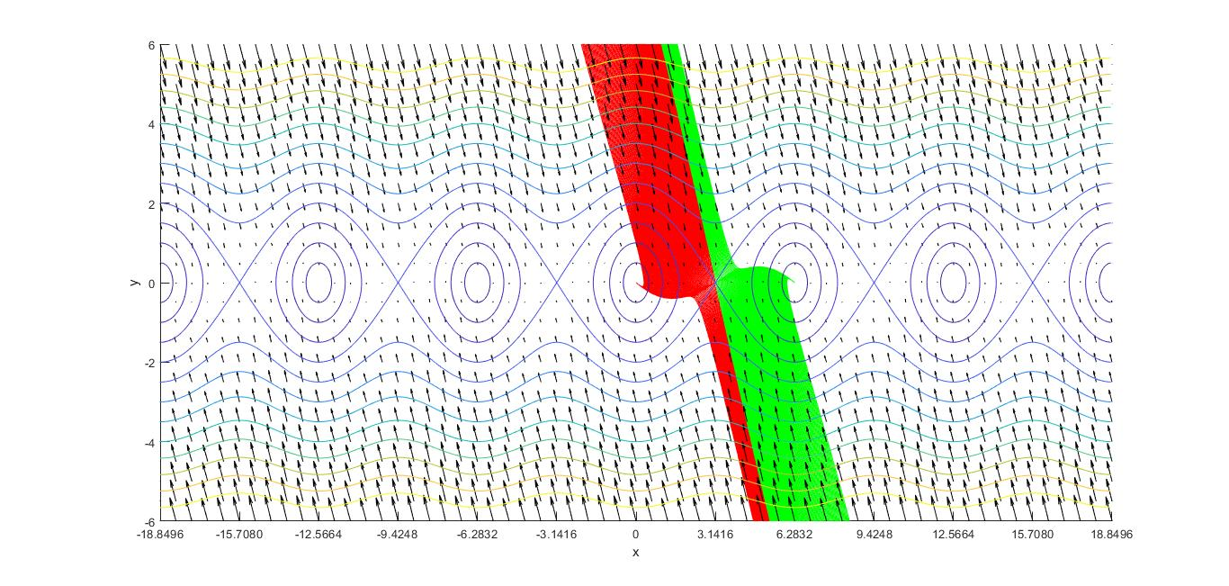
Show the equilibrium points!
Instable fixed points (saddle points are harder to catch)
4. start many trajectories from 2 lines (b=2.5)
Color the trajectories based on there attractor
Turn back time (calculate not only f(x), but also -f(x)) to see the entire separatrix

Slide 16
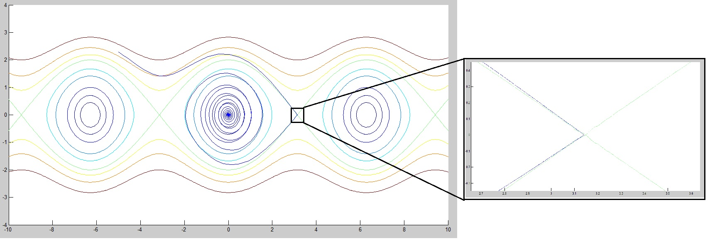
Bolzano shooting
Approach a saddle point with 1.0e-6 precision! (Give the initial x,y coordinates of the trajectory!)

Slide 17
Thank you for your attention!

