Slide 1
The role played by the nervous system to ensure survival
Réka Szabó
2019. 09. 17.
Notes:
I’d like to welcome everyone. I’m going to talk about the role played by the nervous system in surviving. Firstly I’d like to talk a bit about the nervous system and it’s functions, and after that I’d like to introduce you the nociceptors, which play a main part of keeping us alive.

Slide 2
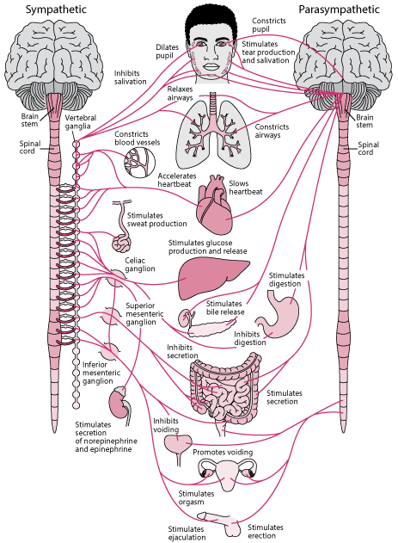
The nervous system
One of the main organ systems
Transports information
Controls the other organ systems
Three main functions:
Collects input
Understands input
Makes response
https://www.msdmanuals.com
Notes:
The nervous system is one of the main organ systems in the body. The nervous system is a network of specialized cells, which transport information about the environment and itself, and also controls the other organ systems in the body.
The nervous system has three main functions:
collects input from the body and the environment
understand and process the sensory input
make a proper response to the input

Slide 3
Surviving
Recognize danger and make a decision
The principal: attack or run
Nociceptors help us to be able to act immediatelly
Experience of the pain indicates damage
Three effect can cause damage:
High pressure
Strong chemical effect
Extremly high temperature
https://www.reddit.com
Notes:
Every animal has to recognize the danger immediately and have to make a decision: attack the threatening one or run away. In danger, the nervous and the hormonal system produce adrenalin and cortisol and affect all organs to be able to attack or run away.
To survive it’s also really important to be able to respond to the environment in every minute - for example if we touch fire, be able to pull away our hand from the fire immediately to not burn it. In this the nociceptors help us, what are the pain receptors in the body. The experience of the pain indicates the damage of the tissue, so these receptors have a high threshold.
There are three main environmental effects, that can cause damage to the tissue:

Slide 4
Nociceptors
Mechanical: react to high pressure, tightness and tissue deformations
Thermal: sensitive for high temperature
Chemical: sense chemical substances
Sleeping/silent: most unsensible, react when the axon’s end is damaged
Polymodal: sensible more than one effect
Notes:
mechanical nociceptors: these nociceptors react to high pressure, tightness and the deformations of the tissue and also indicate the tear of the tissue. Their sensitivities are raised by the transient receptor potential (TRP) ion channels in their axon’s membrane. These channels are opening by the effect of the membrane deformations and allows ions to move through the channels.
thermal nociceptors: these receptors are sensitive for high temperature (43 Celcius or above), which can cause the damage of the tissue. It also contains TRP channels.
chemical nociceptors: this kind of nociceptors sense chemical substances, which cause pain. It also contains TRP channels, mostly TRPVs.
sleeping/silent nociceptors: these are the most unsensible nociceptors. These receptors don’t contain TRP channels, only reacts when the axon end is damaged or there is an intensive inflammation reaction.
polymodal nociceptors: the nociceptors listed above are sensible for only one effect, but polymodal nociceptors are sensible more than one effect.

Slide 5
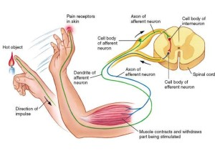
Pain sensible neurons
Both in the spinal cord and in the brain
Spinal cord:
In the ganglion spinale
pseudounopolars: not affect the stimulus, only a „nutrition central”
Brain:
Contain somatosensory fibers
Axons reach the brain stem in the cranial nerve
Protopathic fibers create the spinal trigeminal nucleus
http://northshorechiro.co.nz
Notes:
There are pain sensible neurons in both the spinal cord and in the brain.
In the spinal cord, these neurons are in the ganglion spinale where the other sensory neurons are. The pains sensible neurons are pseudounopolars like the other sensory neurons, so they not affect the stimulus, it’s only a “nutrition central”.
The pain sensible neurons in the brain contain somatosensory fibers. These neuron’s central axons reach the brain stem in the cranial nerve, but after this, the protopathic fibers create the spinal trigeminal nucleus.

Slide 6
Thank you for your attention!
https://study.com/academy/lesson/functions-of-the-nervous-system.html
http://www.valloagnes.hu/content/view/page:Stressz/p:63
https://www.tankonyvtar.hu/hu/tartalom/tamop412A/2011-0094_neurologia_hu/ch03s04.html

