Slide 1
Organization rules of the spinal cord Distribution and function of neurons
Áron ErdÉlyi

Slide 2
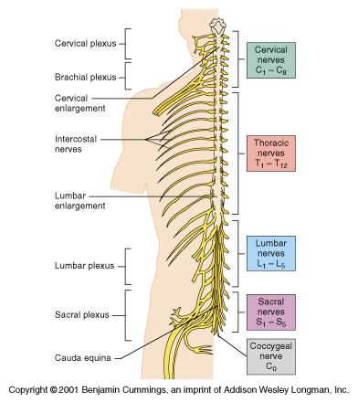
Notes:
The spinal cord is one of two main parts of the CNS. It’s main job is to connect the brain to the PNS. The spinal cord exits the skull through a cavity called that is named the foramen magnum, and it goes down the vertebral column.
The spinal cord is divided into 31 segments, each segment outputs a pair of spinal nerves. These are categorized by their location. There are 8 cervical segments, 12 thoracic segments, 5 lumbar segments, also 5 sacral segments, and a single coccygeal segment.
There are two locations along the cord, that are enlarged compared to the other locations. The cervical and the lumbar enlargements. These parts contain more neurons to supply the limbs.
The grey and white matter composition changes in the segments based on the needs of the particular spinal nerve pair.

Slide 3
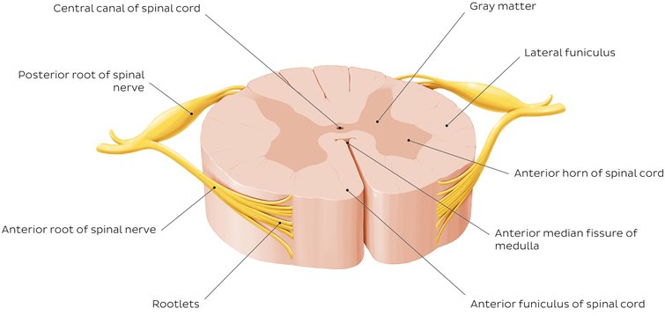
Notes:
At any level of the spinal cord, we can find a butterfly-shaped region of grey matter surrounded by white matter. The grey matter is made up of the cell bodies of the neurons while the white matter consits of axons, that travel up the spinal cord to the brain, or down, to the PNS.
There is a small groove called the posterolateral sulcus where dorsal roots enter the cord carrying sensory information. There is another groove at the front of the cord called the anterolateral sulcus, from where ventral roots leave to carry motor information to the muscles.
The grey matter is divided into three regions.
1) The posterior horn contains neurons, that make connections within the spinal cord called interneurons, and other neurons that are ascending, carrying information to the brain.
2) The anterior horn contains the perikaryon of motor neurons that go to skeletal muscles.
3) The intermediate grey matter has some characteristics of both areas around it, but also contains neurons targeting automatic functions e.g.: heart rate and respiration.
The white matter of the spinal cord consists of bundles of ascending and descending fibers, that carry sensory information to the brain and motor information to the body.
1) The back of the spinal cord contains the posterior funiculi, that carry information about touch and limb position to the brain.
2) The lateral funiculi carries important pain pathways as well as important descending pathways that are responsible for causing movement.
3) The anterior funiculi contain various ascending and descending pathways.

Slide 4
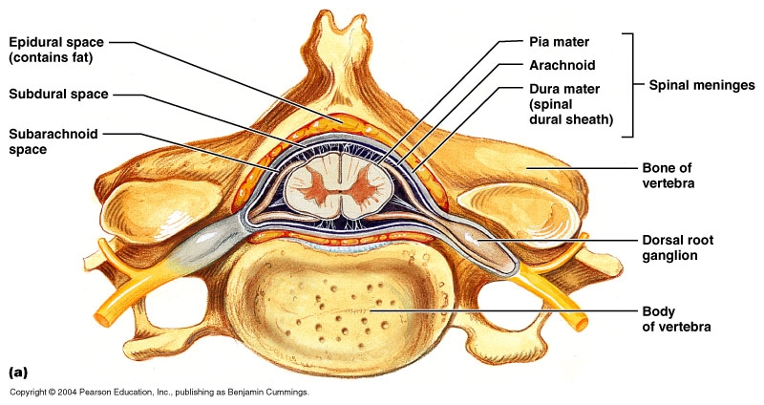
Notes:
The cord is surrounded by a three layer membrane membrane called respectively from inside out:
the piamatter
the arachnoid membrane
and the duramatter
but the cord ends before the end of this protective membranes, and the spinal nerves that leave the cord from segments below this level have to travel down through the vertebral canal untill they reach the appropriate segment.
Also the bones surrounding the spinal cord is a huge factor in protection.

Slide 5
sources
Content:
Zsolt Liposits. SPINAL CORD. Basics of Neurobiology.
Zsolt Liposits. INTERNAL STRUCTURE OF SPINAL CORD. Basics of Neurobiology.
Armando Hasudungan. SPINAL CORD INTRODUCTION.
Schoenen J. THE DENDRITIC ORGANIZATION OF THE HUMAN SPINAL CORD: THE DORSAL HORN. Neuroscience.
Images:
https://www.apsubiology.org/anatomy/2010/2010_Exam_Reviews/Exam_4_Review/CH_12_Gross_Anatomy_of_the_Spinal_Cord.htm
https://www.kenhub.com/en/library/anatomy/the-spinal-cord
https://accessphysiotherapy.mhmedical.com/data/Multimedia/grandRounds/pnervsystem/media/pnervsystem_print.html
http://faculty.etsu.edu/forsman/ftl_3_presentation/peripheral%20nervous%20system.htm

