Slide 1
channel gating during an action potential
Kertész Borbála
I1GTYJ
2019.10.17.

Slide 2
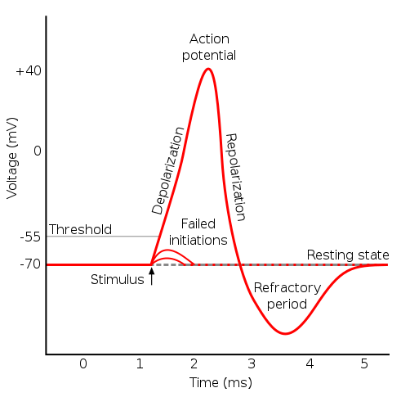
gating of action potential
change in membrane potential from a resting value of about -70 mV to a peak of about +30 mV, and back to -70 mV again
results from a rapid change in the permeability of the neuronal membrane to sodium and potassium due to opening and closing of voltage-gated channels
depolarization – sodium ion channels open due to an electrical stimulus -> charge inside is raised by Na+ ions
action potential – produced when treshold is reached -> maximum response is elicited
repolarisation – raised charge makes Na+ channels close, K+ channels open -> K+ ions move out (electrochemical gradient) -> membrane potential falls -> approaches resting potential
hyperpolarisation – makes up for repolarisation overshots -> refractory period

Slide 3
what is gating?
opening (activation) or closing (by deactivation or inactivation) of ion channels
Closed (non-conducting) state - impermeable to ions and do not conduct electrical current
Open (conducting) state – ion channels conduct electrical current by allowing specific ions to pass through the plasma membrane
-> electrical current across the membrane
causes
changes in voltage across the cell, drugs, hormones, changes in temperature, stretching or deformation of the cell membrane, addition of a phosphate group to the ion channel (phosphorylation), interaction with other molecules in the cell (e.g., G proteins), etc
states
activation, deactivation, inactivation, and reactivation (also called 'recovery from inactivation’)
types
voltage-gated, ligand-gated

Slide 4
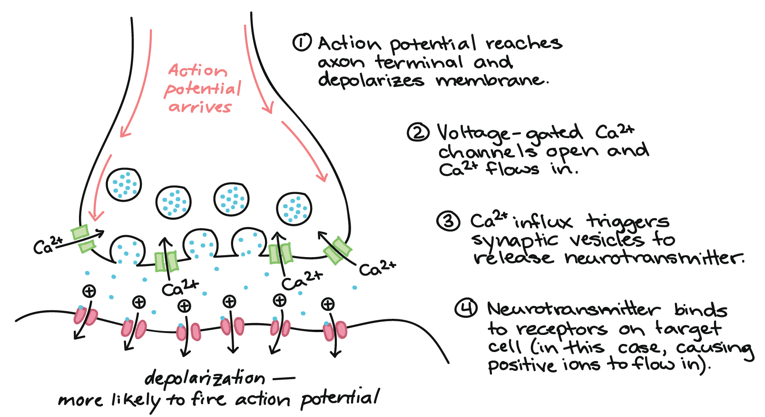
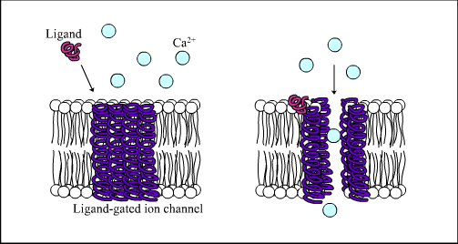
activation
voltage-gated ion channels react to the voltage differential across the membrane -> parts of the channel domain act as voltage sensors
the membrane is depolarized -> change in electrostatic forces moves the voltage-sensing domain -> the conformation of the channel changes -> the pore opens
for example - Na+, Ca+ in presynaptic signalling
ligand gated - the transmembrane ion-channel protein opens to allow ions to pass through in response to the binding of a chemical messenger (ligand, eg. a neurotransmitter) to an extracellular receptor on or near the channel on posynaptic neurons -> conformational change -> pore opens -> ion permeation
for example – AMPA, GABAA, nicothinic-ACh-R
glycine receptors – activated by eg. taurine
Notes:
Voltage-gated ion channel. When the membrane is polarized, the voltage sensing domain of the channel shifts, opening the channel to ion flow (ions represented by yellow circles).
Sodium (Na⁺) channels are some of the main ion channels responsible for action potentials.
Calcium (Ca²⁺) channels regulate the release of neurotransmitters at synapses, control the shape of action potentials made by sodium channels, and in some neurons, generate action potentials.
.
α-amino-3-hydroxy-5-methyl-4-isoxazolepropionic acid receptor
ability to be activated by the artificial glutamate analog AMPA
.
(GABA_{A}R) is an ionotropic receptor and ligand-gated ion channel
Upon activation, the GABA_{A} receptor selectively conducts Cl⁻ through its pore. Cl- will flow out of the cell if the internal voltage is less than resting potential and Cl- will flow in if it is more than resting potential (i.e. -75 mV)^{[4]}. This causes an inhibitory effect on neurotransmission.

Slide 5
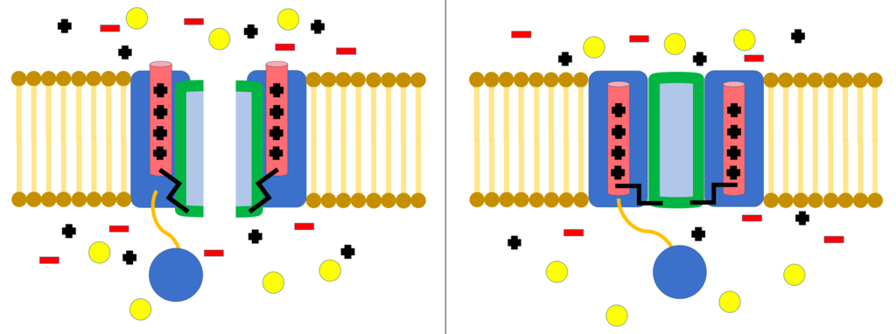
deactivation
closing of the ion channel pore
voltage-gated channels
voltage differntial returns to resting value
membrane potential becomes more negative
ligand-gated channels
ligand dissociates from the cannel’s receptor binding site

Slide 6
inactivation
the flow of ions is blocked by a mechanism other than the closing of the channel
channel in open state stops allowing ions to flow through
a channel in closed state may be preemptively inactivated to prevent the flow of ions
starts by depolarization off cell membrane, ends with the restoration of resting potential
examples:
ball and chain inactivation (N-type or hinged lid inactivation) – voltage-gated
NMDA receptor
iontropic glutamate receptor activated by glutamate and glycine bonding to it – opening is ligand-gated
flow of ion current is voltage dependent (Na+, Ca+)
can be blocked by Mg+ (Zn2+, Cu2+) – voltage dependent
Notes:
4 α subunits, one or more of which will have a ball domain located on its cytoplasmic N-terminus
ball domain is electrostatically attracted to the inner channel domain -> ion channel is activated, the inner channel domain is exposed -> chain folds and the ball enters the channel -> ion permeation
channel returns to closed state -> channel domain is blocked -> ball leaves the pore
-----------
N-methyl-D-aspartate receptor
NMDA receptor is very important for controlling synaptic plasticity and memory function.^{[3]}
NMDA receptor is activated by the binding of two co-agonists, the cation channel opens, allowing Na⁺ and Ca²⁺ to flow into the cell, in turn raising the cell's electric potential. Thus, the NMDA receptor is an excitatory receptor. At resting potentials, the binding of Mg²⁺ or Zn²⁺ at their extracellular binding sites on the receptor blocks ion flux through the NMDA receptor channel.

Slide 7
thank you for your attention
https://www.cell.com/neuron/fulltext/S0896-6273(00)81133-2?_returnURL=https%3A%2F%2Flinkinghub.elsevier.com%2Fretrieve%2Fpii%2FS0896627300811332%3Fshowall%3Dtrue
https://en.wikipedia.org/wiki/Ion_channel
https://en.wikipedia.org/wiki/Gating_(electrophysiology)
https://en.wikipedia.org/wiki/Voltage-gated_ion_channel
https://www.ncbi.nlm.nih.gov/pmc/articles/PMC2867094/
https://www.ncbi.nlm.nih.gov/pmc/articles/PMC3291986/
https://www.britannica.com/science/ion-channel
https://www.ncbi.nlm.nih.gov/books/NBK10883/
https://teachmephysiology.com/nervous-system/synapses/action-potential/

