Slide 1
Peptide transmitters target metabotropic receptors
Szirt Viktória

Slide 2
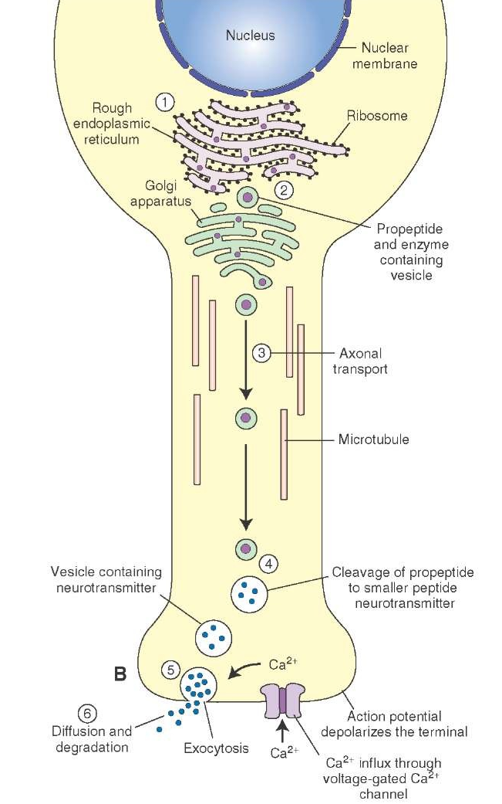
Peptide transmitters
2 major type of neurotransmitters:
amine
peptide
Examples:
endorphin
insulin
oxytocin
vasopressin

Slide 3
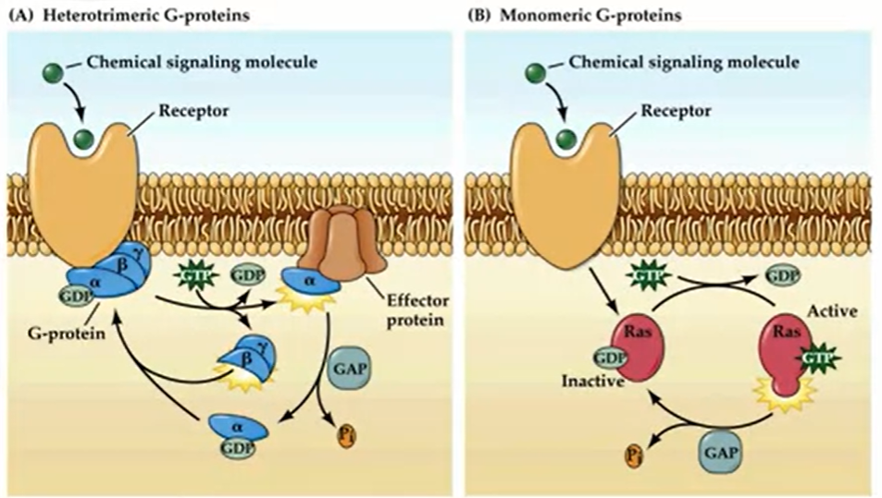
Metabotrobic receptors
G-protein coupled receptors

Slide 4
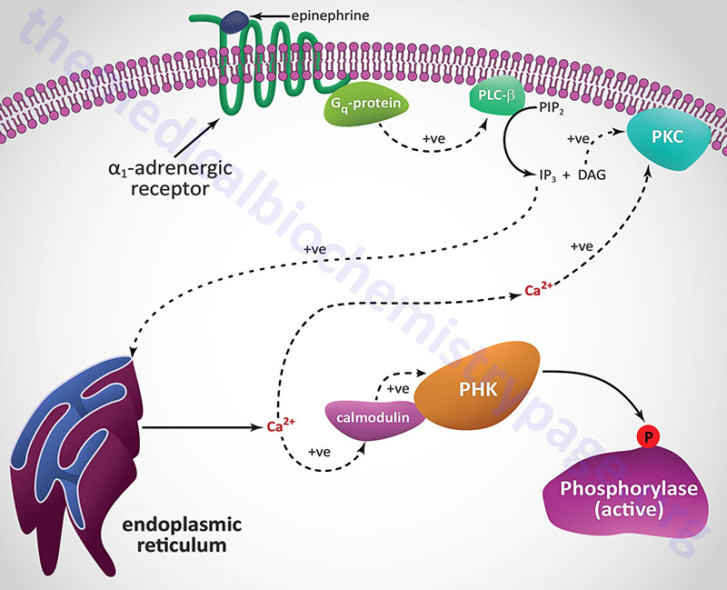
Second messenger-pathways
Advatages:
high-level amplification,
diversity
long term changes

Slide 5
Sources
http://what-when-how.com/wp-content/uploads/2012/04/tmp1466.jpg
https://users.itk.ppke.hu/neurobiologia
http://themedicalbiochemistrypage.org/peptide-hormones.php#receptors https://www.coursera.org/lecture/medical-neuroscience/metabotropic-neurotransmitters-receptors-and-postsynaptic-mechanisms-vvyfY https://www.khanacademy.org/science/biology/human-biology/neuron-nervous-system/a/neurotransmitters-their-receptors
https://en.wikipedia.org/wiki/Neuropeptide

Slide 6
Thank you for your attention

