Slide 1
Dependence of the transmitter effect on the physiological status of the postsynaptic cells
Szemenyei Adrián László

Slide 2
Chemical synaptic communication, Postsynaptic potential
Action potential invades the presynaptic terminal
Ca2+ influx
neurotransmitter exocytosis
transmitter binds to the postsynaptic receptors
PS ion channels open (or close) – conductance change
Conductance change generates PSC
The change of the PS membrane potential produces PSP

Slide 3
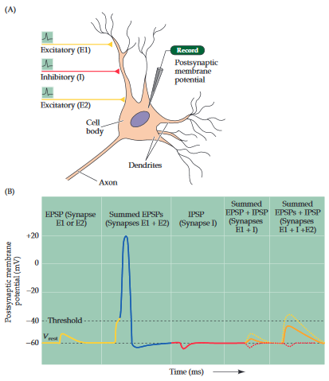
Postsynaptic potential(2.)
Excitatory postsynaptic potential (EPSP)
Inhibitory postsynaptic potential (IPSP)
Depends on the type of channel that is coupled to the receptor, and on the concentration of permeant ions inside and outside the cell.
Excitatory transmitters: Acetylcholine, Glutamate: increase the permeability to sodium
Inhibitory transmitters: GABA, glycine: opens potassium and/or chloride channels
PSPs produced by active synapses sum up

Slide 4
Dependence of the transmitter effect by the postsynaptic neuroreceptors
Ionotropic (short lasting PSP) and metabotropic (long lasting PSP) receptors
Neurotoxins targeting neurotransmitter receptors ( alpha-bungarotoxin irreversible binding, strychnine blocks inhibitory glycinergic receptors )
Blocking the neurotransmitter termination (Organophosphate inhibits Ache)
The number and the lifespan of the receptors, up and down-regulation
Banded krait

Slide 5
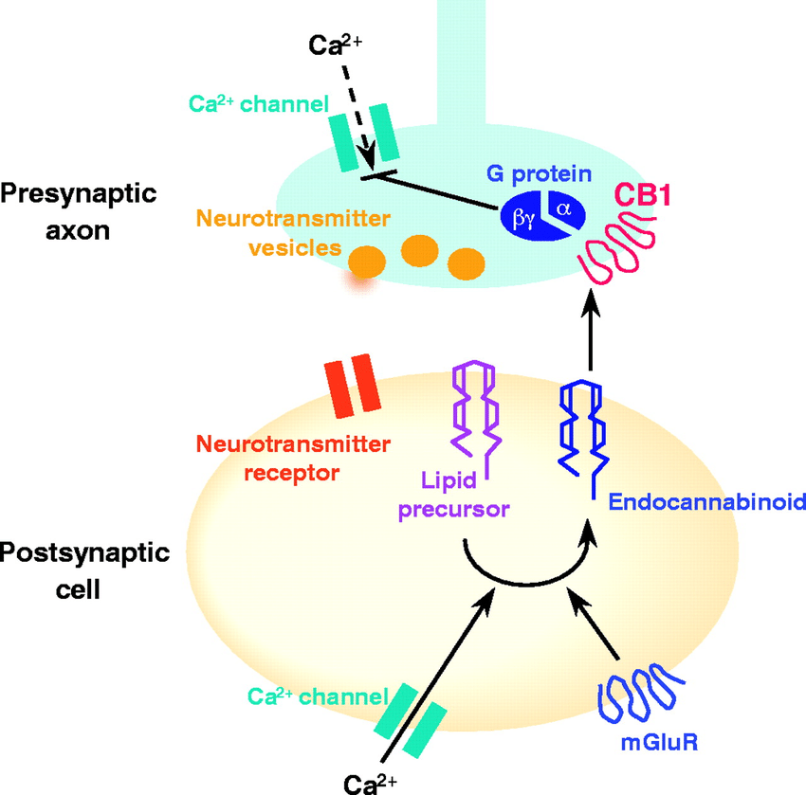
Retrograde synaptic mechanism
Some unconventional neurotransmitters (e.g. anandamide and nitric oxide) can also change the synaptic transmission
Signaling from the postsynaptic cell to the presynaptic cell
Regaulation of GABA release by endocannabinoids
Notes:
Retrograde signaling by endocannabinoids: Postsynaptic depolarization opens voltage-dependent Ca 2+ channels; postsynaptic Ca 2+ then activates enzymes that synthesize endocannabinoids from lipid precursors. Activation of postsynaptic metabotropic glutamate receptors (mGluRs) can also generate endocannabinoids. Endocannabinoids then leave the postsynaptic cell and activate presynaptic CB 1 receptors. G-protein activation liberates G βγ , which then directly inhibits presynaptic Ca 2+ influx. This decreases the probability of release of a vesicle of neurotransmitter

Slide 6
Sources:
DALE PURVES, GEORGE J. AUGUSTINE,(…) - Neuroscience
Postsynaptic potential - https://www.britannica.com/science/postsynaptic-potential
Liqun Luo – Principles of Neurobiology
Larry Squire, Darwin Berg, (…) – Fundamental Neuroscience
Synapses and Neurotransmission - http://learntech.uwe.ac.uk/synapsesNeuro/Default.aspx?pageid=1918
Basics of Neurobiology lecture slides

