Slide 1
Involvement of glial cells in transmitter synthesis and elimination from the extracellular space
Novák Bereniké

Slide 2
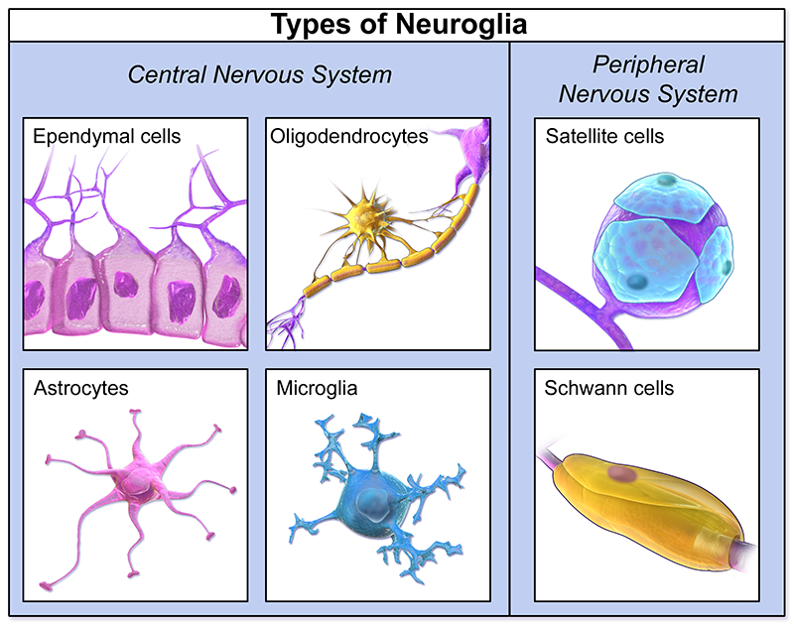
Glial cells
Part of the nerve fibers
Central nervous system:
astrocytes
oligodendrocytes
microglia
ependymal cells
Peripheral nervous system:
Schwann cells
Satellite cells

Slide 3
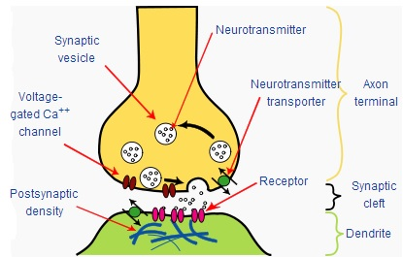
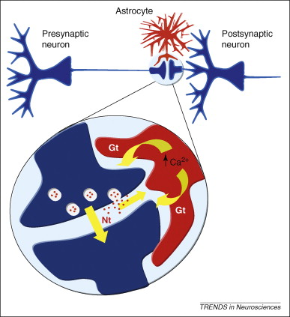
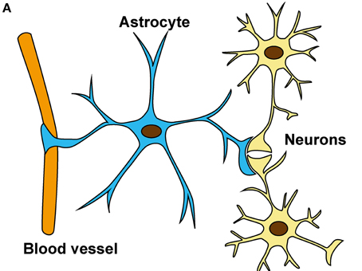
Glial cells in synapses
The tripartite synapse
Astrocytes:
Release the neurotransmitters
Affecting the neuron calcium level
Affect synaptic transmission

Slide 4
Formation and oxidation of glutamate

Slide 5
Thank you for your attention!
Sources:
https://link.springer.com/referenceworkentry/10.1007%2F978-1-4939-3474-4_19
https://qbi.uq.edu.au/brain-basics/brain/brain-physiology/types-glia
https://www.verywellhealth.com/what-are-glial-cells-and-what-do-they-do-4159734
https://www.frontiersin.org/articles/10.3389/fnins.2015.00499/full
https://alieastrocyte.wordpress.com/2015/08/04/threes-company-the-tripartite-synapse/
https://www.mdpi.com/2079-7737/6/1/17/htm

