Slide 1
The common and differing features of amine and peptide transmitter synthesis and release
Kastal Csilla Noémi

Slide 2
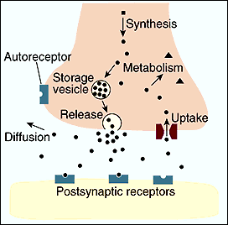
Life cycle of the neurotransmitters
Neurotransmitters: substances, produced by neurons, for the purpose of transmitting information between two nerve cells
2 groups:
Classic amine type
Non-classic peptide type
Life cycle of the neurotransmitters
Synthesis
Packaging into vesicles
Vesicle fusion → release
Activation of postsynaptic receptors
Degradation or reuptake

Slide 3
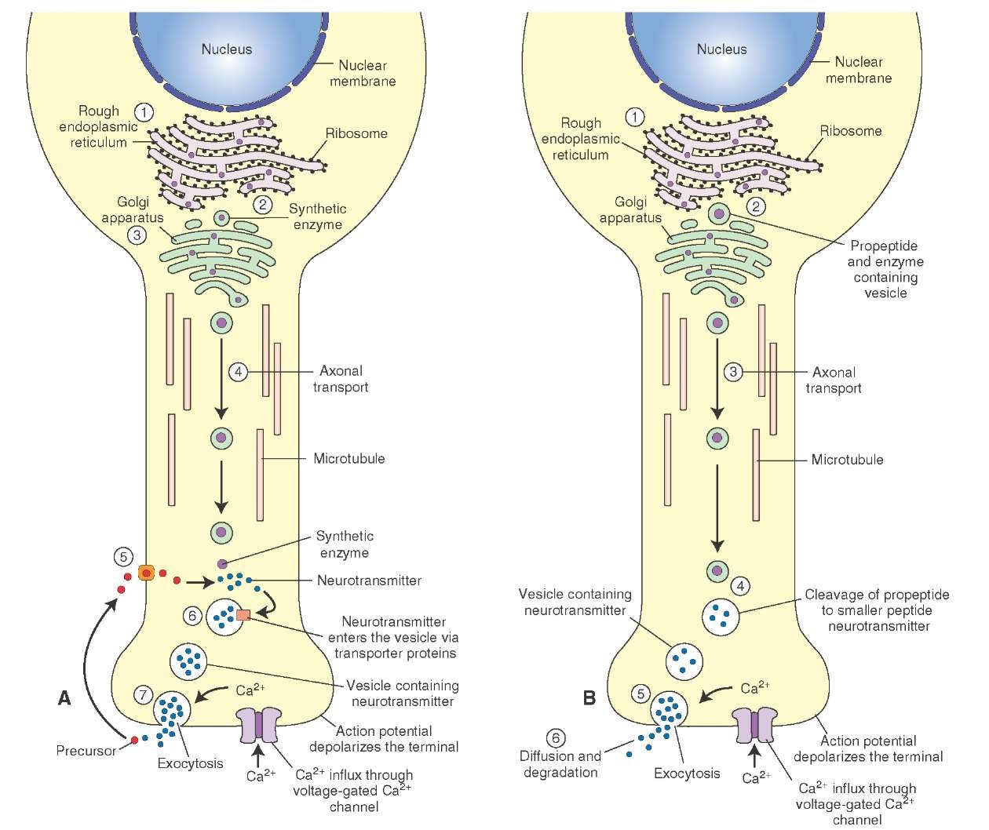
Classic amine neurotransmitters
Enzyme and storage vesicle synthesis
Transport to the Golgi apparatus
Slow axonal transport
Neurotransmitter synthesis and packaging
Vesicle fusion and release
Neurotransitter degradation
Reuptake

Slide 4
Peptide neurotransmitters
Polypeptide, precuror, enzyme and vesicle synthesis
Enzyme and propeptide packaging
Fast axonal transport
Propeptide modification
Vesicle fusion and exocytosis
Neurotransmitter degradation
No reuptake

Slide 5
 | Classic transmitters | Non-classic transmitters
Molecular weight | Less than 200 | More than 300
Synthesis | Cell body
Axonal transport | Slow axonal transport Synthesizing enzymes Storage vesicles | Fast axonal transpor Storage vesicles
Supply of constituents | Cell body Local synthesis Reuptake | Cell body
Vesicles | 40-50 nm | 80-200 nm
Reuptake | Yes | No

