Slide 1
NEUROPIL – Events, which take place in the neuropil
Jánoska Dóra Katalin

Slide 2
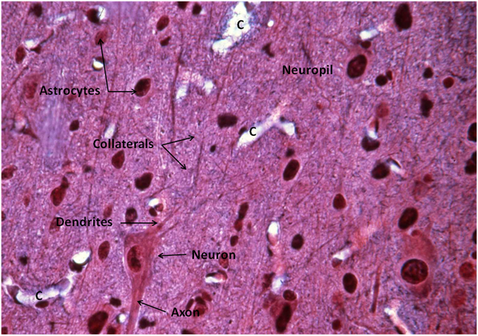
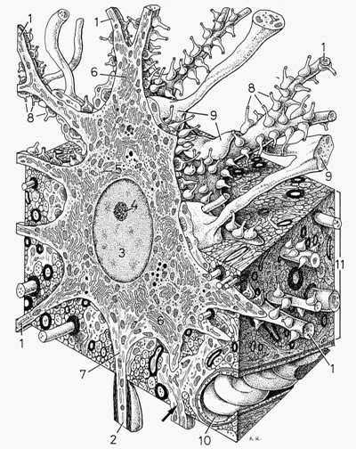
NEUROPIL = SYNAPTIC FIELD
synaptically dense region
formed by:
  unmyelinated axons
  dendrites
  glial cell processes
low number of cell bodies
central nervous system
some parts of the peripheral nervous system
1: dendrite
2: axon
11: neuropil
https://slideplayer.com/slide/8432204/
http://usdbiology.com/cliff/Courses/Behavioral%20Neuroscience/CStart/9%20Cstart%20Fundamentals%20of%20Neurocircuitry%20X.html

Slide 3
TYPES OF NEUROPIL
unstructured
structured
regular fiber configurations
repetitive substructures
diffuse
plexiform
extensively branched
rarely homogeneous
more heterogeneous
complex sensory organs
glomerular
stratified
in layers or apparently unstructured clumps
Olfactory bulb
regular, three-dimensional fiber lattice

Slide 4
EVENTS IN NEUROPIL
metabolic processes → synaptic specialization
Non-synaptic neuronal transmission = volume transmission
Gaseous substances → axon terminals
nutrients uptake
cellular respiration
the location of most complex neural activity

Slide 5
THANK YOU FOR YOUR ATTENTION!

