Slide 1
Organ systems developed and the service provided by them to ensure lifetime survival of „our mind”
Adravecz Lilla

Slide 2
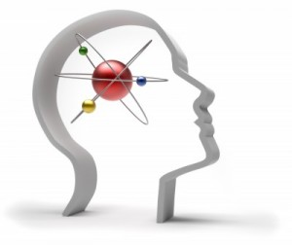
Characterization of the human „mind”
Neuronal activity of brain which enables:
      consciousness
      thinking
      perception of stimuli
      procession of feelings and emotions
      memory storage
      imagination

Slide 3
The NERVOUS SYSTEM
TWO PARTS: CENTRAL NERVOUS SYSTEM, PERIPHERAL NERVOUS SYSTEM
CONTROL AND REGULATION OF:
  BEHAVIOUR
  ENDOCRINE SYSTEM
  SENSORY AND MOTOR SKILLS
ADAPTATION TO ENVIRONMENT VIA SENSORY ORGANS
COLLECTS, TRANSFERS AND PROCESSES INFORMATION: COGNITION, LEARNING, MEMORY (HIGHEST HUMAN MENTAL ABILITIES)
PHYSICAL AND BIOCHEMICAL SUPPORT IS NEEDED

Slide 4
Physical support of some organ systems
SKELETAL SYSTEM | Physical protection from the environment (skull) Life-saving reflexes Active and intentional movement; realization of any mental decision
MUSCULAR SYSTEM

Slide 5
Biological support of some vital life-functions
VISCERAL SYSTEM | Maintainance of homeostasis Supply with nutrients, minerals, vitamins, water and electrolytes
CIRCULATORY SYSTEM | Transport of oxygen, nutrients to brain-cells; Transport of wastes, CO2 from brain-cells; Stabilization of body temperature
LYMPHATIC AND IMMUNE SYSTEM | Defense against infections and other diseases

Slide 6
Controlling and coordinating functions
ENDOCRINE SYSTEM | Various controlling functions of hormones acting as chemical messengers via bloodstream: - Homeostasis - Adaptation; - Emotions
ORGANS OF SPECIAL SENSES | Perception of stimuli from the inner and outer environment Adaptation and reactions to stimuli

