Slide 1
The receptors, first, second and third order neurons and their terminal fields of the medial lemniscus system
Lassú Bálint – Y1E7ZE
2019.11.24

Slide 2
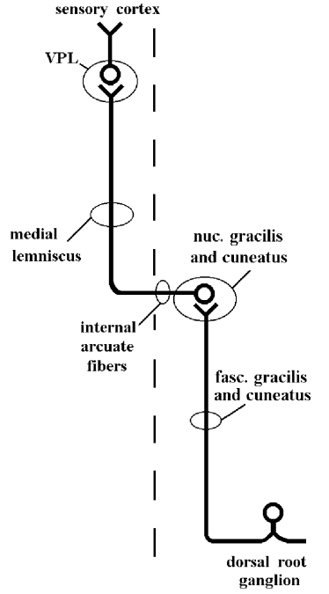
dorsal column–medial lemniscus pathway (DCML)
-Sensory pathway of CNS
-First,second,third order sensory neurons
-light touch, joint position, two point discrimination,vibration

Slide 3
Receptors
-Mechanoreceptors, joint receptors
- Astereognosia, agraphesthesia, and a Romberg’s test
- Receptive fields

Slide 4
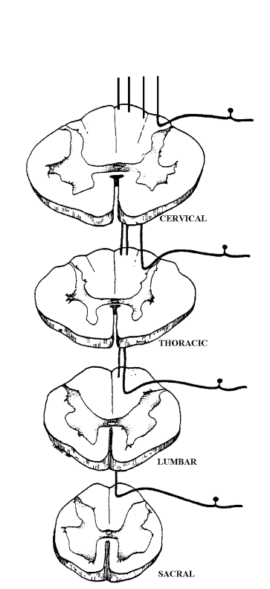
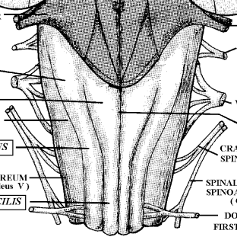
First order neurons
-Cervical → Thoracic 6 Cuneatus Fascicle
- Thoracic 6 → Sacral Gracilis Fascicle
-Terminate in dorsal, caudal medulla oblongata
- gracile-, cuneate tubercule

Slide 5
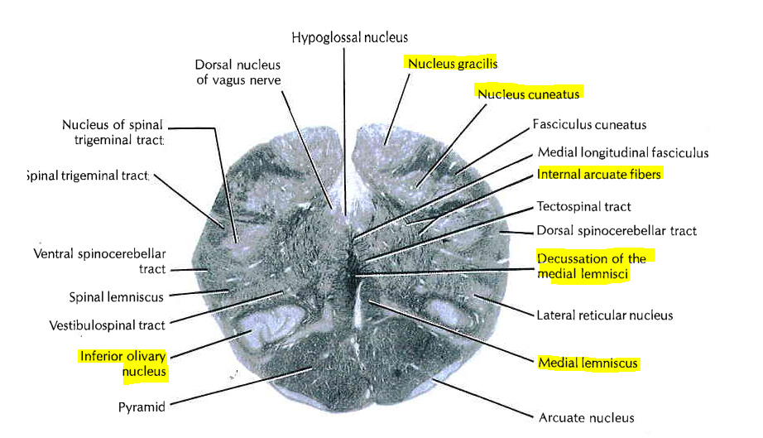
Second order neurons
→ ventral posterior (VPL) nucleus of the thalamus
→ rotation: ventral-lower, dorsal-upper sense

Slide 6
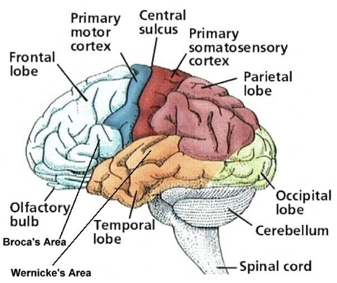
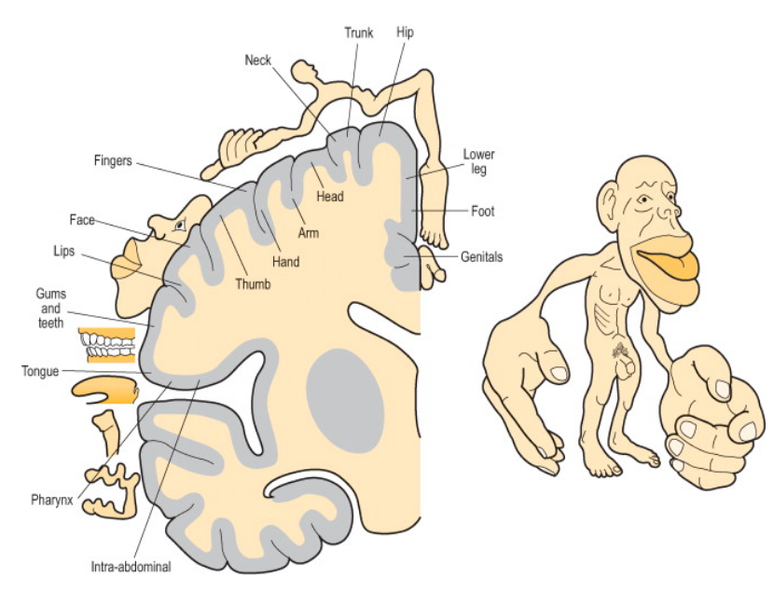
Third order neurons
→ posterior limb of the internal capsule
→primary somatosensory cortex
→cortex surface: relative density of cutaneous tactile receptors
→Brodmann 1,2,3

Slide 7
Thank you for your attention
Sources:
The Human Nervous System: An Anatomical Viewoint, Sixth Edition, Murray L. Barr and John A. Kiernan, J.B. Lippincott Company, Philadelphia, @ I993, seventh chapter
Neuroanatomy coursebook chapter 4 at http://www.neuroanatomy.wisc.edu/coursebook/webstem4-10.pdf
Journal by Adina Michael-Titus, Peter Shortland, in The Nervous System (Second Edition), 2010 chapter: The spinal cord

