Slide 1
Cranial nerves regulating eye movements, accomodation and involved in eye-protection
Lilla Simon

Slide 2
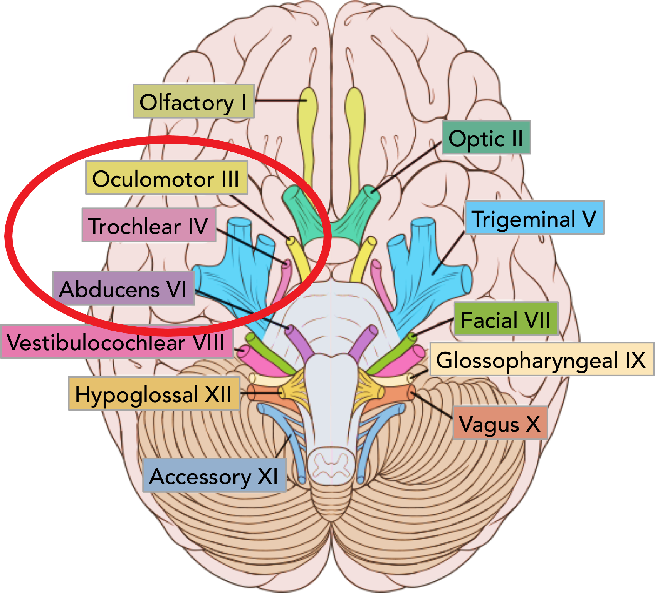
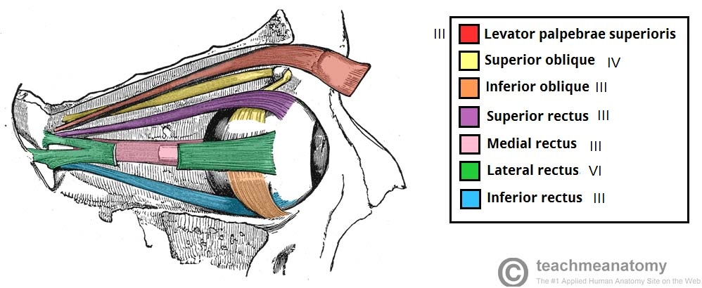
Cranial nerves
12 cranial nerves in humans
4 of them are responsible for eye movements
Fig 2.2
Muscles controlled by these three nerves
Fig 2.1

Slide 3
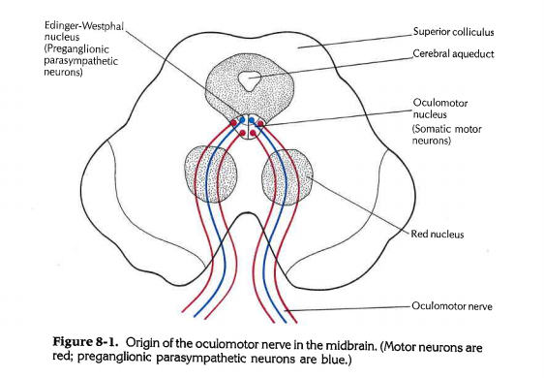
CN III: Oculomotor nerve
Controlled movements:
Lift of the upper eyelid
Moving eyeball upward/downward/medial
Constriction of pupil
Accomodation of the eye
Fig 3.1
Two nuclei for nervus oculomotorius:
Oculomotor nucleus (somatic motor) originates from mesencephalon
Edinger-Westphal nucleus (parasympathetic) is located dorsal from oculomotor nucleus
Fig 3.2

Slide 4
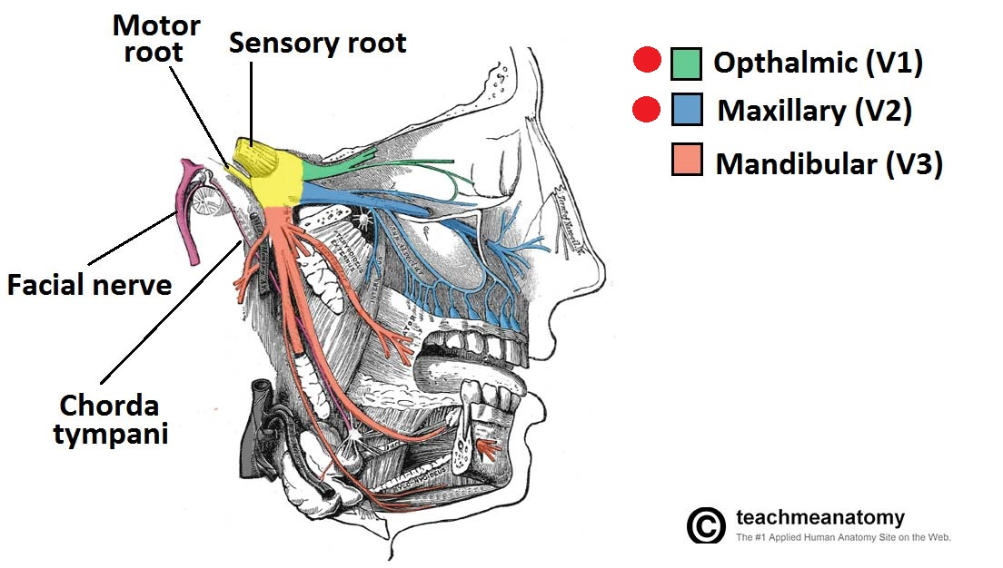
CN IV: Trochlear nerve, CN V: Trigeminal nerve CN VI: Abducens nerve
Fig 4.2
Trigeminal nerve
Trochlear and abducens nerve are only somatic motor nerves and they each affect only one muscle
Controlled movements:
Trochlear nerve: downward and lateral movement of the eye
Abducens nerve: sideway eye movements
Trigeminal nerve delivers sensation of the face to the brain
Has 3 major branches (V1, V2, V3) → V1 & V2 have a role in eye movements
Fig 4.1
Origin of trochlear and abducens nerve with their affected muscle

Slide 5
Thank you for your attention!
Sources:
Szentágothai János – Réthelyi Miklós: Funkcionális anatómia III.
Kiss Ferenc - Szentágothai János: Az ember anatómiájának atlasza
John Alan Kiernan - Murray Llewellyn: Barr’s: The Human Nervous System: An Anatomical Viewpoint
Figures
Fig 2.1: Brain_human_normal_inferior_view.svg: Patrick J. Lynch, medical illustrator
Fig 2.2
Fig 3.1:John Alan Kiernan - Murray Llewellyn: Barr’s: The Human Nervous System: An Anatomical Viewpoint
Fig 3.2: Anatomy Q&A
Fig 4.1
Fig 4.2

