Slide 1
Neuromorph Movement control
Introduction
József LACZKÓ PhD, Balázs Radeleczki
08. 02. 2022

Slide 2
Personal references
LJ
Balázs Radeleczki, practice leader
Phd candidate of Roska Tamás Doctoral School of Sciences and Technology. Research theme: Info-bionics algorithms
e-mail: balazs.radeleczki@gmail.com
radeleczki.balazs@itk.ppke.hu

Slide 3
Main points of the semester
Redundancy problem
Overcompletness
Movement patterns - action patterns
Sensory systems and Motor systems
Sensory-motor transformations
Extrinsic and intrinsic geometry

Slide 4
Requirements of the course
80% participation on the lectures (max. 3 absence)
80% participation on the practices (max. 3 absence)
Midterm exam (at least 50% performance)
Retake exams (at least 50% performance)
Final exam at least 50%
Cheating is strongly forbidden!

Slide 5
Owerview of this lecture
Definition of motor task to execution
The relation between modeling and experimental methods
Elementary definitions
Kinematics
EMG (electromyography)
Types of data acquisition of 3D joint coordinates
Optical (Vicon)
Ultrasound (Zebris)
Case study of arm movements to show EMG’s

Slide 6
General model
Movement planning
(premotor cortex)
Movement command
(motor cortex)
Motor Task
sensing
Execution
(spinal motoneurons, muscles)
Cooperation of sensory and motor systems!

Slide 7
Examples
Movements of the upper extremity (human arm)
Pointing movements (reaching)
Tracking movements (moving the index finger along a trajectory)
Grasping (grasping a given object)
Movements of the lower extremity (human leg)
Walking
Cycling
OthersEye movements („ one joint system”)
Head-Neck movements

Slide 8
Realtion between modeling and experiment
Mathematical model
Experimental protocol
Planning of the experiment (what? who? how? with?)
Computer simulation (MATLAB, Python)
Measured data
Importance of specification (space, time, sampling rate)
Movement analisys
Model adjustment
Comparision

Slide 9
„Which parameters are controlled
and what can be measured experimentally?”
From physical point of view :
Dynamics
Kinematics
From biological-biomechanical:
Firing frequency of neurons in the central nervous system (CNS)
Communication of neurons
Muscle activity patterns, Electromyogram (EMG)
Joint rotations (Torques)
AIM: to investigate the relation between kinematical movement patterns and neurobiological processes
Neuromorph movement control

Slide 10
Levels of motor control and execution
CNS
(central nervous system)
electric signal
Muscle
contraction
Joint
rotation
Limb
displacement

Slide 11
Comparison
Kinematics
(study of geometric properties of motion as function of time)
Definition of an object’s position according to a reference frame at a certain instant
Linear algebric processing of measured coordinates (vector algebra)
MEASUREMENT (recording the coordinates of a moving point):
Computer controlled movement analyzer
Sampling Frequency: depends on the motor task (velocity of motion) and on number of mmeasured points
EMG (ElektroMyoGram)
the CNS send commands
To invoke muscle force
Electronic potential on muscle fibers (mV,uV)
MEASUREMENT
Invasive and non-invasive
(surface or implanted electrodes)
Minimalization of artefacts
Depilation
Cleaning and shaving the surface of the skin

Slide 12
How does it possible?
We are placing markers on anatomical landmarks (joints).
Different marker types:
Active = Transmitter (transmitts a given signal)
Passive = Receiver (receives the transmitted signal)
Movement Analyzer (MA) systems:
Optical markers (active markers as lightsource)
Infrared (selspot, elite, vicon)
Ultrasonic markers(ZEBRIS)

Slide 13
Video and Opt. Marker demo.

Slide 14
Video and Opt. Marker demo 2.

Slide 15
Ultrasound Based System (Zebris)
Receiver
Receives transmitted signals
Central Unit
Signal processing
Signal Generator
Generates ultrasound signals

Slide 16
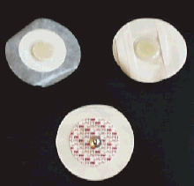
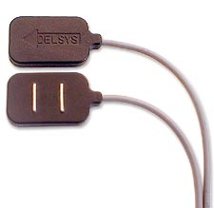
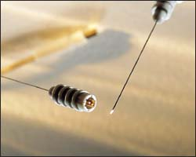
Measurements of electromyogram by electrodes: Kiegeszíteni!
Surface
(non-invasive)
monopolar bipolar
Implanted electrodes
(invasive)

Slide 17
The analsys of movements
Kinematics: based on visible parameters
Changes of coordinates as a function of time
Joint angles
Joint angular velocity (1st time derivative) and acceleration (2nd time derivative)
Result:
Measured data can be compared with the output of model based computer simulation (prediction) of a motor task.

Slide 18
CÍM?
High coherence during implementation
Between modeling and measurement
Model improvement
Processing of measured data
Mathematical and physical algorithms
Programming of algorithms
MATLAB, Python, EXCEL …
Algorithms
To make the model more realistic the algorithms employed
To compute Inertia, Torque, Gravity, Muscle force
Biomechanical parameters (attachment sites, muscle length and contraction)
Error correction
Time normalization

Slide 19
Differential kinematics
\dot{x}
Position of a point
$$x$$
Velocity
$$\dot{x}=\frac{ⅆx}{ⅆt}$$
Acceleration
$$\ddot{x}=\frac{ⅆ\dot{x}}{ⅆt}$$
Jerk
$$\frac{ⅆ\ddot{x}}{ⅆt}$$
Trigonometrics (3D mathematics)
Joint angle
$$α$$
Angular velocity
$$\dot{α}=\frac{ⅆα}{∂t}$$
Angular Acceleration
$$\ddot{α}=\frac{ⅆ\dot{α}}{ⅆt}$$
Angular jerk
$$\frac{ⅆ\ddot{α}}{ⅆt}$$
Linear algebra – coordinate transformation
Calculating variances – optimal movement execution

Slide 20
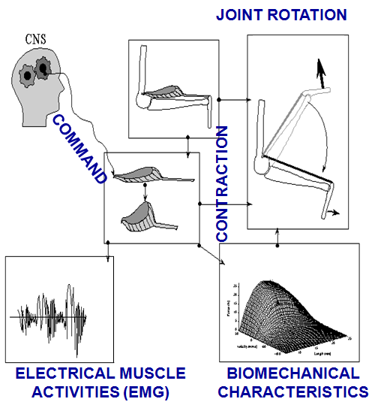
Overview

Slide 21
The Software of the Movement Analysing System
We save and store measured data in text and excel files
Post processing in:
MATLAB
Excel
Development of algorithms by
MATLAB

Slide 22
Sensori-motor transformations
Sensation
Execution
vision, audition
posture,
vestibular system,
muscle spindle,
proprioception,
motoneurons,
muscles,
joints,
limbs,
Sensori-Motor Transformation

Slide 23
Extrinsic and intrinsic geometry
external world
internal representation
(x,y,z) Cartesian (orthogonal) coordinate systems
„intrinsic”
coordinate-systems
not orthogonal
3D vectors
(e.g. position, velocity)
high dimensional vectors $\left(n>3\right)$
Transformation

Slide 24
Extrinsic and intrinsic geometry
Sensory
coordinate - systems
Motor
coordinate-systems
The coordinates
are independent
from each other.
Coordinates are interdependent
dimensions are high: num. of joints,
num. of muscles, num. of neurons.
Defined by the structure of sensory organs.
Defined by the geometry of limbs, muscles, neural systems.
Sensori-Motor Transformation

Slide 25
Free SLIDE!

Slide 26
Vestibulo-Ocular Reflex (example for sensori-motor transformation)
Biologically:
Vestibular information (sensation)
transformed into
Eye muscle activity (execution)
Physically:
Angular velocity vector of head rotation
transformed into
Compensatory Eye rotation
Sensory representation is transformed into motor execution!

Slide 27
Tensor network theory
Contravariant coordinates
The coordinates are interdependent
e.g. motor coordinate sytems
Covariant coordiantes
The coordinates are independent
e.g. sensory coordinate systems
Metric tensor
y^{c}
y_{c}
$$\left[\begin{matrix}1 & \cos\left(α\right) \\ \cos\left(x\right) & 1\end{matrix}\right]$$
α
x_{c}
x^{c}
In orthogonal coordinate systems the two types of coordinates aligne.

Slide 28
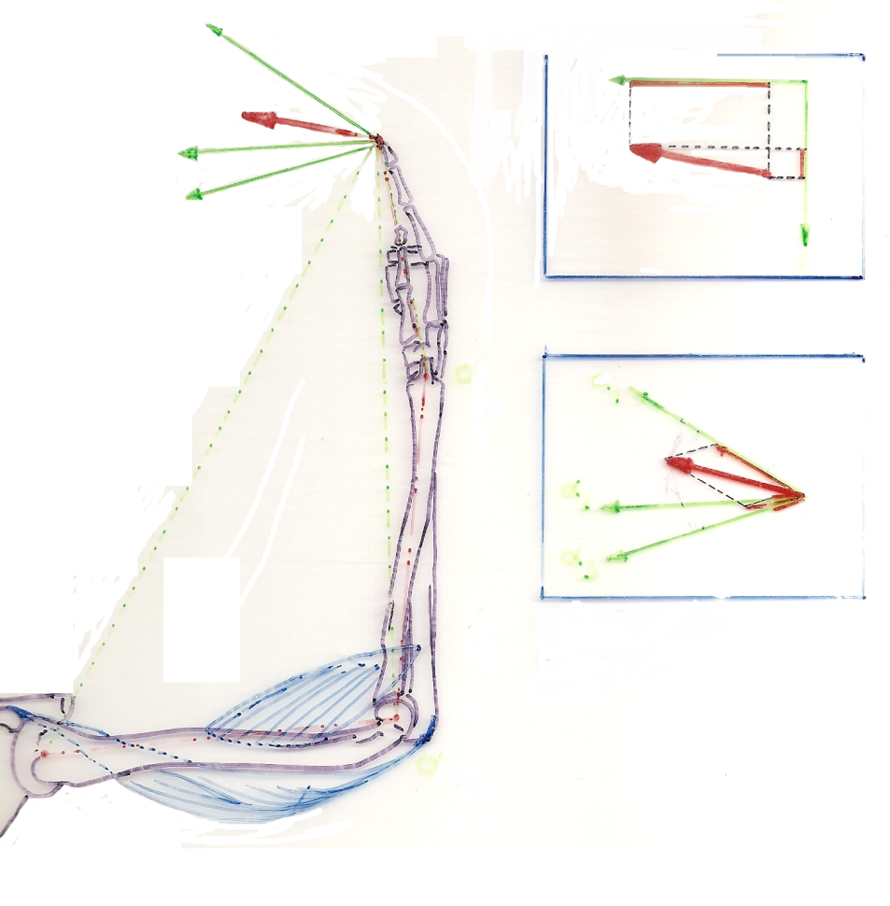
The human arm and an intrinsic coordinate system
a₁
Each joint defines a coordinate axis
Orthogonal to the line that connects the joint and the finger
Rotations in:
Shoulder (a₁)
Elbow (a₂)
Wrist (a₃)
Moves the finger along the correspondig axis
Displacement vector (v) is:
Represented in a 2D orthogonal coordinate-system and in a 3D generalized joint-coordinate-system.
a₂
v
v
a₃
a₁
a₂
a₃

