Slide 1
The function of hypothalamic hormones
Csomai Borbála

Slide 2
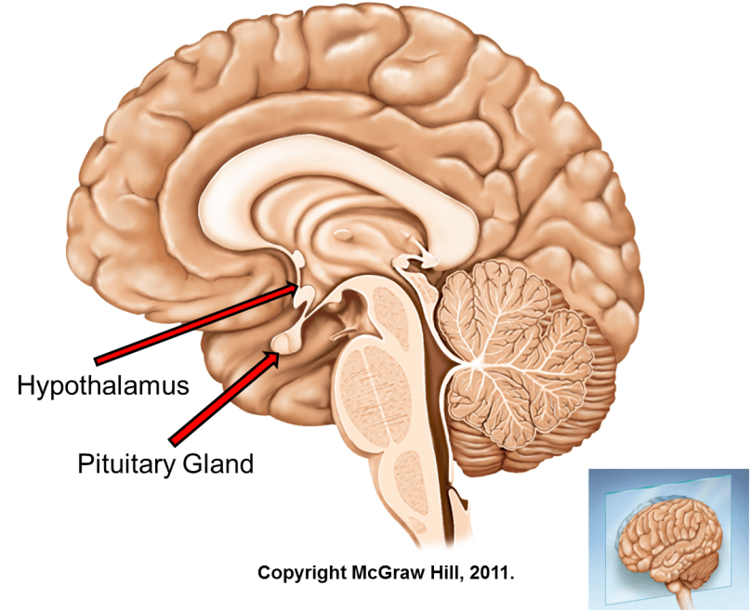
The hypothalamus
Maintaining homeostasis
Important role in hormone production
Connection between the nervous and the endocrine system → neuroendocrine system
hypothalamus-hypophyisis system
Two sets of nerve cells that produce hormones

Slide 3
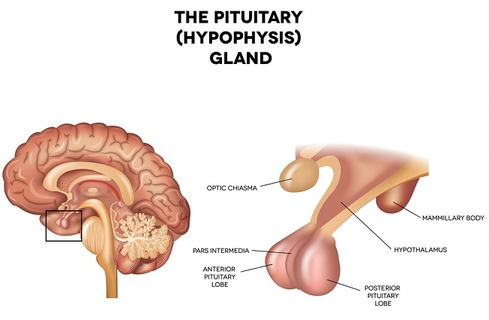
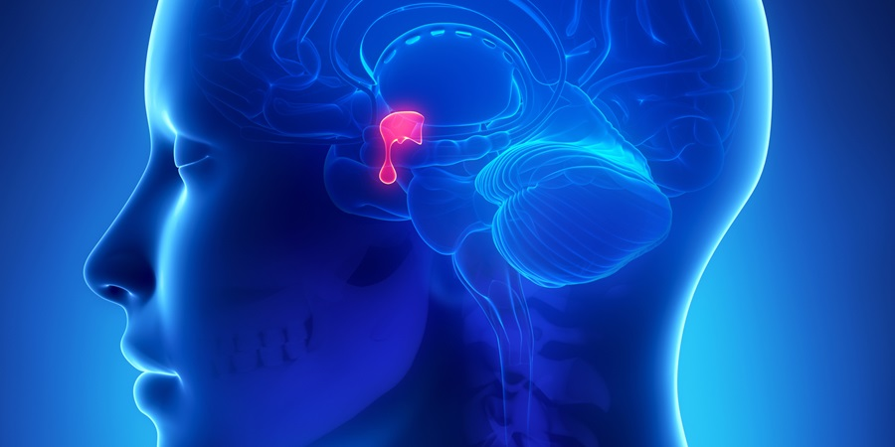
The hypophysis
The „master gland”
Anterior and posterior lobe
Anterior lobe: releasing and inhibiting factors
Posterior lobe: stores hormones produced in the hypothalamus

Slide 4
Anterior lobe
Posterior lobe
Growth hormone
Hypersecretion: gigantism
Hyposecretion: dwarfism
Prolactin
Tropic hormones
Thyrotropic hormone
Adrenocorticotropic hormone/Corticotropin
Corticoids
Gonadotropic hormone
Follicle stimulating hormone
Luteinizing hormone
Vasopressin/Antidiuretic hormone
Hyposecretion: continuous elimination of urine → dehydration
Oxytocin

Slide 5
